Slide 1
Why Are We Sleepy and What Can We Do About It?
Navy and Marine Corps Public Health Webinar
20 June 2019
J. Lynn Caldwell, Ph.D.

Slide 2
Legal Notices
Distribution
Approved for public release; distribution is unlimited.
Disclaimer
The views expressed in this presentation are those of the author and do not necessarily
reflect the official policy or position of the Department of the Navy, Department of Defense,
nor the U.S. Government.
Copyright
I am an employee of the U.S. Government. This work was prepared as part of my official duties. Title 17, USC, §105 provides that ‘Copyright protection under this title is not available for any work of the U.S. Government.’ Title 17, USC, §101 defines a U.S. Government work as
a work prepared by a military service member or employee of the U.S.
Government as part of that person’s official duties.

Slide 3
Objectives
Recognize the dangers of inadequate sleep in various settings which affect performance, safety, and health
Understand how to apply countermeasures in specific contexts

Slide 4
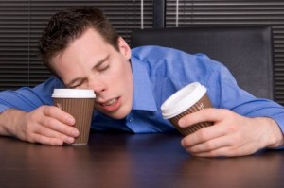
Part I
What is Fatigue and Why Worry About It?
http://www.enkivillage.com/coffee-makes-me-sleepy.html

Slide 5
Fatigue Defined
Extended wakefulness or chronic sleep restriction depletes the sleep reservoir (Homeostatic mechanism)
Working non-standard or variable schedules disrupts the circadian rhythm (Circadian mechanism)
Trying to perform too quickly after awakening from sleep or a nap is impaired by post-sleep grogginess (Sleep inertia component)
Akerstedt J, Folkard S. (1996). Predicting sleep latency from the three-process model of alertness regulation. Psychophysiology, 33:385-389.

Slide 6
Fatigue is a Big Problem
The fact that fatigue is difficult to measure doesn’t mean it’s not a concern.
Expert consensus is that fatigue is “the largest identifiable and preventable cause of accidents in transport operations… Official statistics often underestimate this contribution.”
Fatigue from sleep restriction, sleep disturbances, and body-clock disruptions has been responsible for numerous mishaps & other problems.
Akerstedt T. (2000). Consensus statement: Fatigue and accidents in transport operations. Journal of Sleep Research, 9:395.

Slide 7
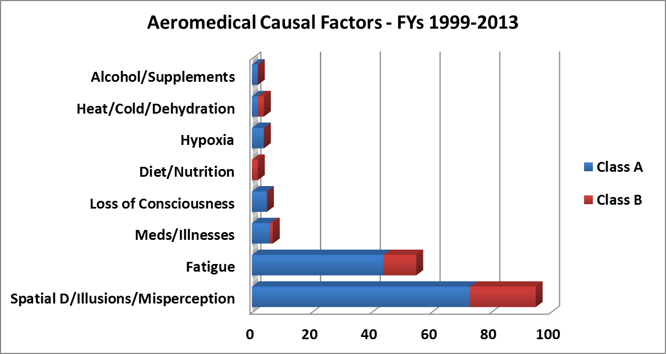
High Mishap Contributor
Aeromedical factors cited in recent
Naval aviation mishaps and flight hazards
Navy Safety Center

Slide 8
Sleep Loss Impairs Performance
Like food and water, sufficient sleep is necessary for survival.
Adequate sleep is one of the most important underlying factors for optimal performance.
Sleep deprivation is associated with reduced mental performance, learning deficits, and accidents.
  Accuracy and timing degrade
  Lower standards of performance become acceptable
  Attentional resources are difficult to divide
  A tendency toward perseveration develops
  The ability to integrate information is lost
  Everything becomes more difficult to perform
  Social interactions decline
  Logical reasoning is impaired
  Attention wanes
  Attitude and mood deteriorate
  Involuntary lapses into sleep begin to occur
Chronic sleep curtailment creates a dangerous cumulative effect.
Yarnell and Deuster (2016). Sleep as a strategy for optimizing performance. J Spec Ops Med, 16(1):81-85

Slide 9
Sleep Restriction Impairs Health
Over the past decade, a substantial amount of research has shown that short or disturbance sleep increases health risks.
Sleeping less than 7 h per night leads to a host of major disease states.
  Cardiovascular disease
  Glucose metabolism
  Pain threshold
  Hunger and weight gain
  Stress regulation and energy balance
  Immune system
  Cancer
  Irritability, anger, and hostility
  Mood disorders
The greater the amount of sleep restriction, the greater the extent of adverse effects.
Erwin MR (2015). Why sleep is important for health: A psychoneuroimmunology perspective. Annu Rev Psycholo, 66:143-172.
Colten & Altevogt (2006). Sleep disorders and sleep deprivation: An unmet public health problem. National Academies Press

Slide 10
Sleep in the Military
While interest in the importance of sleep is on the increase, a 2015 review of military policies found “no evidence of healthy sleep enforcement mechanisms.”
The report further stated that “DoD… implementation often falls short on guidance to line leaders in terms of how to effectively track and enforce local sleep programs” in operational contexts.
This is a serious problem in light of growing evidence that sleep problems are increasing across the services.
Troxel et al. (2015). Sleep in the military: Promoting healthy sleep among US Servicemembers. Rand Corporation. www.rand.org/t/rr739

Slide 11
Sleep Duration in the Military
Only about 24 percent of service members report sleeping the optimal 7-8 hours per day
Compared to civilians, military personnel are significantly more sleep deprived!
Military
Civilian
Troxel et al. (2015). Sleep in the military: Promoting healthy sleep among US Servicemembers. Rand Corporation. www.rand.org/t/rr739

Slide 12

Part II
What Causes Fatigue?
www.quandoquidem.com

Slide 13
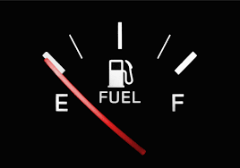
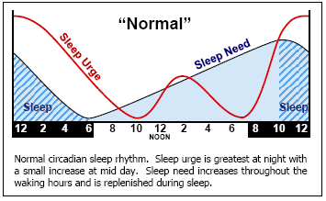
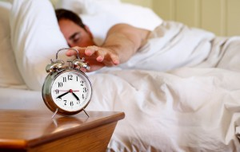
The Basic Mechanisms
  Low-point in the circadian rhythm due to working when mother nature intends sleep
Depleted sleep reservoir due to acute sleep loss or chronic sleep restriction
  Sleep inertia from trying to perform too quickly after awakening
  Homeostatic component
  Circadian component
  Inertia component
www.publicdomainpictures.net
www.abc.net.au
Folkard, S. and T. Akerstedt, (1991) A three-process model of the regulation of sleepiness and alertness. In Ogilvie, R. and Broughton, R. (eds.) Sleep, arousal and performance: problems and promises, Boston, Birhhauser, 1991:11-26 .

Slide 14
Homeostatic Mechanism
Time since the last sleep episode is an important part of the fatigue equation.
Homeostatic sleepiness is low after sleep, but increases as time passes.
At night, sleepiness is high because homeostatic sleep pressure is high.
Sleep restriction progressively increases homeostatic pressure.
You cannot train yourself to get by on less sleep.

Slide 15
Acute and Chronic Sleep Loss
The average adult needs 7-9 hours of restful sleep every 24 hours in order to be fully alert.
Despite individual differences in sleep needs, less than 5 hours of sleep is a universal safety hazard.
Research has shown that people cannot overcome sleep restriction by repeatedly exposing themselves to insufficient sleep.
In addition, it is now clear that chronic sleep restriction poses serious recovery problems.

Slide 16
The Reason We Need to Sleep
At present, the exact function of sleep is unknown, and scientists remain somewhat perplexed by the need to sleep since:
  You can’t eat or drink while sleeping
  You can’t reproduce while sleeping
  You can’t attend to the environment while sleeping
  You are vulnerable to predators while sleeping
In light of these negative aspects, sleep must serve a very important offsetting evolutionary advantage to make it worthwhile.

Slide 17
Select Proposed Functions of Sleep
Sleep affects the immune system:
  Sleep is altered during infectious diseases
  It improves antigen-specific immune defenses
  It aids in disease recuperation
Sleep reduces caloric use:
  Sleep reduces metabolism so energy stores depleted while awake are restored – we couldn’t continue to consume the same amount of energy asleep as when awake or we couldn’t catch up on energy supply
Sleep serves a glymphatic function:
  Cerebrospinal fluid flow in the brain is increased to aid in removal of wake-related toxins
  In particular, removal of extracellular beta-amyloid proteins associated with Alzheimer’s Disease in enhanced
Sleep serves a connectivity function:
  Strengthens newly-formed synapses
  Aids in other complex processes that erase obsolete memories, consolidate new memories, and maintain plasticity (to help form new memories)
Krueger et al. (2016). Sleep function: Toward elucidating an enigma. Sleep Med Rev, 28:46-54.

Slide 18
Circadian Mechanism
Time of day (body-clock time) is another part of the fatigue equation.
Exposure to sunlight is a major determinant of the body clock.
Maximum sleepiness usually is predawn and right after sunrise (0200-0800).
After changing to a new schedule, the sleepy time may occur at work.
Constant schedule changes will disturb internal rhythms and may impair sleep and subsequent performance.

Slide 19
Circadian Rhythm Facts
Most biological and psychological processes vary on a 24-hour cycle:
  Body temperature
  Hormone levels
  Alertness levels
Normal rhythm is slightly longer than 24 hours
The sun entrains the rhythm daily
People deprived of light exposure maintain a rhythm about 25 hours in length

Slide 20
Circadian Disruptions
Jet Lag
Rapid time-zone changes cause disagreements between the body clock and the local time schedule
Shift Lag
Rapid work-hour changes cause disagreements between the body clock and the new work schedule
Notes:
.

Slide 21
Symptoms of Circadian-adjustment Problems
Exhaustion
Loss of ability to concentrate
Performance decrements
Constipation or diarrhea
Insomnia
Loss of appetite
Headache
Impaired night vision
Limited peripheral vision
Decreased mood
Sleepiness

Slide 22
Sleep Inertia
Sleep inertia is the brief period of grogginess that occurs upon awakening
In most contexts, sleep inertia is not a concern since it dissipates in about 20-30 minutes
However, when napping is used as a fatigue countermeasure, sleep inertia can cause problems
Safety may be compromised if performance is required too quickly after awakening

Slide 23

Part III
What Can Be Done to Address Operational Fatigue?
www.clipartreview.com

Slide 24
Reducing Fatigue
Ensure sufficient daily sleep
Use good sleep habits
Be careful with shift work scheduling
Control the length of the duty period
Consider using light to enhance alertness
Consider melatonin to adjust to new schedules
Implement strategic naps
Consider stimulants
Employ rest breaks
Take advantage of posture effects
Eliminate unproven strategies

Slide 25
1) Avoid Sleep Restriction
Insufficient sleep leads to drowsiness while:
watching TV, in meetings, working, driving, or in sedentary tasks
If present, evaluate the amount of time spent asleep each night and adjust accordingly.
To determine your physiological sleep need:
  Gradually lengthen the sleep period until
  daytime sleepiness subsides.
  Track natural sleep / wake rhythms during vacation
Ignore what people say about their own sleep; individual sleep needs differ quite a bit

Slide 26
Small Amounts Matter!
Vigilance Task Performance
Johnson ML et al. (2004). Modulating the homeostatic process to predict performance during chronic sleep restriction. Aviation, Space and Environmental Medicine, 75(3 Suppl):A141-6.

Slide 27
Recovery is Slow
Most research indicates that recovery from chronic sleep restriction occurs slowly.
  After 7 days of sleep restricted to 7 or fewer hours, 3 nights of 8 hours sleep was not sufficient to recovery cognitive functions.
People who are pre-loaded with sleep prior to sleep restriction recover more quickly than those who are not (Rupp et al., 2009).
Preloading sleep prior to an anticipated sleep restriction period can reduce the impact of sleep loss on performance.
Rupp TL et al. (2009). Banking sleep: Realization of benefits during subsequent sleep restriction and recovery. Sleep, 32(3):311-321.
Banks S et al. (2010). Neurobehavioral dynamics following chronic sleep restriction: Dose-response effects of one night for recovery. Sleep, 33(8):1013-1026

Slide 28
Fatigue Tolerances Differ
16 hrs awake
37 hrs awake
Caldwell JA et al. (2005). Are individual differences in fatigue vulnerability related to baseline differences in cortical activation? Behavioral Neuroscience, 119:694-707.

Slide 29
2) Use Good Sleep Habits
When possible make the daily schedule consistent
Use the sleep area only for sleep and sex
Resolve daily dilemmas away from sleep area
When possible use consistent “getting ready for bed” routine
Develop cardio exercise routine & stick to it
Ensure quiet, dark, cool, comfy sleep environment
Don’t consume caffeine within 4 hours of bedtime
Don’t use alcohol as a sleep aid
Don’t take naps during the day
Don’t smoke immediately before bed
Don’t be a clock-watcher
Keep the smart phone in another room

Slide 30
Other Sleep Habits
Avoid the use of technology near bedtime
Minimize noise
Minimize light
Watch the temperature; optimal sleep temp is 68 degrees
Attend to the sleep surface
Manage food/hunger

Slide 31
3) Carefully Plan Rosters
Schedule design is not easy or straightforward
No scheduling approach eliminates
all problems in working non-standard hours
Consideration must be given to:
  Work setting & nature, types of employees
  Fatigue and circadian impact of desired schedule
  Effect of schedules on employee morale
Consider as many of the follow scheduling recommendations as possible!

Slide 32
Scheduling Considerations (1)
Provide at least 2 full days off after each night rotation ends.
Create higher acceptance of the schedule system by allowing employee input.
Provide education about needs of people working non-standard hours for the family.
Pay special attention to workload distribution and staffing levels, especially for night crews.
Rotate duties if possible to help with monotony.
Avoid long night duty periods.

Slide 33
Scheduling Considerations (2)
Increase light levels at night as much as possible.
Emphasize the importance of double-checking work performed at night.
Ensure that managers and schedulers have experience with working non-standard schedules.
Provide education on sleep/body-clock to new managers and schedulers.
Make sure those working at night have full access to resources available to day workers.
Educate the personnel about circadian rhythms & sleep & night work & appropriate fatigue countermeasures.

Slide 34
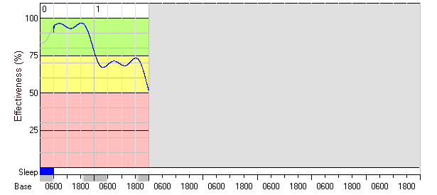

Scheduling Aids Can Help
Performance decrement with sleep loss
Improvement with a short sleep period
Day 1
Day 2
Day 1
Day 2
Note the rapid recovery with only 4 hours of sleep
Note the continued performance loss with no sleep
Fatigue Avoidance Scheduling Tool (FAST)
Hursh SR et al. (2004). Fatigue models for applied research in warfighting. Aviat Space Environ Med, 75(3 Suppl):A44-53.

Slide 35
4) Use Light Exposure
Light is a powerful modulator of non-visual functions including alertness and performance
  Bright light is best, but dim light has effects too
  In some blind people light exposure can induce responses
  Non-visual responses are maximally sensitive to blue light
Bright light is known to reset the body clock
  Light in the morning advances the rhythm
  Light in the evening delays the rhythm
  At best, light can shift the clock 3 hrs/day
Light exposure, also has acute effects
  Typically within 30 minutes
  Enhances cognitive performance and physiological alertness

Slide 36
Light and Night Work
First shift: 4-hour 4000 Lux pulse @ start. Second and Third: 1000 Lux throughout.
Campbell (1995). Effects of timed bright-light exposure on shift-work adaptation in middle-aged subjects. Sleep, 18:408-416.

Slide 37
7) Employ Nap Strategies
When schedule issues prevent adequate sleep, naps can help maintain performance.
Naps can be used proactively to maintain performance during a subsequent period of wakefulness or before the start of duty.
Naps also can be used strategically to arrest performance declines that occur from fatigue.
Short naps of only 30-45 minutes are better than getting no sleep at all.
Even a 5- to 10-minute nap is better than nothing.

Slide 38
Down-side of naps: Sleep inertia
Remember to allow 20-30 minutes post-nap for grogginess to subside!!
Subsequent performance improvement
Initial performance decrement
Adapted from Tietzel AJ, Lack LC. (2001). The short-term benefits of brief and long naps following nocturnal sleep restriction. Sleep, 24:293-300.

Slide 39
8) Use Stimulants
When adequate sleep is impossible, stimulants can help mitigate sleepiness.
Most readily-available option is caffeine.
  Studies report significant improvement in alertness & performance.
Prescription stimulants are an option in select populations and circumstances.

Slide 40
Caffeine
When adequate sleep is impossible, caffeine can help mitigate sleepiness.
Effective caffeine doses range from 200-600 mg (limit daily max to 1000 mg).
Caffeine starts working in about an hour, and the effect lasts about 4 hours.
Use judiciously--tolerance develops quickly.
Common Sources of Caffeine
1 cup tea= 50 mg 1 Coke= 50 mg
1 Mountain Dew= 55 mg 1 Hot cocoa= 14 mg
2 Excedrin Xtra. Str.= 130 mg 1 cup Maxwell House=100 mg
1 Max. Str. NoDoze= 200 mg Chocolate milk (1OZ)= 3-6mg
2 Jolt Caffeine Gum= 100 mg Snapple Lemon Tea= 31.5mg

Slide 41
Caffeine Can Attenuate Fatigue
Psychomotor Vigilance Lapses
21 hrs awake
The caffeine here was administered in the form of caffeine gum.
Kamimori GH et al. (2005). Multiple caffeine doses maintain vigilance during early morning operations. Aviation, Space and Environmental Medicine, 76:1046-1050.

Slide 42
Caffeine and a Nap
Pre Nap/Caffeine Intervention
Reyner LA & Horne JA. (1997). Suppression of sleepiness in drivers: Combination of caffeine with a short nap. Psychophysiology, 34(6):721-5.

Slide 43
9) Utilize Rest Breaks
Help sustain performance and provide physiological recovery, mental stimulation, & improved mood
Long bouts of work produce fatigue & boredom; can seriously impair performance
Studies have shown that work breaks improve productivity and reduce subjective sleepiness.
Exercise break can be beneficial if not too strenuous
A break at least every hour is recommended
The more repetitious, boring, & tedious the task, the more frequently breaks should be scheduled

Slide 44
Restorative Effects of Breaks
Eight-hour night flight
64 Hours Sleep Deprivation
Neri DF et al. (2002). Controlled breaks as a fatigue countermeasure on the flight deck. Aviation, Space, and Environmental Medicine, 73:654-664.
Angus RG and heslgrave RJ. (1985). Effects of sleep loss on sustained cognitive performance during a command and control simulation. Behavior Research Methods, Instruments, & Computers, 17(1):55-67.

Slide 45
10) Use Body Posture
The more upright the body’s position, the less sleepiness there will be
  Tilting people upright on a tilt-table causes higher-frequency brain activity than lying flat
  The less people are allowed to recline in their seats, the less they are able to sleep
  Narcolepsy patients report less sleepiness while standing than while sitting
Physiological alertness & performance in sleep-deprived people is better when standing than when sitting
This is a physiological effect related to baroreceptor firing and noradrenergic activity!

Slide 46
Upright Posture and Alertness
Slow-wave Brain Activity
Psychomotor Vigilance Lapses
Caldwell JA, Prazinko BF, & Caldwell JL. (2003). Body posture affects electroencephalographic activity and psychomotor vigilance task performance in sleep-deprived subjects. Clinical Neurophysiology, 114:23-31.

Slide 47
11) Treat Sleep Disorders
Sleep disorders can significantly degrade sleep quantity and quality.
  Sleep apnea, periodic limb movements, restless legs, etc.
24% of males between 30 and 60 experience sleep apnea
The American Academy of Otolarynology reveals that a BMI at or above 32 has an 89% positive predictive value for identifying OSA.
Sleep apnea has been identified as a risk factor in motor vehicle accidents.

Slide 48
Untreated sleep disorders will increase the level of fatigue
A number of medically-recognized sleep disorders can adversely affect sleep quality:
  Sleep apnea- numerous periods of non-breathing during the night
  Restless legs syndrome/Periodic limb movement disorder- frequent involuntary jerks of the limbs, usually legs, before and during sleep
  Narcolepsy
  Gastroesophageal reflux- stomach acid backing up in the esophagus
  Insomnia- inability to initiate sleep and/or maintain sleep

Slide 49
12) Unproven Techniques
Many counter-fatigue strategies have not been scientifically shown to work well (or at all).
“Placebo effects” influence subject impressions.
Unless a strategy is validated in the scientific literature, DO NOT use it!
If in doubt, research it at Entrez PubMed: http://www.ncbi.nlm.nih.gov/entrez/query.fcgi?DB=pubmed
You can just Google “pubmed” to get there…

Slide 50
Summary & Conclusions
Fatigue is a huge problem in safety-sensitive occupations of all types.
However, it CAN be managed once the scientific underpinnings are understood.
A host of scientifically-validated countermeasures are available for use in isolation or in combination which can help mitigate fatigue.

Slide 51

Resources
Naval Postgraduate School resource page
https://nps.edu/web/crewendurance/index
Books from Ashgate publishing

Slide 52
QUESTIONS?
J. Lynn Caldwell, Ph.D.
Senior Research Psychologist
Naval Medical Research Unit Dayton
Jo.Caldwell@us.af.mil

