Slide 1
Announcements
REGISTER
FY20 Epi-tech Training
Registration is required:
Register at: https://tiny.army.mil/r/EZY8/EpiTechFY20
Log in with CAC, or follow prompts to Request access/Logon ID
Contact your service surveillance hub to receive monthly updates and reminders
Attendance:
Please enter your full name/email/location into the DCS chat box to the right, or email your service hub
An attendance confirmation will be sent to your email; if you do not receive this message within 3 days, please contact your service hub
Reminder:
Mute your phones by pressing the mute button or pressing *6
DO NOT press the “hold” button as the rest of the conference will hear the hold music

Notes:
Good [morning, afternoon, evening] everyone and welcome to today’s Epi-tech training session:
My name is [name], and I’m an [title] with the [Public Health location]. I’m joined by my colleagues at the [Navy and Marine Corps Public Health Center], the [U.S. Air Force School of Aerospace Medicine], and the [Army Public Health Center].
A few housekeeping items before we get started:
1. If you’ve registered for the monthly trainings already, you do not need to register every month, you simply need to register one time and we’ll keep you on the email list thereafter. Please enter your name, location, and email into the chat box to the right for attendance purposes.

Slide 2
FY20 Epi-Tech Surveillance Training
Tuesday, October 1, 2019 - Wednesday, September 30, 2020
DCS, APG, MD
Provided By
U.S. Army Medical Command
Activity ID Course Director CME Planner
2019-1389 John Ambrose Mimi C. Eng
Accreditation Statement
The U.S. Army Medical Command is accredited by the Accreditation Council for Continuing Medical Education (ACCME) to provide continuing medical education for physicians.
Credit Designation
The U.S. Army Medical Command designates this Live Activity for a maximum of 5 AMA PRA Category 1 Credit(s)TM. Physicians should claim only the credit commensurate with the extent of their participation in the activity.
This is a required handout. It must be disseminated to each learner prior to the start of the activity.

Slide 3
Statement of Need/Gap Analysis The purpose of this CME activity is to address the identified gap(s):
1. Disease identification - verification of disease by established case definitions have been utilized by the local health departments, Centers for Disease Control and Prevention, World Health Organization, and the Department of Defense. With the every changing list of reportable medical events and new emerging infections, case definitions change rapidly. Army epidemiologist conduct verification studies that monitor the efficiency of reporting by local public health experts and have concluded that completeness percentages for reportable medical events range as low as 35% for select diseases.
2. Outbreak reporting - Recent evidence have demonstrated that outbreak reporting and communication between public health agencies is poor. In fact, the Army failed to report six outbreaks in the DRSi between June 2016 and September 2016.
3. Surveillance techniques - Surveillance of common communicable diseases continues to be a problem among local MTFs. In fact, cases of campylobacter were not investigated in 2015 for PACOM MTFS, while 2016 cases of salmonella were not investigated. Civilian public health agencies are required to conduct investigations into all reportable medical events. However, DoD facilities often do not take initiative to conduct this investigation. Learning Objectives
1. Based on case presentation, enhance your ability to improve case finding and surveillance practices within your local MTF.
Target Audience / Scope of Practice
Target Audience: The intended audience for this educational activity includes preventive medicine physicians, community health nurses, public health nurses, and epidemiology technicians.
Scope of Practice: This activity will improve the performance of preventive medicine personnel who conduct surveillance activities in inpatient and outpatient settings.

Slide 4
Disclosure of Faculty/Committee Member Relationships
It is the policy of the U.S. Army Medical Command that all CME planning committee/faculty/authors disclose relationships with commercial entities upon invitation of participation. Disclosure documents are reviewed for potential conflicts of interest and, if identified, they are resolved prior to confirmation of participation.
Faculty Members
Kebisek, Julianna - No information to disclose.
Committee Members
Ambrose, John - No information to disclose.
Constantino, Joycelyn - No information to disclose.
Diaz, Rolando - No information to disclose.
Eng, Mimi - No information to disclose.
Gibson, Kelly - No information to disclose.
Graham-Glover, Bria - No information to disclose.
Holbrook, Victoria - No information to disclose.
Kebisek, Julianna - No information to disclose.
Riegodedios, Asha - No information to disclose.
Rudiger, Courtney - No information to disclose.
Acknowledgement of Commercial Support
There is no commercial support associated with this educational activity.

Slide 5
Lung Injury Associated with E-Cigarette Use and/or Vaping: Current Status and DoD Response
Julie Kebisek, MPH
Epidemiologist
Defense Health Agency in support of the Army Public Health Center

Slide 6
Learning Objectives
Describe the current epidemiology of the outbreak of lung injuries associated with e-cigarettes and/or vaping in the United States
Explain the current DoD guidelines in regard to reporting and responding to cases
Provide information on proper interviewing and reporting tactics of suspected cases
Notes:
These are our learning objectives for today’s epi-tech presentation.

Slide 7
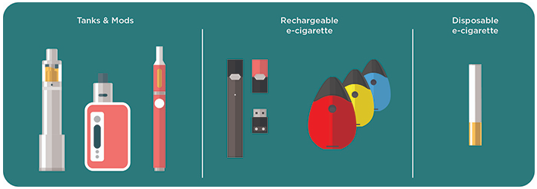
Background: What are E-Cigarettes?
Also known as: “e-cigs”, “e-hookahs”, “mods”, “vape pens”, “vapes”, “tank systems”, and “electronic nicotine delivery systems (ENDS)”.
E-cigarettes produce an aerosol by heating a liquid that usually contains nicotine – the addictive drug in regular cigarettes, cigars, and other tobacco products – flavorings, and other chemicals that help to make the aerosol. Users inhale the aerosol into their lungs. Bystanders can also breathe in this aerosol when the user exhales into the air.
E-cigarettes can be used to deliver marijuana and other drugs.
Some e-cigarettes can be modified by the user.
Notes:
First, I’ll provide a little background into what is being investigated in this outbreak. E-cigarettes are also known as e-cigs, e-hookas, mods, vape pens, vapes, tank systems, and electronic nicotine delivery systems. E-cigarettes are battery operated devices that people use to inhale an aerosol, which typically contain nicotine, flavorings, and other chemicals, depending on the product in question. Bystanders can also breathe in the aersol when the user exhales. Some of these products can be modified by the user, and the CDC has learned recently of youtube videos that instruct users how to modify their products by either injecting an agent that helps to extend the life of the product, or add additional flavorings, etc.

Slide 8
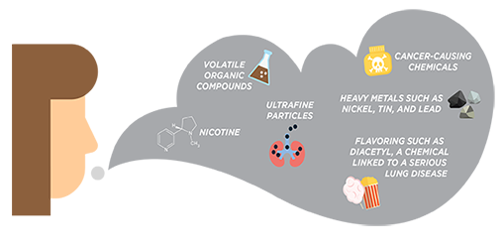
Background: What is in e-cigarette aerosols?
Notes:
The e-cigarette aerosol that users breathe from the device and exhale can contain harmful and potentially harmful substances, including:
Nicotine
Ultrafine particles that can be inhaled deep into the lungs
Flavoring such as diacetyl, a chemical linked to a serious lung disease
Volatile organic compounds
Cancer-causing chemicals
Heavy metals such as nickel, tin, and lead¹
It is difficult for consumers to know what e-cigarette products contain. For example, some e-cigarettes marketed as containing zero percent nicotine have been found to contain nicotine. The variety of products created for e-cigarettes, and the modification and illegal use of these products, have made it difficult to understand what is in these aerosols.

Slide 9
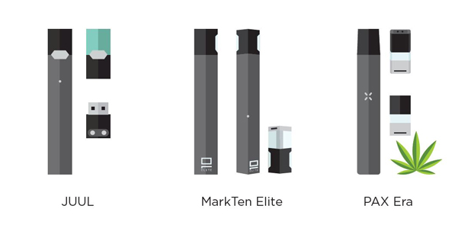
Background: JUUL Brand E-Cigarette
A single JUUL pod contains as much nicotine as a pack of 20 regular cigarettes.
JUUL uses nicotine salts, which allow particularly high levels of nicotine to be inhaled more easily and with less irritation than the free-base nicotine that has traditionally been used in tobacco products, including e-cigarettes.
Approximately two-thirds of JUUL users aged 15-24 do not know that JUUL pods always contain nicotine.
A recent CDC study found that 99% of the e-cigarettes (JUUL and other brands) sold in assessed venues in the United States contained nicotine
Some do not disclose that they contain nicotine, and some marketed as having no nicotine have been found to contain nicotine
Notes:
It’s not clear what role JUUL products currently play in this outbreak, but given their popularity, I wanted to provide a bit of background. JUUL was introduced in 2015 and uses a propriety blend of nicotine developed by the JUUL team. They boast that they contain more nicotine than other e-cigarettes. It has been found that a single JUUL pod contains as much nicotine as a full pack of 20 regular cigarettes. One study found that users were hitting their nicotine e-cigarette over 25 times per day.

Slide 10
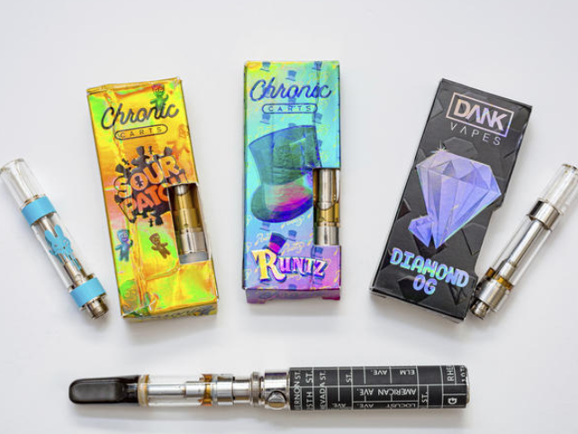
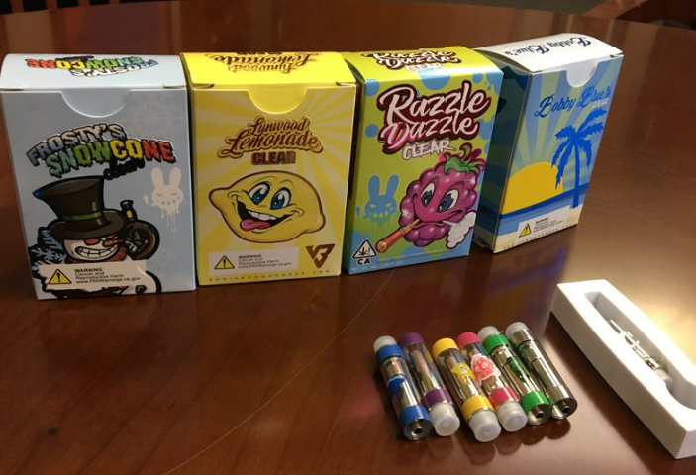
Background: THC Vape Products
Illegal THC vape products available online
Dank Vapes, Rove, Golden Gorilla, others
Illegal THC vaping operations across the country
Contents of THC vape products largely unknown
Common packaging available online and used by distributors to market THC-containing cartridges
Recent study of Utah EVALI cases (n=84) acquired THC vape products from:
THC-based products most often acquired from informal sources
44% - Friend | 6% - Out of state dispensary
25% - Dealer | 1% - In-state vape shop
24% - Online Dealer | 0% - Convenience store
Notes:
State crackdowns of vaping products have found:
Labeled Dank Vapes, and appear commercially packaged, with a variety of flavors, but the product itself is manufactured by the dealers in many cases
Standard-looking brownish oil, consistency of motor oil
Unregulated
Wide variety of products used
In Wisconsin and Illinois, 86 patients reported using 234 different products

Slide 11
E-Cigarette Products: Behaviors
Hacking: modifying device in a way not intended by the manufacturer
Refilling single-use cartridges (e.g., with homemade or illicit substances)
Dripping: dropping liquid directly onto device heating coil to attain higher compound concentrations in the aerosol
Dabbing: superheating substances containing high concentrations of THC or other cannabinoids (e.g., budder, BHO, 710, CBD)

Slide 12
Patient Exposures in the Lung Injury Outbreak
How was this outbreak identified?
Series of 53 cases from Illinois and Wisconsin*
All had history of e-cigarette use and related products
41 extensively interviewed
61% reported nicotine use; 80% reported THC use; 7% reported CBD use
37% reported THC use alone; 17% reported nicotine use alone
44% reported both nicotine and THC product use
Various brands and flavors
Among patients with additional data, 94% used within week before symptom onset; 88% reported daily use
*Layden J, et al. Pulmonary illness related to e-cigarette use in Illinois and Wisconsin – preliminary report NEJM 2019

Slide 13
Outbreak of Lung Injury Associated with E-Cigarette Use or Vaping
What we know, per the Centers for Disease Control (CDC)
As of October 22 2019: 1,604 lung injury cases associated with using e-cigarette or vaping products have been reported to the CDC from 49 states, the District of Columbia, and 1 U.S. territory
A total of 34 deaths have been confirmed from 24 states
All patients have reported a history of using e-cigarette or vaping products
The median age of deceased patients was 49 years and ranged from 17 – 75 years
Case breakdown (of 1,358 cases, as of 15 October 2019):
70% of patients are male
Median age of cases is 23 years; range of 13 – 75 years
79% of cases are under 35 years old
Among 849 patients with information on history of vaping (as of 15 Oct):
78% used THC products; 31% used THC exclusively
58% used nicotine products; 10% used nicotine exclusively

Slide 14
Frequent Clinical Symptoms
Clinical presentations of patients based on data submitted to CDC from 339 patients:
95% initially experienced respiratory symptoms (i.e. cough, shortness of breath, chest pain)
77% experience gastrointestinal symptoms (i.e. abdominal pain, nausea, vomiting, or diarrhea)
47% required transfer to intensive care units
22% required mechanical ventilation (being hooked up to a breathing machine)
Products containing THC that were obtained ‘off the street’ or from unknown sources are linked to most of the cases and play a major role.
Nicotine products have not been ruled out as a potential cause.
The vaping devices used have not been ruled out as a potential cause.
Information obtained from a transcript of the CDC telebriefing: Lung Injury Investigation on Friday, October 11, 2019. Accessed 18 October 2019 from https://www.cdc.gov/media/releases/2019/t1011-lung-injury-investigation.html
Notes:
- 95% experienced respiratory symptoms like cough, chest pain, or shortness of breath

Slide 15
Flu Season and Other Considerations
It is unknown if patients with a history of EVALI are at higher risk for severe complications of influenza or other respiratory viral infections if they are infected simultaneously or after recovering from lung injury.
Emphasize annual vaccinations against influenza, including for patients with a history of EVALI.
During influenza season, health care providers should consider influenza in all patients with suspected EVALI.
Antivirals should be considered in accordance with established guidelines.
Decisions on initiation or discontinuation of treatment should be based on specific clinical features and, when appropriate, in consultation with specialists.
Information obtained from a CDC. Accessed 28 October 2019 from https://www.cdc.gov/tobacco/basic_information/e-cigarettes/severe-lung-disease/healthcare-providers/index.html

Slide 16
Outbreak of Lung Injury Associated with E-Cigarette Use or Vaping
What we DON’T know, per the CDC
The specific cause of the chemical exposure(s).
No single product or substance has been linked to all lung injury cases.
Cases have reported use of e-cigarette products which may have a mix of ingredients, complex packaging and supply chains, and include potentially illicit substances.
Users may not know what is in their e-cigarette or e-liquid solutions.
More information is needed to know whether one or more e-cigarette or vaping products, substances, or brands is responsible for the outbreak.

Slide 17
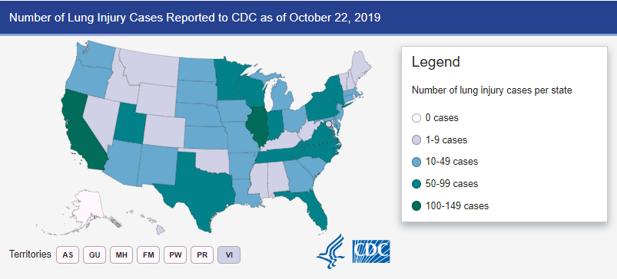
US Map of Known Cases

Slide 18
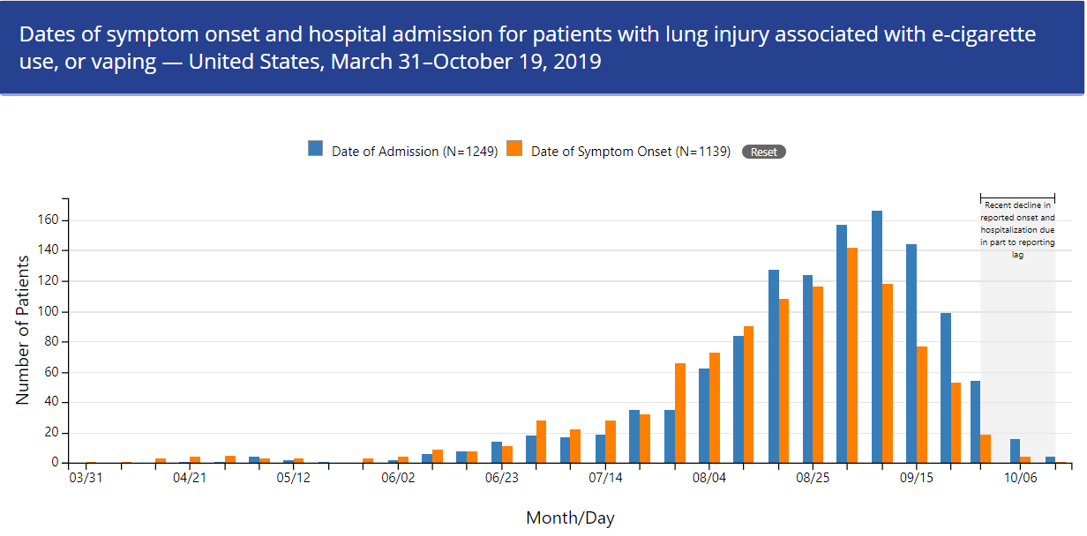
CDC Epi Curve of Outbreak

Slide 19
CDC and DoD Case Definition*
Probable
Using an e-cigarette (“vaping”) or dabbing in 90 days prior to symptom onset AND
Pulmonary infiltrate, such as opacities, on plain film chest radiograph or ground-glass opacities on chest CT AND
Infection identified via culture or PCR, but clinical team believes this infection is not the sole cause of the underlying lung injury OR
Testing not performed but clinical team believes infection is not the sole cause of lung injury AND
No evidence in medical record of alternate plausible diagnoses
Confirmed
Using an e-cigarette (“vaping”) or dabbing* in 90 days prior to symptom onset AND
Pulmonary infiltrate, such as opacities, on plain film chest radiograph or ground-glass opacities on chest CT AND
Absence of pulmonary infection on initial workup with either:
A negative respiratory viral panel AND
A negative influenza PCR or rapid test AND
All other clinically-indicated respiratory infectious disease testing are negative AND
No evidence of medical record of alternative plausible diagnoses
*As of 18 September 2019. The case definition may be subject to change as more information is learned about this outbreak.

Slide 20
Flowchart of Case Definition
Has the case used an e-cigarette or “vaped” within 90 days prior to symptom onset?
No
Yes
Not a Case
Pulmonary infiltrate on plain film chest radiograph or ground-glass opacities on chest CT?
No
Yes
Not a Case
Result of respiratory infectious disease laboratory tests?
(+) infection via culture or PCR
Labs not performed
(-) labs^
Does the medical team providing care to the patient believe infectious disease is the sole cause of the lung injury?
Any evidence in medical record of alternative plausible diagnoses?
No
Yes
No
Yes
Any evidence in medical record of alternative plausible diagnoses?
Not a Case
Confirmed
Not a Case
No
Yes
^ Negative labs must include negative results for all of the following: influenza (PCR or rapid), Streptococcus pneumoniae and Legionella, sputum culture if productive cough, bronchoalveolar lavage (BAL) culture if done, blood culture, HIV-related opportunistic respiratory infections if appropriate
Probable
Not a Case

Slide 21
Department of Defense Reporting Requirements for cases of EVALI **These requirements are subject to change. Each Service will send out specific guidance to MTFs soon.

Slide 22
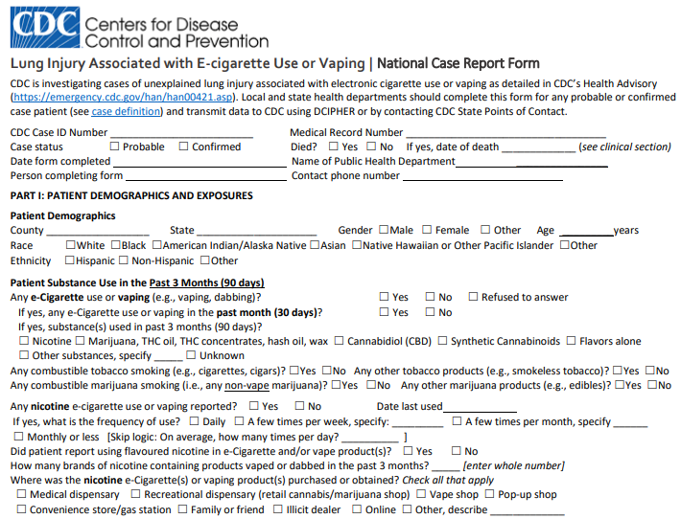
Interview Expectations
Access the full 2-page form here: https://www.cdc.gov/tobacco/basic_information/e-cigarettes/severe-lung-disease/healthcare-providers/pdfs/National-Case-Report-Form-v01.pdf
Notes:
All Service MTFs – ensure that the case has been reported to your state/local health department.
Army MTFs – try to acquire the completed CDC (or state/local) investigation form, upload it to AHLTA (if possible), and report the case to DRSi.
Air Force MTFs – request state/local provide public health with the CDC case ID number after they report to CDC

Slide 23
Interview and Reporting Expectations: CONUS
All Service MTFs:
Ensure that the case has been reported up your local chain of command AND to the state/local health department
Obtain as much information as possible from AHLTA or your state/local health department and report the case to DRSi and enter the CDC case ID number in the comments
Army MTFs:
If possible, get a copy of the completed CDC case interview form and upload it into AHLTA
If the state/local health department has not interviewed the case, try to interview the case using the CDC case interview form
Air Force MTFs:
Coordinate with your state/local health department
Get their latest investigation form
Follow guidance from your state/local health department
Report to DRSi with as much relevant information as is available
Navy MTFs:
Coordinate with your state/local health department
Get their latest investigation form
Follow guidance from your state/local health department
Report cases through your chain of command in accordance with BUMED INST 3100.1A
Report to DRSi with as much relevant information as is available

Slide 24
Interview and Reporting Expectations: OCONUS
All Service MTFs:
Report the case up your chain of command AND to DRSi
Interview the case patient using the CDC case report form and send a copy of the completed form to your Service surveillance hub (APHC, USAFSAM, your NEPMU).
Your Service surveillance hub will then send you a DoD CDC Case ID number
Enter the DoD CDC case ID number in the DRSi medical event report in the comments section
The Armed Forces Health Surveillance Division (AFHSD) will report OCONUS cases to the CDC. Entering the CDC case ID number in the DRSI comments ensures that cases are reported and were not double-reported.

Slide 25
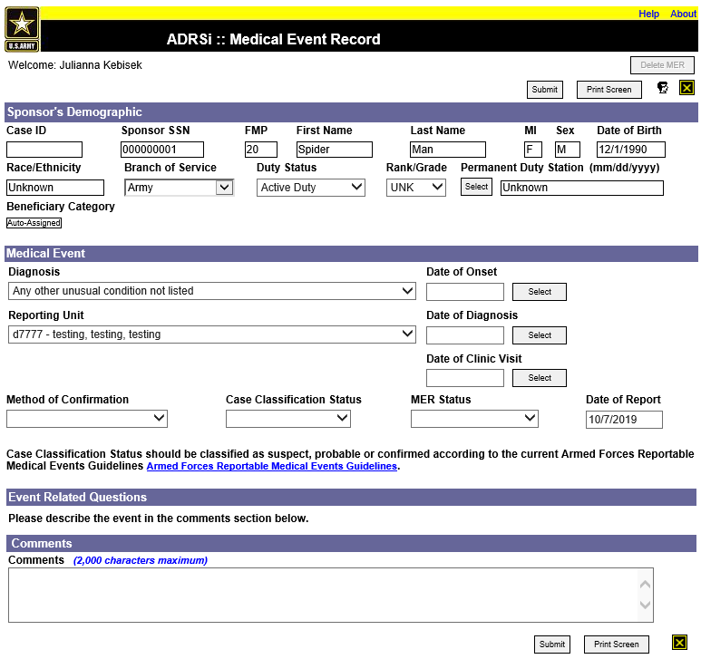
DoD Reporting Expectations
Reporting:
Probable and confirmed cases of severe lung disease associated with e-cigarette use as defined by the CDC should be reported to:
Your local chain of command AND
State/local public health authority per state regulations AND
The Disease Reporting System internet (DRSi) under the “Diagnosis” of “Any other unusual condition not listed”
Enter information in the comments section

Slide 26
DRSi Reporting

Slide 27
Information to Include in DRSi Report
(1) E-cigarette* usage in 90 days prior to symptom onset? (Yes or No)
(2) Is the patient a current or former smoker (cigarettes, pipes, cigars, etc.) (Yes or No)
(3) Are the E-cigarette and its substances available for testing? (Yes or No)
(4) Was the device modified/customized in any way? (Yes or No)
(5) What was the method of substance use? (e.g., vaping, dabbing, dripping, etc.)?
(6) Was a plain film chest radiograph or chest CT (Computed Tomography) performed? (Yes or No)
(7) Does the patient have evidence of pulmonary infection on initial work-up? (Yes or No) (if yes, specify which)
(8) Does the patient have evidence in their medical record of alternative plausible diagnoses (e.g., cardiac, rheumatologic or neoplastic process)? (Yes or No)
(9) If an infection is identified through culture or PCR by clinical team, do they believe that this is not the sole cause of the patient’s underlying respiratory disease process? (Yes or No)
(10) If testing is not performed to rule out pulmonary infection, does the clinical team believe that this would not be the sole cause of the patient’s underlying respiratory disease process? (Yes or No)
(11) Was the patient hospitalized? (Yes or No)
(12) Did the patient receive any respiratory assistance (oxygen, intubation, etc.)? (Yes or No)

Slide 28
Information to Include in DRSi Report
(1) E-cigarette* usage in 90 days prior to symptom onset? (Yes or No)
(2) Is the patient a current or former smoker (cigarettes, pipes, cigars, etc.) (Yes or No)
(3) Are the E-cigarette and its substances available for testing? (Yes or No)
(4) Was the device modified/customized in any way? (Yes or No)
(5) What was the method of substance use? (e.g., vaping, dabbing, dripping, etc.)?
(6) Was a plain film chest radiograph or chest CT (Computed Tomography) performed? (Yes or No)
(7) Does the patient have evidence of pulmonary infection on initial work-up? (Yes or No) (if yes, specify which)
(8) Does the patient have evidence in their medical record of alternative plausible diagnoses (e.g., cardiac, rheumatologic or neoplastic process)? (Yes or No)
(9) If an infection is identified through culture or PCR by clinical team, do they believe that this is not the sole cause of the patient’s underlying respiratory disease process? (Yes or No)
(10) If testing is not performed to rule out pulmonary infection, does the clinical team believe that this would not be the sole cause of the patient’s underlying respiratory disease process? (Yes or No)
(11) Was the patient hospitalized? (Yes or No)
(12) Did the patient receive any respiratory assistance (oxygen, intubation, etc.)? (Yes or No)
Notes:
Trying to get more information on the source of their exposures – what is their exposure history, what substances have they used, have they modified it at all or can we rule that out as a cause, etc.

Slide 29
Information to Include in DRSi Report
(1) E-cigarette* usage in 90 days prior to symptom onset? (Yes or No)
(2) Is the patient a current or former smoker (cigarettes, pipes, cigars, etc.) (Yes or No)
(3) Are the E-cigarette and its substances available for testing? (Yes or No)
(4) Was the device modified/customized in any way? (Yes or No)
(5) What was the method of substance use? (e.g., vaping, dabbing, dripping, etc.)?
(6) Was a plain film chest radiograph or chest CT (Computed Tomography) performed? (Yes or No)
(7) Does the patient have evidence of pulmonary infection on initial work-up? (Yes or No) (if yes, specify which)
(8) Does the patient have evidence in their medical record of alternative plausible diagnoses (e.g., cardiac, rheumatologic or neoplastic process)? (Yes or No)
(9) If an infection is identified through culture or PCR by clinical team, do they believe that this is not the sole cause of the patient’s underlying respiratory disease process? (Yes or No)
(10) If testing is not performed to rule out pulmonary infection, does the clinical team believe that this would not be the sole cause of the patient’s underlying respiratory disease process? (Yes or No)
(11) Was the patient hospitalized? (Yes or No)
(12) Did the patient receive any respiratory assistance (oxygen, intubation, etc.)? (Yes or No)
Notes:
How was their diagnosis determined, and what was the result of the chest x-ray? Were any clinical specimens collected, etc.

Slide 30
Information to Include in DRSi Report
(1) E-cigarette* usage in 90 days prior to symptom onset? (Yes or No)
(2) Is the patient a current or former smoker (cigarettes, pipes, cigars, etc.) (Yes or No)
(3) Are the E-cigarette and its substances available for testing? (Yes or No)
(4) Was the device modified/customized in any way? (Yes or No)
(5) What was the method of substance use? (e.g., vaping, dabbing, dripping, etc.)?
(6) Was a plain film chest radiograph or chest CT (Computed Tomography) performed? (Yes or No)
(7) Does the patient have evidence of pulmonary infection on initial work-up? (Yes or No) (if yes, specify which)
(8) Does the patient have evidence in their medical record of alternative plausible diagnoses (e.g., cardiac, rheumatologic or neoplastic process)? (Yes or No)
(9) If an infection is identified through culture or PCR by clinical team, do they believe that this is not the sole cause of the patient’s underlying respiratory disease process? (Yes or No)
(10) If testing is not performed to rule out pulmonary infection, does the clinical team believe that this would not be the sole cause of the patient’s underlying respiratory disease process? (Yes or No)
(11) Was the patient hospitalized? (Yes or No)
(12) Did the patient receive any respiratory assistance (oxygen, intubation, etc.)? (Yes or No)
Notes:
This information helps to determine if the case meets the case definition – per the case def, are there any other plausible/more likely diagnoses considered by the medical team, is there an infection – ESPECIALLY important as we approach flu season

Slide 31
Information to Include in DRSi Report
(1) E-cigarette* usage in 90 days prior to symptom onset? (Yes or No)
(2) Is the patient a current or former smoker (cigarettes, pipes, cigars, etc.) (Yes or No)
(3) Are the E-cigarette and its substances available for testing? (Yes or No)
(4) Was the device modified/customized in any way? (Yes or No)
(5) What was the method of substance use? (e.g., vaping, dabbing, dripping, etc.)?
(6) Was a plain film chest radiograph or chest CT (Computed Tomography) performed? (Yes or No)
(7) Does the patient have evidence of pulmonary infection on initial work-up? (Yes or No) (if yes, specify which)
(8) Does the patient have evidence in their medical record of alternative plausible diagnoses (e.g., cardiac, rheumatologic or neoplastic process)? (Yes or No)
(9) If an infection is identified through culture or PCR by clinical team, do they believe that this is not the sole cause of the patient’s underlying respiratory disease process? (Yes or No)
(10) If testing is not performed to rule out pulmonary infection, does the clinical team believe that this would not be the sole cause of the patient’s underlying respiratory disease process? (Yes or No)
(11) Was the patient hospitalized? (Yes or No)
(12) Did the patient receive any respiratory assistance (oxygen, intubation, etc.)? (Yes or No)
Notes:
What is the prognosis for this patient?

Slide 32
Assigning and Reporting the CDC Case ID
It is not the responsibility of the MTF to report to the CDC
The MTF must report to:
The state/local health department AND
Your chain of command AND
DRSi
The state/local health department (or the Armed Forces Health Surveillance Division) will report the case to the CDC
Once the case has been reported, the CDC will assign a de-identified Case ID number in the format: CA-00001 (state code and five digit number identifying the number of cases reported from that state). AFHSD will assign a Case ID for OCONUS cases.
After reporting the case to your state/local public health, ask for the CDC case ID number, then enter that case ID number in the DRSi comment box.
Notes:
AF folks do not need to report the CDC case ID number in the DRSi report.

Slide 33
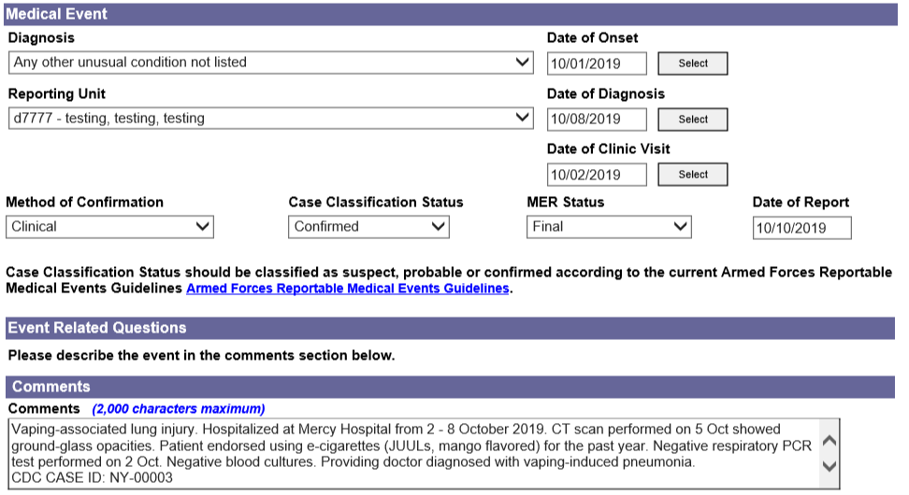
Example of Good Case Report
Notes:
Add alternative example with numbered questions and answers?

Slide 34
In Summary
The outbreak of lung injuries associated with e-cigarettes and/or vaping is ongoing, and there is much we still don’t know about the cause of this outbreak.
We do know that the outbreak is caused by a chemical exposure(s) from nicotine and/or THC products smoked using an e-cigarette or vape.
We will continue to learn more as more cases are identified and properly reported.
Report all cases to up your chain of command, to your state/local health department, and to DRSi. Try to gather as much information as possible on the case history per the interview form. Enter the CDC Case ID in the MER comments.
Do not contact the CDC
Do not do nothing

Slide 35
Contact Information
Army: APHC – Disease Epidemiology Program
Aberdeen Proving Ground – MD
COMM: (410) 436-7605 DSN: 584-7605
usarmy.apg.medcom-aphc.mbx.disease-epidemiologyprogram13@mail.mil
Navy: NMCPHC Preventive Medicine Programs and Policy Support Department
COMM: (757) 953-0700; DSN: (312) 377-0700
Email: usn.hampton-roads.navmcpubhlthcenpors.list.nmcphc-threatassess@mail.mil
Contact your cognizant NEPMU
NEPMU2: COMM: (757) 950-6600; DSN: (312) 377-6600
Email: usn.hampton-roads.navhospporsva.list.nepmu2norfolk- threatassess@mail.mil
NEPMU5: COMM: (619) 556-7070; DSN (312) 526-7070
Email: usn.san-diego.navenpvntmedufive.list.nepmu5-health-surveillance@mail.mil
NEPMU6: COMM: (808) 471-0237; DSN: (315) 471-0237
Email: usn.jbphh.navenpvntmedusixhi.list.nepmu6@mail.mil
NEPMU7: COMM (int): 011-34-956-82-2230 (local): 727-2230; DSN: 94-314-727-2230
Email: NEPMU7@eu.navy.mil
Air Force: Contact your MAJCOM PH or USAFSAM/PHR
USAFSAM / PHR / Epidemiology Consult Service
Wright-Patterson AFB, Ohio
COMM: (937) 938-3207 DSN: 798-3207
usafsam.phrepiservic@us.af.mil

Slide 36
Questions?

