Slide 1
Announcements
REGISTER
FY20 Epi-tech Training
Registration is required:
  Register at: https://tiny.army.mil/r/EZY8/EpiTechFY20
  Log in with CAC, or follow prompts to Request access/Logon ID
  Contact your service surveillance hub to receive monthly updates and reminders
Attendance:
  Please enter your full name/email/location into the DCS chat box to the right,
  or email your service hub
  An attendance confirmation will be sent to your email; if you do not receive this message within 3 days, please contact your service hub
Reminder:
  Mute your phones by pressing the mute button or pressing *6
  DO NOT press the “hold” button as the rest of the conference will hear the hold music

Notes:
Good [morning, afternoon, evening] everyone and welcome to today’s Epi-tech training session:
My name is [name], and I’m an [title] with the [Public Health location]. I’m joined by my colleagues at the [Navy and Marine Corps Public Health Center / U.S. Air Force School of Aerospace Medicine / Army Public Health Center].
A few housekeeping items before we get started:
Registration is required; if you registered for the FY20 monthly trainings already, you do not need to register every month, you simply need to register once a year. The registration link is shown on the screen.
For attendance purposes, please enter your name, location, and email into the chat box to the right. If you are attending as a group, be sure to list all individuals present.
If you are on the phone, please put your phone on mute (if you do not have a mute button, you can press *6 to mute and unmute as needed. If you get another call during this meeting, please do not put us on hold otherwise we’ll hear the hold music.
To download the entire presentation directly from DCS, click on the icon of the large arrow pointing into a tray, displayed at the bottom center of the screen. A copy of the slides, and a video recording, will also be available on the epi-tech surveillance training webpage shortly.

Slide 2
FY20 Epi-Tech Surveillance Training
Tuesday, October 1, 2019 - Wednesday, September 30, 2020
DCS, APG, MD
Provided By
U.S. Army Medical Command
Activity ID Course Director CME Planner
2019-1389 John Ambrose Mimi C. Eng
Accreditation Statement
The U.S. Army Medical Command is accredited by the Accreditation Council for Continuing Medical Education (ACCME) to provide continuing medical education for physicians.
Credit Designation
The U.S. Army Medical Command designates this Live Activity for a maximum of 5 AMA PRA Category 1 Credit(s)TM. Physicians should claim only the credit commensurate with the extent of their participation in the activity.
This is a required handout. It must be disseminated to each learner prior to the start of the activity.

Slide 3
Statement of Need/Gap Analysis
The purpose of this CME activity is to address the identified gap(s):
1. Disease identification - Verification of disease by established case definitions have been utilized by the local health departments, Centers for Disease Control and Prevention, World Health Organization, and the Department of Defense. With the every changing list of reportable medical events and new emerging infections, case definitions change rapidly. Army epidemiologist conduct verification studies that monitor the efficiency of reporting by local public health experts and have concluded that completeness percentages for reportable medical events range as low as 35% for select diseases.
2. Outbreak reporting - Recent evidence have demonstrated that outbreak reporting and communication between public health agencies is poor. In fact, the Army failed to report six outbreaks in the DRSi between June 2016 and September 2016.
3. Surveillance techniques - Surveillance of common communicable diseases continues to be a problem among local MTFs. In fact, cases of campylobacter were not investigated in 2015 for PACOM MTFS, while 2016 cases of salmonella were not investigated. Civilian public health agencies are required to conduct investigations into all reportable medical events. However, DoD facilities often do not take initiative to conduct this investigation.
Learning Objectives
1. Based on case presentation, enhance your ability to improve case finding and surveillance practices within your local MTF.
Target Audience / Scope of Practice
Target Audience: The intended audience for this educational activity includes preventive medicine physicians, community health nurses, public health nurses, and epidemiology technicians.
Scope of Practice: This activity will improve the performance of preventive medicine personnel who conduct surveillance activities in inpatient and outpatient settings.

Slide 4
Disclosure of Faculty/Committee Member Relationships
It is the policy of the U.S. Army Medical Command that all CME planning committee/faculty/authors disclose relationships with commercial entities upon invitation of participation. Disclosure documents are reviewed for potential conflicts of interest and, if identified, they are resolved prior to confirmation of participation.
  Faculty Members
  Bylsma, Victoria - No information to disclose.
  Demarcus, Laurie - No information to disclose.
  Kebisek, Julianna - No information to disclose.
  Thervil, Jeffrey - No information to disclose.
  Wolff, Gregg - No information to disclose.
  Committee Members
  Ambrose, John - No information to disclose.
  Bylsma, Victoria - No information to disclose.
  Constantino, Joycelyn - No information to disclose.
  Diaz, Rolando - No information to disclose.
  Eng, Mimi - No information to disclose.
  Gibson, Kelly - No information to disclose.
  Graham-Glover, Bria - No information to disclose.
  Kebisek, Julianna - No information to disclose.
  Riegodedios, Asha - No information to disclose.
  Rudiger, Courtney - No information to disclose.
Acknowledgement of Commercial Support
There is no commercial support associated with this educational activity.

Slide 5

2020 Reportable Medical Events Guidelines Update and
Influenza Mid-Season Update
US Air Force School of Aerospace Medicine (USAFSAM)
Epidemiology Consult Service (PHR)
DoD Global Respiratory Surveillance Program
28 Jan 2020
Notes:
Welcome to the January 2020 Epi Tech DCS! I am Tori Bylsma, formerly Holbrook, an epidemiologist with the Epidemiology Consult Service at the USAF School of Aerospace Medicine. Today’s presentation will cover two topics: First, I’ll cover updates to the Armed Forces Reportable Medical Events Guidelines and Case Definitions, which were released on 01 January 2020. Second, our presenter from the DoD Respiratory Surveillance Program, ________________________, will provide updates on the current influenza season.

Slide 6
Objectives
Describe the changes in the 2020 Reportable Medical Events Guidelines
Recognize the effect updates to the Guidelines have on daily business processes and how to begin addressing these gaps
Describe the current flu burden on the military population
Notes:
The objectives include: (read objectives)

Slide 7
2020 RME Guideline Updates

Slide 8
Reporting Requirements
Air Force
  AFI 48-105 “Surveillance, Prevention, and Control of Diseases and Conditions of Public Health or Military Significance”
Navy
  BUMED INST 6220.12C “Medical Surveillance and Medical Event Reporting”
  NMCPHC-TM-PM 6220.12 “Medical Surveillance and Reporting”
Army
  Army Regulations 40-5 “Medical Services Preventive Medicine”
  Department of the Army Pamphlet 40-11 “Medical Services Preventive Medicine”
DoD
  DODD 6490.02E “Comprehensive Health Surveillance”
  DODI 6490.03 “Deployment Health”
  Joint Publication 4-02 “Doctrine for Health Service Support for Joint Operations”
Notes:
For reference, this slide shows service-specific directive for surveillance and reporting that everyone should be familiar with.

Slide 9
Overview: General
14 events have been updated
No events were added
No events were removed
No significant changes to format, style, or layout
Notes:
An updated version of the Armed Forces Reportable Medical Events Guidelines and Case Definitions were released on 1 January 2020. Hopefully you’ve brought a copy with you for reference during this DCS. We advise keeping a copy of the Guidelines on your office shared drive and having a printed copy in a three ring binder for quick reference. If you need a copy of the Guidelines or the List of Reportable Medical Events, contact your service hub. For the Air Force, the Guidelines are also available on the Public Health KX.
In general, (read slide)

Slide 10
Overview: Disease Updates
Anthrax – updated clinical forms and updated laboratory criteria
Arboviral Diseases – updated inclusion and exclusion criteria
E. coli, Shiga Toxin Producing – laboratory criteria updated for every case classification
Hepatitis A – case definition fully rewritten
Hepatitis C – clarification of laboratory requirements
Lyme Disease – simplified case definition and updated clinical description
Norovirus – probable case classification added
Post-Exposure Prophylaxis against Rabies – clarification of comments section
Notes:
This slide and the next are a quick summary of big changes to specific Reportable Medical Events, or RMEs. For reference, this information is on page 5 of the 2020 Guidelines. Some diseases, like Anthrax, are not commonly reported so changes to the definition may not effect routine surveillance as much as changes to a case definition like norovirus or hepatitis A.

Slide 11
Overview: Disease Updates
Q Fever – updated epidemiological link requirements
Salmonellosis – clarified inclusion criteria
Spotted Fever Rickettsiosis – suspected case classification removed, clinical criteria updated, added interpretation comments
Trypanosomiasis – case definition for American Trypanosomiasis rewritten
Tuberculosis – updated inclusion criteria
Typhus Fever – case definition rewritten
Varicella – edits to the exclusion criteria
Notes:
As a result, in this presentation I will cover changes that are mostly likely to require updates to your routine surveillance procedures. However, it is important that you review all the diseases that have been updated and note the changes.

Slide 12
Critical RME Updates
Notes:
We’re going to cover 8 specific RMEs

Slide 13
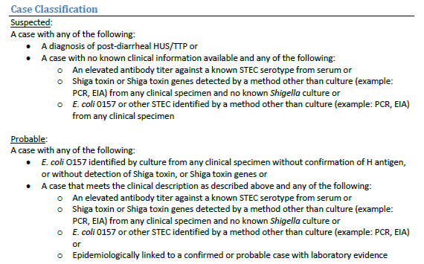

E. coli, Shiga Toxin Producing (STEC) infection
Notes:
First lets look at E. coli, Shiga toxin producing (STEC) infection on page 29 of the Guidelines.
All three case classifications have been updated, but the most significant change is that positive PCR results are now accepted as Suspected or Probable cases, depending on the details. Looking at the Suspected case classification it says “A case with no known clinical information and any of the following: Shiga toxin or shiga toxin genes detected by a method other than culture (EIA, PCR) … and no known Shigella culture OR E. coli O157 or other STEC by a method other than culture (PCR, EIA).” In other words, a positive PCR result for Shiga toxin genes or E. coli O157 genes is reportable as suspected if there is no information about symptoms.. And if there is no culture for Shigella.
Looking at the probable case classification, it says “A case that meets the clinical description as described above and any of the following:” then lists the same lab requirements as suspected. The difference is, if there are positive PCR result for Shiga toxin genes or E. coli O157 genes, AND the case has symptoms, the case is reportable as probable.

Slide 14
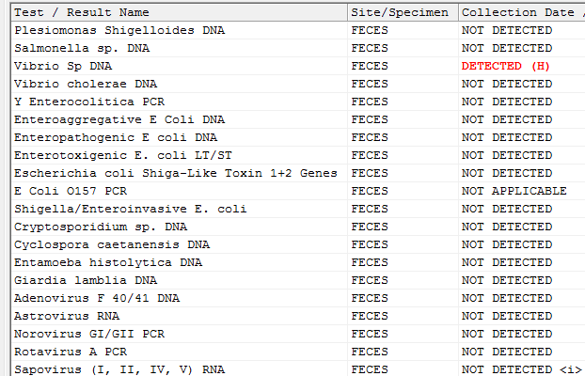
E. coli, Shiga Toxin Producing (STEC) infection
Notes:
Now, in the typical biofire PCR panel, both of these results, if positive, are reportable. It is likely that ad hoc spools are not currently written to include these lab results.

Slide 15
E. coli, Shiga Toxin Producing (STEC) infection
Notes:
What about these e. coli results?

Slide 16
E. coli, Shiga Toxin Producing (STEC) infection
X
X
Notes:
NOT REPORTABLE as STEC.

Slide 17
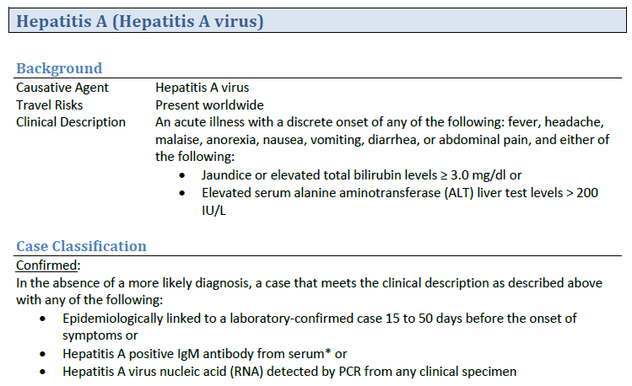
Hepatitis A
Notes:
Next is Hepatitis A on page 41.
The clinical description was updated to require specific elevated bilirubin and ALT levels. Elevated AST levels were removed. Most importantly, the Confirmed case classification was updated to include detection of hepatitis A by PCR from any clinical specimen. Much like in E. coli, it is likely that ad hoc spools are not currently written to include this lab result.

Slide 18
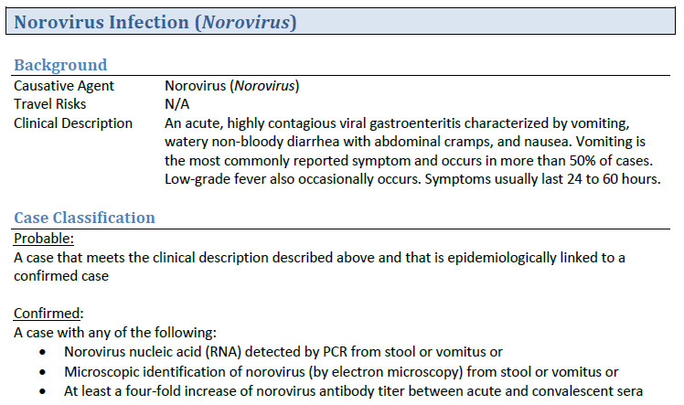
Norovirus
Notes:
Up next, norovirus on p 57.
In cases where an individual has symptoms consistent with the clinical description and is epi linked to a confirmed case, they should be reported as a “Probable” case. Previously there was no probable classification.
If they eventually have a positive lab result that meets the confirmed case classification then they should be updated accordingly.
Probable case classification added; allows reporting of cases when symptomatic and epi-linked to a confirmed case

Slide 19
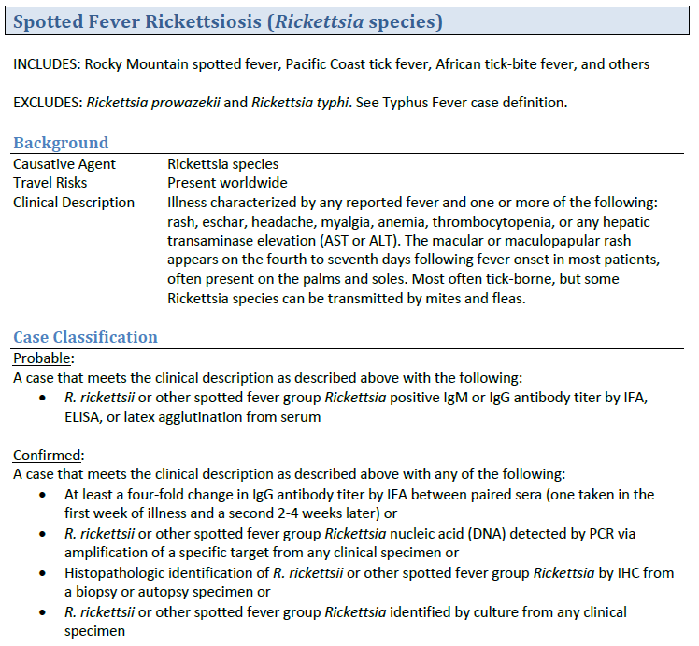
Spotted Fever Rickettisosis (SFR)
Notes:
Removed Suspected case classification
Updated clinical criteria; fever and one or more symptoms are required
Added comment to assist in interpreting cross-reactivity between SFR and typhus fever antibodies

Slide 20
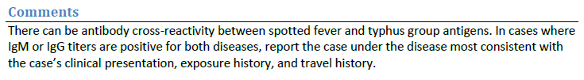
Spotted Fever Rickettisosis (SFR)

Slide 21
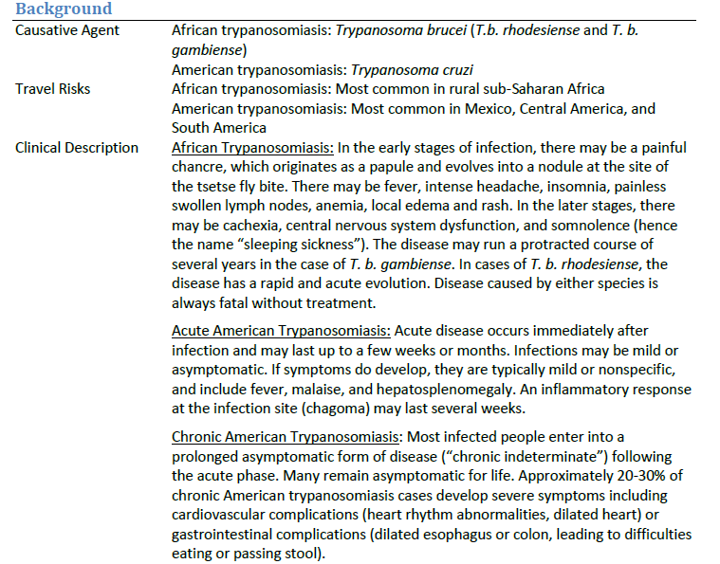
Trypanosomiasis
Notes:
Updated clinical description for American Trypanosomiasis
All new Probable and Confirmed case classification requirements
Probable requires laboratory results from screening tests
Confirmed clarifies laboratory requirements; adds detection by PCR

Slide 22
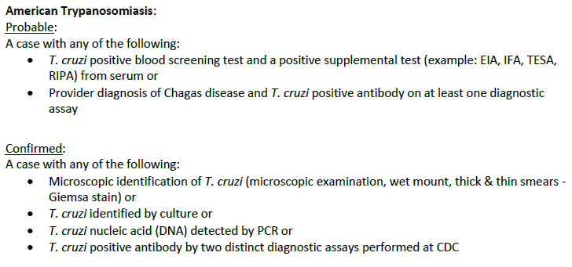
Trypanosomiasis
Notes:
Updated clinical description for American Trypanosomiasis
All new Probable and Confirmed case classification requirements
Probable requires laboratory results from screening tests
Confirmed clarifies laboratory requirements; adds detection by PCR

Slide 23
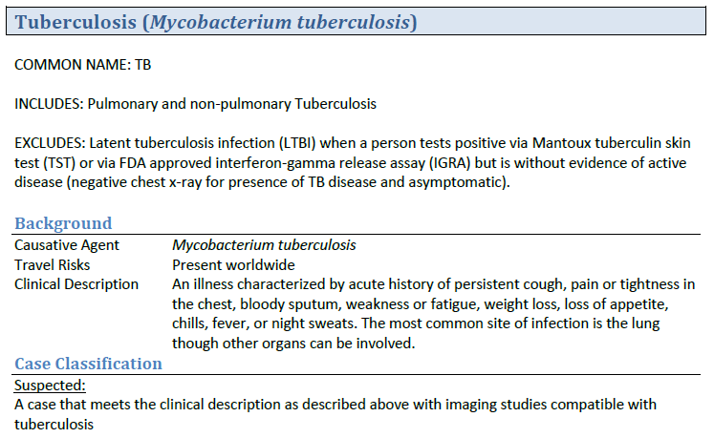
Tuberculosis
Notes:
Updated inclusion criteria; clarified that non-pulmonary Tuberculosis is also reportable

Slide 24
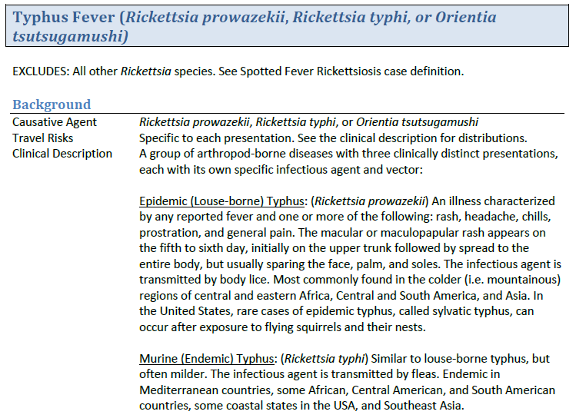
Typhus Fever
Notes:
Updated clinical criteria for Epidemic (R. prowazekii) and Murine Typhus (R. typhi); fever and one or more symptoms are required
Probable case classification added to “R. prowazekii or R. typhi” case definition; adds reporting of elevated antibody titers
Added comment to assist in interpreting cross-reactivity between SFR and typhus fever antibodies

Slide 25
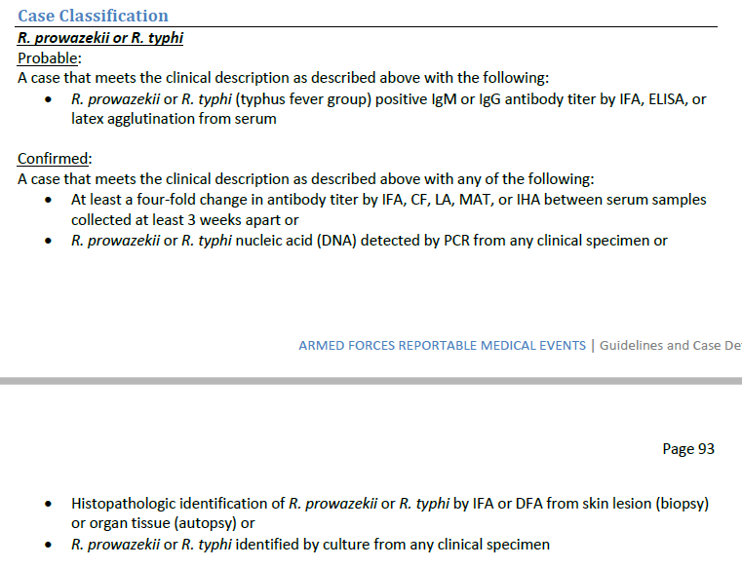

Typhus Fever
Notes:
Updated clinical criteria for Epidemic (R. prowazekii) and Murine Typhus (R. typhi); fever and one or more symptoms are required
Probable case classification added to “R. prowazekii or R. typhi” case definition; adds reporting of elevated antibody titers
Added comment to assist in interpreting cross-reactivity between SFR and typhus fever antibodies

Slide 26
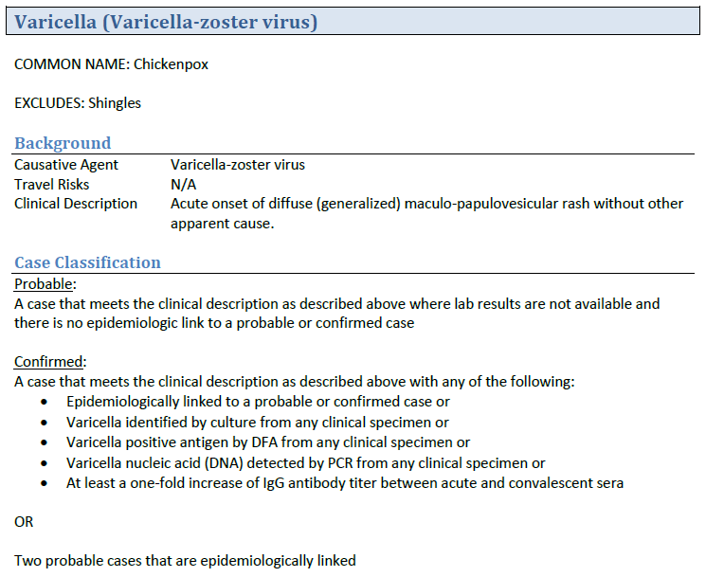
Varicella
Notes:
Updated exclusion criteria; excludes reporting of Shingles

Slide 27


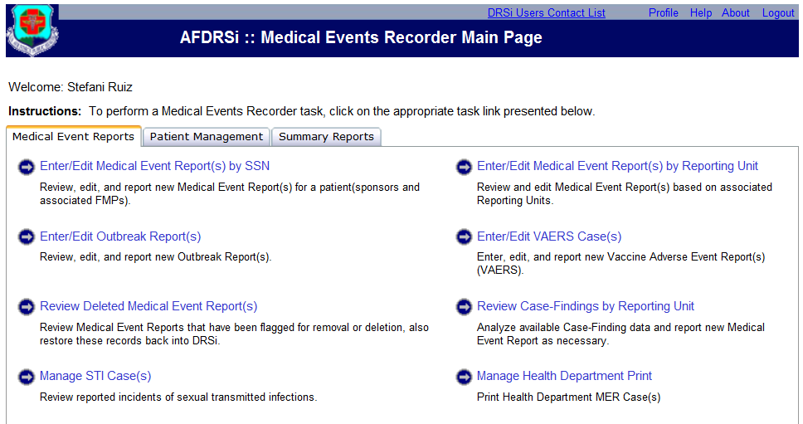

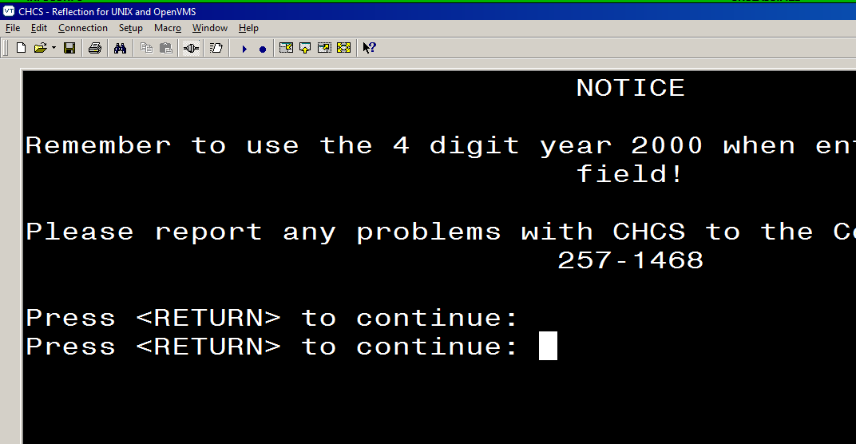
Effects on Daily Business Processes
CHCS ad hocs
Lab personnel
Providers
Lab
Providers
DRSi Case Finding Module
CHCS reports
Notes:
So, with these changes in mind, how do they affect your daily business processes? The most prominent and pressing change is the expanded case definitions, like Salmonella, campylobacter, varicella, etc. Not only are the ad hocs from CHCS probably pulling 2017 specific labs, but lab personnel and providers may have been familiar with and accustomed to only giving you cases that matched the 2017 guidelines. But now more labs or a larger population are reportable, so it’s likely if your CHCS code has not yet been updated, you may be missing out on events that should be reported under the new definitions.
Now, the DRSi Case Finding Module and background process that feed it have been updated to reflect lab changes in the 2020 guidelines. But remember that the module only spools on 54 of the 68 reportable medical events. It does not catch everything!

Slide 28
Effects on Daily Business Processes
Updating ad hocs/spools
  Laboratory System Support Center (LSSC) – Requests for updates must come from your LAB, not public health/prev med
  Requests from any service should be sent to:
  dha.ncr.clinic-support.mbx.lssc-service-request-mailbox@mail.mil
Comm Disease weekly standup
ProStaff
Lab
Notes:
So the DRSi case finding module is updated, but what about the other issues? We recommend contacting the Lab System Support Center (LSSC) to update ad hoc reports. They are contracted through the Navy, but support all DoD MTF Laboratory Support needs. Note: Public health should not reach out directly to the LSSC without going through their local laboratory; lab personnel must submit the request for updates.
Additionally, a weekly Comm Disease standup to highlight changes in your most common diseases can help familiarize everyone with the new guidelines. It also ensures use of and engagement with the new guidelines, even for those who may not be responsible for reporting. Attending ProStaff and, at the minimum, distributing the updated list of Reportable Medical Events to providers, nursing staff, and laboratory personnel can help increase the reporting of cases. That way you are made aware of cases, even if you come to find they do not meet a case definition after further evaluation.
With regard to lab personnel, if you have a representative with you, ask them the best way to inform the rest of the lab about the updates. If none are present, get in touch with your leadership and see what steps they would like to take.

Slide 29



Defense Health Agency, Public Health Division, Armed Forces Health Surveillance Branch, AF Satellite and USAF School of Aerospace Medicine, Department of Public Health
Presented by: DoD Global Respiratory Pathogen Surveillance Program (DoDGRS)
Laurie DeMarcus, MPH; Jeffrey Thervil, MPH; Gregory Wolff, MPH
DSN: 798-3196 (Comm: 937 938-3196)
28 January 2020
DISTRIBUTION STATEMENT C. Distribution authorized to U.S. Government agencies and their contractors.
Influenza Mid-Season Update

Slide 30
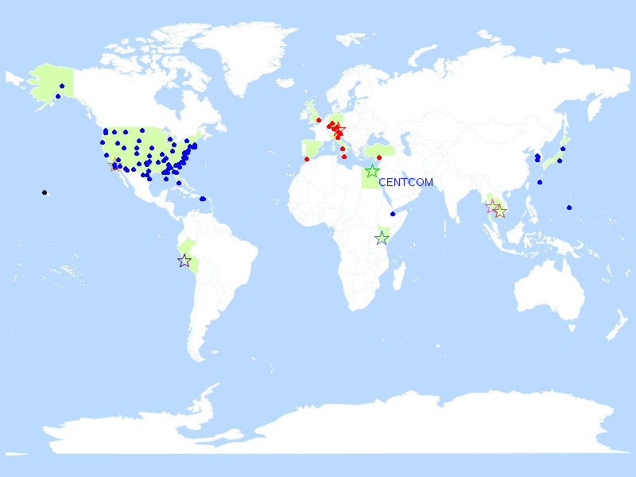


Influenza Surveillance
DoD Global Respiratory Pathogen Surveillance Program
  102 sentinel sites worldwide across the DoD
  Influenza-like Illness (ILI) case definition
    Fever ≥ 100.5°F and Cough OR sore throat < 72 hours duration
  Testing Capabilities
    Multiplex Respiratory Pathogen Panel
    Viral Culture
    Sequencing
    Influenza A/B and subtyping PCR

Slide 31
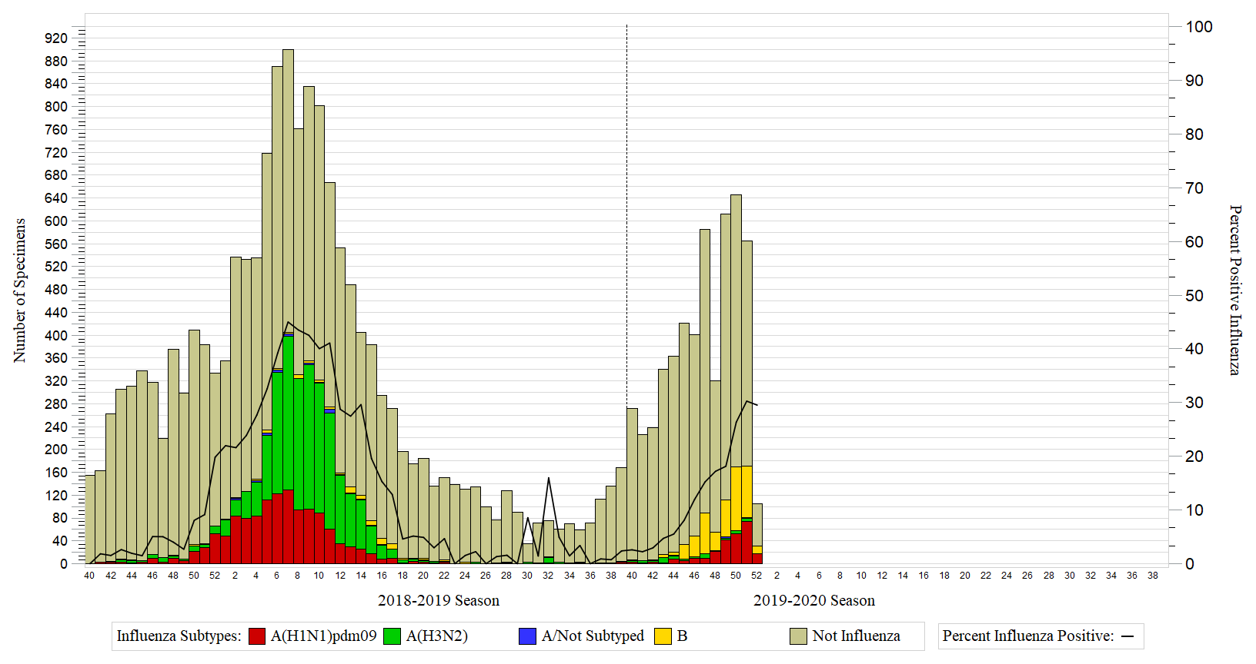
Influenza Trends for Seasons 2018-2019 through 2019-2020

Slide 32
Influenza Percent Positive for Seasons 2014-2015 through 2019-2020

Slide 33
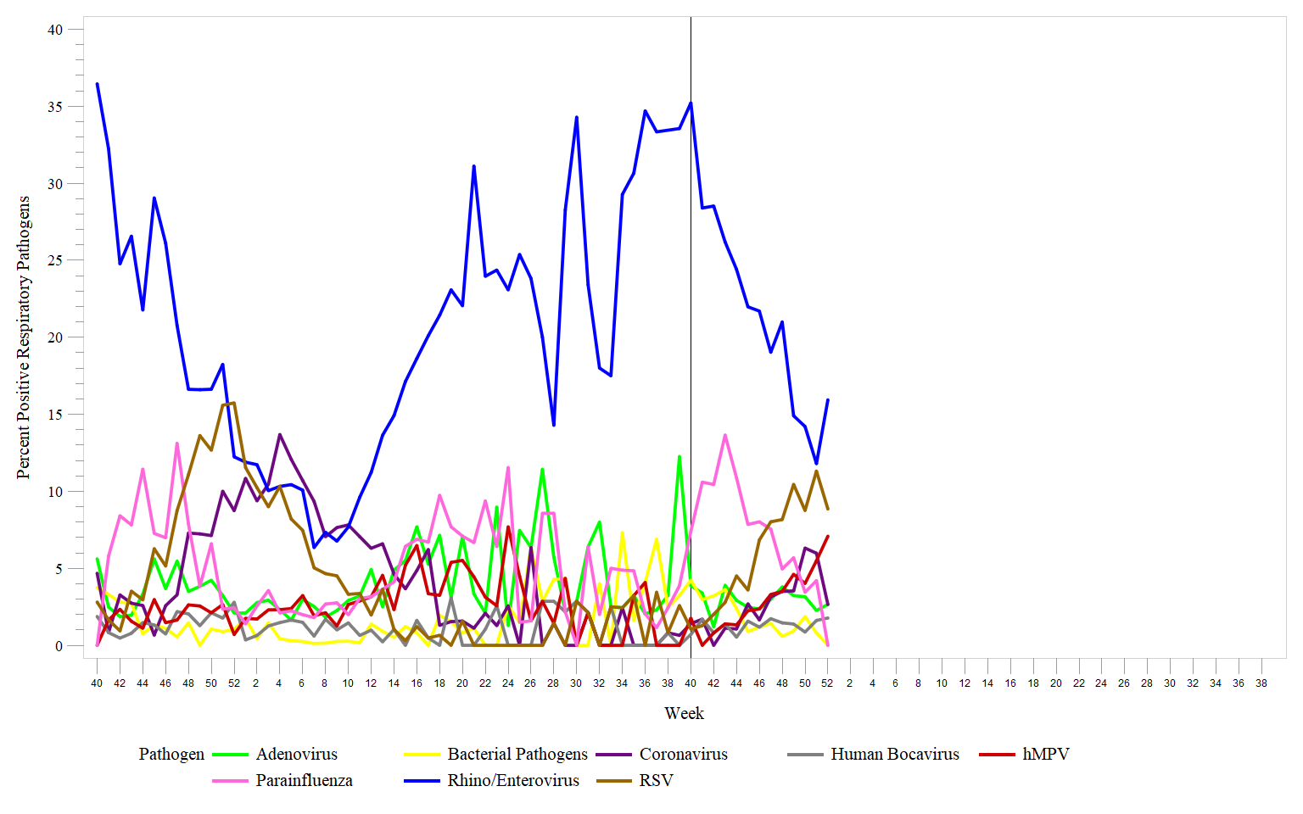
Other Respiratory Pathogens for Seasons 2018-2019 through 2019-2020

Slide 34

Preliminary Interim Mid-Season Vaccine Effectiveness (VE) Estimates
Case test-negative control study used to estimate VE
Multivariable logistic regression used to calculate odds
ratio and 95% confidence intervals
  VE=(1-OR)100%
Population: DoD healthcare beneficiaries (excluding Active Duty)
Time period: 3Nov – 28Dec2019 (Weeks 45 - 52)
Cases confirmed by a positive RT-PCR or viral culture and controls tested negative
Vaccination obtained through electronic immunization records and/or self-report

Slide 35
Preliminary Interim Mid-Season Vaccine Effectiveness Estimates
Population
Influenza Type/Subtypes
Dependents
Overall
(any positive flu)
Children
(2-17 years)
Adults
(18+ years)
A (all subtypes)
B
A/Not subtyped
A(H3N2)
Analysis by influenza type/subtype:
Overall: Dependents, Children, Adults
B: Dependents, Children, Adults
A (all subtypes): Dependents, Children, Adults
A(H1N1)pdm09: Dependents, Children, Adults
A(H3N2): Insufficient data for influenza A(H3N2) analysis
Too sparse data to perform a 65+ year analysis
Most models were adjusted for age, time of specimen collection, and Health and Human Services region
A(H1N1)pdm09

Slide 36
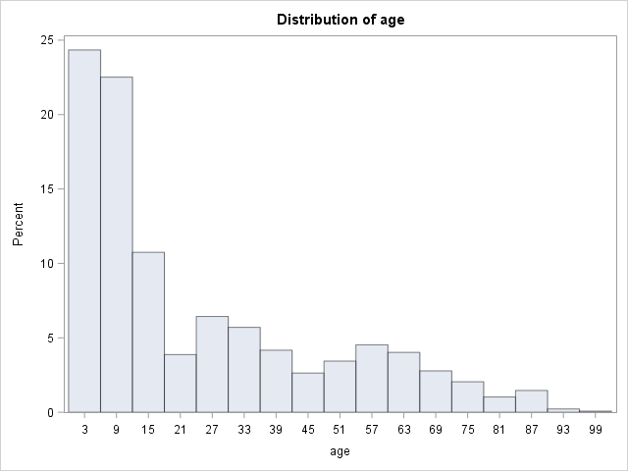
Descriptive Summary
Vaccination Status | Case | Control | Total
Yes | 93 | 414 | 507
No | 320 | 541 | 861
Total | 412 | 955 | 1368
Population: 37% vaccinated
  Cases: 23% vaccinated
  Controls: 43% vaccinated
  Of total cases:
    67% were influenza B
    29% were influenza A(H1N1)pdm09
    3% were influenza A (H3N2)
    <1% were A/not subtyped
Age range: 2-97 years
Mean: 24 years
Median: 13 years
Mode: 4 years

Slide 37
Characteristics of participants in the VE study by outcome

Slide 38
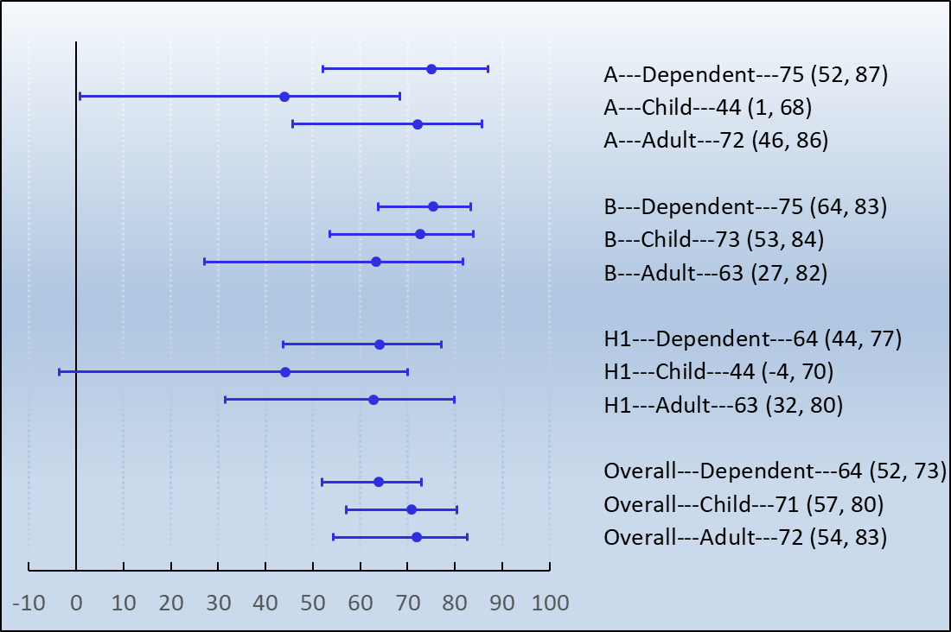
Results
Type/Subtype---Population---VE(95% CI)
Vaccine effectiveness (%)
Early season results – may change as more data is received
Overall VE was moderate to highly protective and significant
Influenza B in all dependents had the highest VE at 75%
    80% of influenza B cases were children
Influenza A(H1N1)pdm09 not significant in children

Slide 39


Limitations
Observational study
Recall bias and documentation errors
when obtaining vaccination status
Selection bias for specimen selection
Early in the season

Slide 40
Contact Information
Army: APHC – Disease Epidemiology Program
Aberdeen Proving Ground – MD
COMM: (410) 436-7605 DSN: 584-7605
usarmy.apg.medcom-aphc.mbx.disease-epidemiologyprogram13@mail.mil
Navy: NMCPHC Preventive Medicine Programs and Policy Support Department
COMM: (757) 953-0700; DSN: (312) 377-0700
Email: usn.hampton-roads.navmcpubhlthcenpors.list.nmcphc-threatassess@mail.mil
Contact your cognizant NEPMU
NEPMU2: COMM: (757) 950-6600; DSN: (312) 377-6600
Email: usn.hampton-roads.navhospporsva.list.nepmu2norfolk- threatassess@mail.mil
NEPMU5: COMM: (619) 556-7070; DSN (312) 526-7070
Email: usn.san-diego.navenpvntmedufive.list.nepmu5-health-surveillance@mail.mil
NEPMU6: COMM: (808) 471-0237; DSN: (315) 471-0237
Email: usn.jbphh.navenpvntmedusixhi.list.nepmu6@mail.mil
NEPMU7: COMM (int): 011-34-956-82-2230 (local): 727-2230; DSN: 94-314-727-2230
Email: NEPMU7@eu.navy.mil
Air Force: Contact your MAJCOM PH or USAFSAM/PHR
USAFSAM / PHR / Epidemiology Consult Service
Wright-Patterson AFB, Ohio
COMM: (937) 938-3207 DSN: 798-3207
usafsam.phrepiservic@us.af.mil

