Slide 1
Announcements
All participants must register for the Monthly Disease Surveillance Trainings in order for us to provide CMEs:
  Log-on or Request log-on ID/password:
  https://tiny.army.mil/r/zB8A/CME
  Register for FY17 Epi-Tech Surveillance Training: https://tiny.army.mil/r/4TgNE/EpiTechFY17
Confirm attendance for today’s training:
  Enter your full name/email address in the chat box; enter each individual’s information if attending with a group
  You will receive a confirmation email within 48 hours
  Contact your Service Hub if you do not receive this email
Please put your phones on mute when not speaking. Press *6 to mute/unmute your phone.

Slide 2
Tuberculosis Surveillance and Control
MAJ Jodi Brown, MPH, RN-BC
28 MAR 17

Slide 3
Learning Objectives
At the end of the presentation, the learner will be able to:
  Describe the epidemiology of tuberculosis (TB) in the United States
  Explain the difference between active TB disease and latent tuberculosis infection (LTBI)
  Identify high-risk groups for targeted LTBI/TB testing
  Describe steps to handle patient with suspected TB disease
  List TB case definition and reporting criteria
  Explain how to enter Pulmonary TB case report in the Disease Reporting System internet (DRSi)
  Describe the systematic approach to active TB contact investigation
  Communicate LTBI and TB disease treatment protocols
  Explain TB prevention and control measures

Slide 4
Key Facts
In 2015, 10.4 million people around the world became ill with TB disease.
There were 1.8 million TB-related deaths worldwide in 2015.
It is estimated that up to 13 million people in the United States have LTBI.
5-10% of people with LTBI will develop active TB disease over a lifetime if not treated.
TB is one of the leading causes of death for people who are Human Immunodeficiency Virus (HIV) infected; causing 1/5 of all deaths.
TB is only second to HIV/Acquired Immune Deficiency Syndrome (AIDS) as the greatest killer worldwide due to a single infectious agent.
(CDC, 2016)

Slide 5
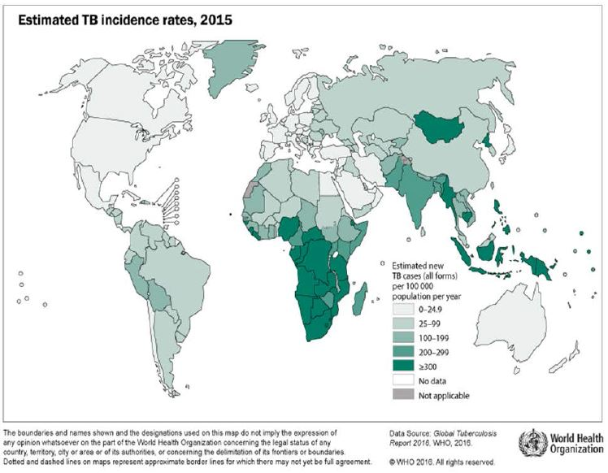
Worldwide TB Case Rates 2015
Notes:
Estimated TB incidence rates, 2015

Slide 6
TB Incidence in the US, 2010-15
Year | Number | Rate *
2015 | 9,557 | 3.0
2014 | 9,406 | 2.9
2013 | 9,550 | 3.0
2012 | 9,942 | 3.2
2011 | 10,510 | 3.4
2010 | 11,159 | 3.6
* TB Cases and Case Rates per 100,000 Population
(CDC, 2016)

Slide 7
What is TB?
TB is a disease caused by the bacteria Mycobacterium tuberculosis (M. tuberculosis/Mtb).
TB disease usually occurs in the lungs (pulmonary TB) but can also occur in other places in the body (extrapulmonary TB) such as the kidney, spine, brain, eyes, reproductive organs, etc.
If not treated properly, TB disease can be fatal.
(World Health Organization, 2016)

Slide 8
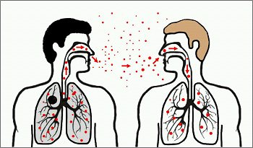
What is TB?
TB is spread from person to person through the air when a person with infectious TB disease coughs, sneezes, speaks, or sings
Tiny particles (droplet nuclei) containing M. tuberculosis may be expelled into the air and can remain suspended in the air for several hours
If another person inhales the infected droplet nuclei, transmission may occur
(World Health Organization, 2016)

Slide 9
LTBI vs TB Disease
A Person with Latent TB Infection | A Person with TB Disease
Asymptomatic | Has symptoms that may include: ▪ a bad cough that lasts 3 weeks or longer ▪ pain in the chest ▪ coughing up blood or sputum ▪ weakness or fatigue ▪ weight loss ▪ no appetite ▪ chills ▪ fever ▪ sweating at night
Does not feel sick | Usually feels sick
Cannot spread TB bacteria to others | May spread TB bacteria to others
Usually has a skin test or blood test result indicating TB infection | Usually has a skin test or blood test result indicating TB infection
Has a normal chest x-ray (CXR) and a negative sputum smear | May have an abnormal CXR, or positive sputum smear or culture
Needs treatment for latent TB infection to prevent active TB disease | Needs treatment to treat active TB disease
(CDC, 2013)
Notes:
Speaker notes:
Additional information on LTBI:
The condition when a person is infected with tubercle bacilli but has not developed TB disease, the body’s immune system is keeping the bacilli under control and inactive.
The immune system does this by producing special immune cells that surround the tubercle bacilli. The cells form a shell that acts as a fence and keeps the bacilli contained and inactive.
Persons with LTBI carry the organism that causes TB but do not have symptoms of TB and CANNOT spread TB germs to others

Slide 10
TB Disease in U.S. Military
Risk of TB disease in military is typically less than 1/100,000 population (compared to U.S. Rate of 3.0/100,000).
The prevalence of LTBI is estimated at 1% in military-aged groups compared to 4% of U.S. population overall.
Since the prevalence of TB in most military populations is low, targeted testing of high-risk individuals based on risk assessment should be conducted.
(Mancuso et al., 2010)

Slide 11
Target Testing for LTBI (1/2)
Both the Centers for Disease Control and Prevention (CDC) and the Assistant Secretary of Defense (ASD) recommend that TB testing should be targeted to persons at high risk and discouraged in those at low risk.
Universal testing results in significant numbers of false positives in settings with low prevalence of LTBI such as military settings.
Reducing the number of individuals tested reduces the risk of unnecessary treatment.
Targeted testing could reduce the number of tests by more than 90 percent.
(MEDCOM Regulation 4-64, 2013)
Notes:
Note: Remember that each military Service has slightly different criteria/guidance for LTBI testing

Slide 12
Target Testing for LTBI (2/2)
Targeted testing for LTBI based on:
  Facility risk assessment (conducted annually by APHN)
  Anticipated occupational TB exposures (as determined by Occupational Health)
  Based on TB Risk Assessment Tool (RAT), those high risk for infection with M. Tuberculosis include:
    Exposed to someone with TB disease
    From a country within the last 5 years where TB is common
    People who live/work in high-risk settings (e.g. prisons, shelters, nursing homes)
    Healthcare workers who care for patients at increased risk for TB disease
    Infants and children exposed to adults who are at increased risk for TB disease
(MEDCOM Regulation 4-64, 2013)
Notes:
Each service has different requirements for LTBI testing. If the information provided is different from your Service’s established protocol, please refer to your prescribed guidelines.
Navy :
Follows BUMEDINST 6224.8B, requires universal LTBI testing upon entry into the navy, then:
During the Periodic Health Assessment, using form NAVMED 6224/8, to determine TB exposure history
As directed by combatant commanders
As part of a contact or outbreak investigation
If clinically indicated by licensed healthcare provider based on history or physical
Prior to or within six months of arrival on a commissioned vessel
Prior to separation from Naval service
- The Navy Medical Matrix sets forth the Occ Med requirements for HCW screening.
Army:
- The OH service will ensure that target testing is only performed on those as indicated by the TB risk assessment.
- The Army follows guidelines from MEDCOM Regulation 4-64, only targeted testing will be performed in these settings:
Accession-
Universal skin testing not performed
Testing is targeted through the use of MEDCOM Form 829 (Initial Entry TB Risk Assessment Tool)
Only Soldiers with at least one risk factor identified on RAT will be tested for TB
Pre-Deployment-
No testing pre-deployment, only will be performed at the PHA.
During Deployment-
Testing only done if the Soldier is a TB case contact and under the guidance of the Theater Preventive Medicine consultant.
Periodic Health Assessment-
Soldiers will have an annual risk assessment completed during the PHA using MEDCOM Form 830 (Periodic TB RAT)
Only those with a risk factor identified by the RAT will be tested.
Separation-
No universal testing, use MEDCOM Form 830
Special populations:
Healthcare workers:
Targeted testing should occur based on the Medical Treatment Facility’s annual TB risk assessment (baseline testing only requirement for low-risk facilities and at point where TB exposure occurs):
Low risk- baseline/initial LTBI testing and then after any exposure
Medium/Potential ongoing transmission- every 12 months or after any TB exposure
Use MEDCOM Form 831

Slide 13
Types of LTBI Testing
Tuberculin Skin Test (TST)/Purified Protein Derivative (PPD):
  Injects a small amount of tuberculin
  Produces delayed-type hypersensitivity reaction
  Read PPD in 48-72 hours
Interferon Gamma Release Assay (IGRA):
  Quantiferon (QFT)
  A blood test that can replace a TST as a diagnostic test
  Measures interferon gamma released by lymphocytes in response to TB antigens
(Lewinsohn et al., 2017)

Slide 14
Which LTBI Test is Best?
The 2017 American Thoracic Society, Infectious Diseases Society of America, and CDC (2017) Clinical Practice Guidelines- Diagnosis of TB in Adults and Children recommend:
  Performing the IGRA rather than TST in people 5 years or older who meet the following criteria:
    Are likely to infected with Mtb
    Have a low or intermediate risk of disease progression
    It has been decided that testing for LTBI is warranted (per RAT)
    Either have a history of BCG vaccination or are unlikely to return to have their TST read
  Performing TST rather than the IGRA in healthy children <5 years when it has been determined that testing for LTBI is warranted
(Lewinsohn et al., 2017)

Slide 15
Evaluation and Referral
Army: All individuals with TST reaction of 5mm of induration or larger, or have a positive IGRA:
  Refer to Preventive Medicine (PM)
  Medical evaluation by a physician or other appropriate licensed independent provider
Navy: Each military treatment facility (MTF) medical department determines patient referrals to PM based on individual risk factors and induration cutoff criteria
TST in persons vaccinated with BCG should be interpreted using the same criteria for those not BCG vaccinated
First step in medical evaluation is to determine if TB disease is present:
  Careful medical history and physical exam to elicit signs and symptoms suggestive of active TB disease and a CXR
(CDC, 2013; MEDCOM Regulation 4-64, 2013; BUMED INST 6224.8, 2014)
Notes:
- Again, each Military Service has their own procedures for evaluation and referral.
- A reaction of 5mm of induration is not considered positive in all people, it just is used as a baseline that further medical evaluation is required to determine LTBI/TB risk.
Additional Information:
An induration of 5 mm or more is considered positive in:
HIV-infected persons
A recent contact of a person with TB disease
Persons with fibrotic changes on chest radiograph consistent with prior TB
Patients with organ transplants
Immunosuppressed persons
An induration of 10 mm or more is considered positive in:
Recent immigrants (<5 years) from high prevalence countries
Injection drug users
Residents or employees of high-risk congregate settings
Bacteriology personnel
Persons with clinical medical conditions that place them at higher risk (DM, Silicosis, etc.…)
Children < 5 years of age
Infants, children, and adolescents exposed to adults in high risk categories
An induration of 15 mm or more is considered positive in:
In persons with no known risk factors for TB
Get a CXR

Slide 16
Suspected Active TB Cases
If patient has s/s suspect of active TB disease, initial steps include:
  Isolating (negative pressure room if available) the suspected case until determined minimal contagiousness
  If in a clinic, immediately place a surgical mask on the patient
  Coordinate with hospital infection control to implement TB infection-control plan
  Perform TB Bacteriology (Acid-Fast Bacilli Smear, Nucleic Acid Amplification Test, and Culture)
(CDC, 2014)

Slide 17
Acid-Fast Bacilli (AFB) Smear
At least 3 sputum specimens should be collected at 8 to 24 hour intervals, with at least 1 collected in the morning
Detecting AFB in smears may be first evidence of mycobacteria
Quickest (results within 24 hours) and easiest procedure
Provides a preliminary presumptive diagnosis of TB
A positive AFB smear result does not confirm pulmonary TB
A negative AFB does not necessarily mean culture will come back with no growth
(CDC, 2013)

Slide 18
Nucleic Acid Amplification Test (NAAT)
Rapidly identify a specimen via DNA and RNA amplification
Benefits include:
  Earlier lab confirmation of TB disease
  Earlier respiratory isolation and treatment initiation
  Improved patient outcomes
Perform at least 1 NAAT on each pulmonary TB suspect
A single negative NAAT does not exclude TB
(CDC, 2013)

Slide 19
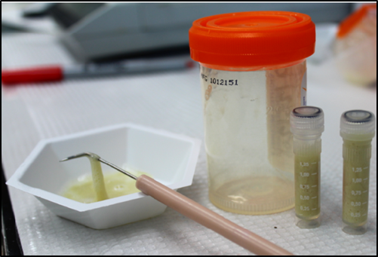
Culture
Gold standard for confirming diagnosis of TB
Culture all specimens, even if smear and/or NAAT are negative
Results in 4-14 days when liquid medium systems used
Culture monthly until conversion (e.g. 2 consecutive negative cultures).
(CDC, 2013)
Notes:
Note: if treatment was given prior to sputum sample, a negative culture doesn’t necessarily = no TB

Slide 20
Armed Forces RME
Pulmonary TB Clinical Case Definition
Clinical Case Definition (all of the following):
  A positive tuberculin skin test of an FDA-approved blood assay for M. Tuberculosis (unless immunocompromised);
  Other signs and symptoms compatible with tuberculosis (e.g., an abnormal and unstable chest radiograph, or clinical evidence of current disease; and
  Completed diagnostic evaluation, including: history, physical exam, smear and culture, Mantoux skin test (or IGRA), and CXR
(Armed Forces Health Surveillance Center, 2012)

Slide 21
Pulmonary TB DRSi Reporting Criteria
Laboratory Criteria for Pulmonary TB diagnosis:
  Any of the following:
    Isolation of M. tuberculosis from a clinical specimen (culture), or
    Demonstration of M. tuberculosis from a clinical specimen by NAAT
Case Classification:
  Probable: Clinical signs and symptoms of pulmonary tuberculosis with demonstration of AFB in a clinical specimen when a culture has not or cannot be obtained
  Confirmed: A clinically compatible case that is laboratory-confirmed (culture or NAAT)
Report all probable and confirmed cases in the Disease Reporting System internet (DRSi) w/in 24 hours
Report all probable or confirmed cases to the designated local and/or state public health official(s) w/in state specified time frame
(Armed Forces Health Surveillance Center, 2012)

Slide 22
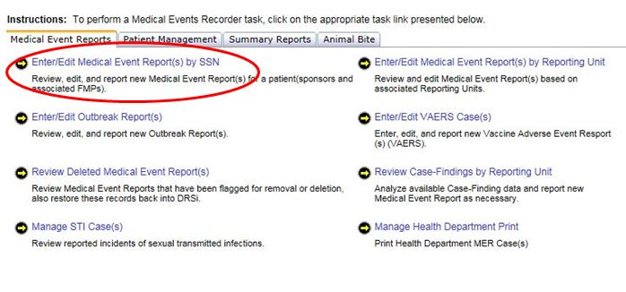
Entering into DRSi (1/4)

Slide 23
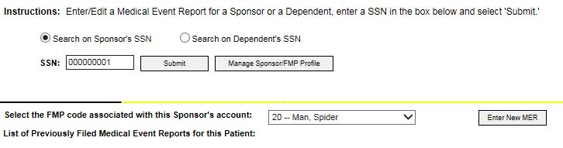
Entering into DRSi (2/4)

Slide 24
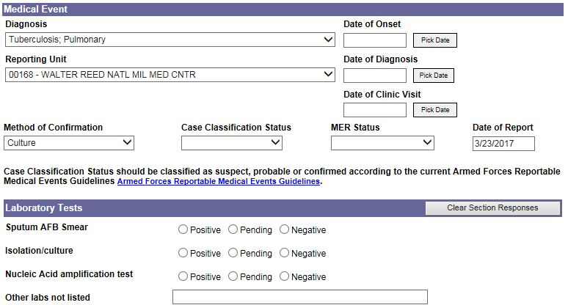
Entering into DRSi (3/4)
Notes:
Speaker Notes:
Method of confirmation options: biopsy, slide, serology, culture, clinical, other; usually latter three (culture, clinical, or other)
Case Classification: confirmed, suspect, probable, not a case. Go back to previous case classification definitions
MER Status: preliminary or final
Note: Can always edit MER report

Slide 25
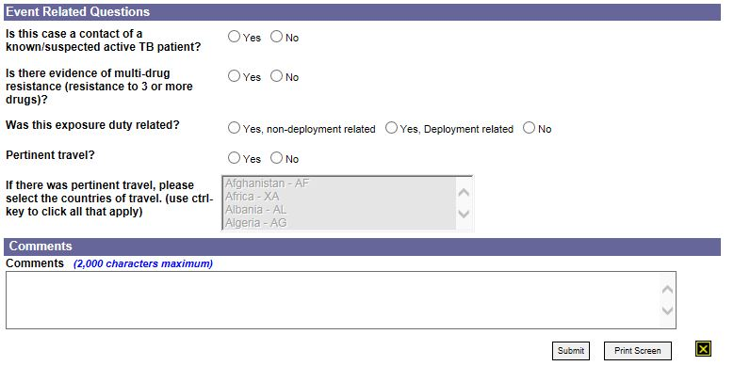
Entering into DRSi (4/4)
Notes:
Notes:
- Include in the comments section any pertinent information about the case (e.g. more information on travel/exposure, treatment, isolation precautions).
- The Navy requires that each MER include: (1) exposure of other individuals and (2) what actions are being taken for your investigation.

Slide 26
TB Contact Investigation
A TB Contact Investigation is a systematic process to:
  Identify persons (contacts) exposed to a person with infectious TB disease (case)
  Assess contacts for infection with M. tuberculosis and TB disease
  Provide appropriate treatment for contact with LTBI or TB disease
(CDC, 2014)
Notes:
Speaker Notes:
Approximately 1% of all TB contacts have TB disease at the time of the contact investigation and are in need of treatment.
Additionally, about 20% to 30% of TB contacts are infected with M. tuberculosis and are at risk for developing TB disease if not diagnosed and treated for LTBI.

Slide 27
Who is Responsible for
TB Contact Investigations?
Installation (Military) Public Health Department:
  Active Duty cases
  DA Civilian/Contractor cases
  Dependents/beneficiaries that live on base
State and local health departments:
  Civilian cases
  Dependents/beneficiaries that live off base (will vary depending on state/situation)
  Have legal responsibility to:
    Investigate TB cases reported in their jurisdiction
    Evaluate effectiveness of TB investigations
Important to develop relationships with your state and/or local health departments PRIOR to TB cases being identified
(CDC, 2014; Clagett, C., 2015)
Notes:
Each TB investigation may be split into both a military and civilian investigation which will vary depending on the scenario.
For example, if a shipboard case occurs, the military (navy) typically will lead that contact investigation on the military side (even if the case is a contractor) – any exposure that has occurred outside the ship goes to the civilian health department to investigation that portion of the investigation. Civilian public health is not authorized to conduct an investigation on a ship or a unit on a Navy/MC installation.

Slide 28
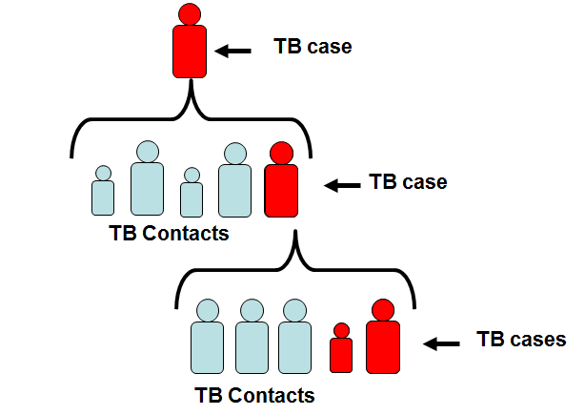
Who are TB Contacts?
Any persons who have shared an airspace with a person with infectious TB disease. This might include:
  Household members
  Friends
  Co-workers
(CDC, 2014)
Notes:
Speaker Notes:
Remember TB is transmitted person-to-person, every TB case began as a TB contact

Slide 29
TB Transmission Factors
The probability that TB will be transmitted to contacts depends on the following factors:
  Infectiousness of person with TB disease
  Duration and frequency of exposure
  Environment in which the exposure occurred
(CDC, 2014)

Slide 30
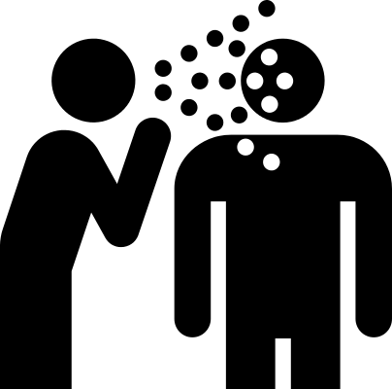
1. Infectiousness of Person with TB Disease
Characteristics associated with infectiousness:
  TB of lungs, airway or larynx
  Presence of cough
  Positive sputum smear
  Cavity on CXR
  Positive cultures
  Not covering mouth when coughing
  Not receiving adequate treatment
  Undergoing coughing inducing procedures
(CDC, 2014)

Slide 31
2. Duration and Frequency of Exposure
Contacts at higher risk for TB infection are those who:
  Frequently spend “a lot of time” with the case
  Have been physically close to the case
Important to define these criteria prior to TB investigation, for example:
  8 hours or more in a single episode, close range (6ft) or at least in the same room, indoors
  15 cumulative hours in a week, close range or at least in the same room indoors
Brief proximity (e.g. clinic reception areas, dining facility serving lines) do not meet the criteria.
(CDC, 2014; Clagett, C., 2015)

Slide 32
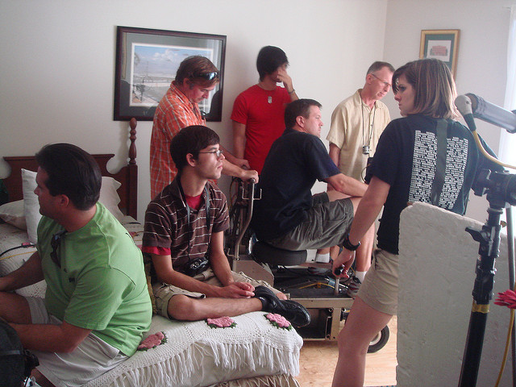

3. Environment in Which Exposure Occurred
Environmental characteristics that increase chances of TB transmission:
  Small or crowded rooms
  Areas that are poorly ventilated
  Rooms without air-filtering systems
(CDC, 2014)

Slide 33
Prioritizing Contacts
Begin with high priority contacts:
  Children <5 years of age ALWAYS high priority
  Immunocompromised (e.g. cancer, steroids)
  Chronic medical conditions (e.g. DM, silicosis)
The CDC grades exposure settings according to size:
  “1”- Vehicle (highest priority)
  “2”- Bedroom or smaller office
  “3”- House
  “4”- Indoor environment larger than a house (lowest priority)
(CDC, 2014; Clagett, C., 2015)
Notes:
Speaker notes:
You may have more contacts than you have resources to track down and interview. If high priority contacts do not show elevated conversions, there is no need to interview and test lower priority contacts.

Slide 34
Risk of Developing TB Disease
In the United States, about 5% of people recently infected with M. tuberculosis will develop TB disease within one to two years.
Another 5% will develop TB disease later in their lives.
In other words, about 10% of all people with normal immune systems who have LTBI will develop TB disease at some point in their lives.
(World Health Organization, 2016)

Slide 35
Risk Factors for Developing TB Disease
Risk factors for developing TB disease
  Human Immunodeficiency Virus (HIV) Infected (Risk 20 to 30 times higher)
  Children <5 years of age
  Diabetes (Risk 3 times higher)
  Chronic renal failure
  Silicosis
  Immunosuppressive therapy
  Head and neck cancer
  Weakened immune system
  Abnormal CXR consistent with prior TB
Exposure to person with infectious TB
  Both recent and distant exposures
Previous LTBI or TB disease diagnosis
(CDC, 2013)

Slide 36
Contacts Exposed to TB
Not everyone exposed to TB becomes infected
Contacts should receive a TST or IGRA unless a previous, documented positive result exists
A TST induration of 5mm or larger is positive
A contact with a:
  Positive TST or IGRA should be medically examined for TB disease
  Negative TST or IGRA should be re-tested in 8 to 10 weeks after the date of last exposure to the case
(CDC, 2014)

Slide 37
Importance of
TB Contact Investigation
It is important to rapidly identify, find and assess contacts for TB infection and disease; contact investigations:
  Interrupt the spread of TB
  Prevent outbreaks of TB
  Ensure appropriate treatment for LTBI or TB disease
On average, 10 contacts are identified for each case:
  20 to 30% of household contacts have LTBI
  1% of contacts have TB disease
(CDC, 2014)

Slide 38
LTBI Treatment
Treatment of LTBI is essential to controlling and eliminating TB Disease
LTBI is treated with one of three options:
  Isoniazid (INH) daily x 6 or 9 months
  Rifampin (RIF) daily for 4 months
  INH and Rifapentine (RPT) administered weekly for 12 weeks as Directly Observed Therapy (DOT)
    INH/RPT is an equal option for treatment for LTBI in: (1) otherwise healthy people; (2) > 12 years old; (3) recent contact with active TB; (4) conversion of PPD/QFT; or (5) radiographic changes consistent with healed pulmonary TB
    INH/RPT not recommended for: (1) pregnant women; (2) children <2 years old; (3) HIV-Infected persons on anti-retroviral drugs; and (4) contacts of INH or RPT resistant Mtb
(CDC, 2013; Ono, 2017)

Slide 39
TB Disease Treatment
Four first-line drugs considered standard treatment for TB disease:
  Isoniazid (INH)
  Rifampin (RIF)
  Pyrazinamide (PZA)
  Ethambutol (EMB)
Rifabutin and Rifapentine also considered first-line drugs in some circumstances
DOT is standard
Isolate: May return to the community if smear is negative
(CDC, 2013; Shuping, 2016)

Slide 40
Drug-Resistant TB
Caused by organisms resistant to one or more TB drugs
Transmitted in same way as drug-susceptible TB, and no more infectious
Delay in detecting drug resistance may prolong period of infectiousness because of delay in starting correct treatment
(CDC, 2013; Shuping, 2016)

Slide 41
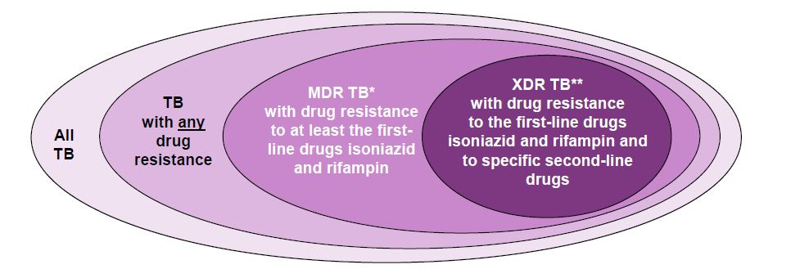
Multi-Drug Resistant (MDR) and
Extensively Drug-Resistant (XDR) TB
MDR TB caused by bacteria resistant to best TB drugs, INH and RIF
XDR TB caused by organisms resistant to INH and RIF, plus fluoroquinolones and ≥1 of the 3 injectable second-line drugs.
* Often resistant to additional drugs
** Resistant to any fluoroquinolone and at least one of the injectable second-line drugs
(CDC, 2013; Shuping, 2016)

Slide 42
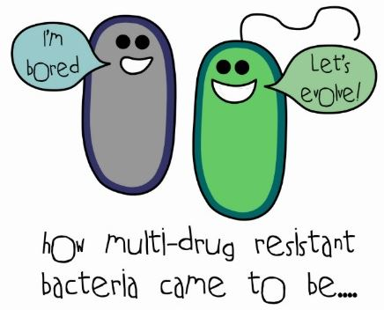
Types of Drug Resistance
Drug resistance develops in two ways:
  Primary resistance develops in persons initially infected with resistant organisms
  Secondary (acquired) resistance develops during TB therapy
(CDC, 2013; Shuping, 2016)

Slide 43
TB Prevention and Control
Respiratory Protective Equipment
Environmental Controls
Administrative Controls
(CDC, 2016)
Notes:
Speaker notes:
It is necessary to have a TB infection plan designed to ensure the following:
Prompt detection of infectious patients
Airborne precautions
Treatment of people who have suspected or confirmed TB disease
Administrative Controls:
Assigning someone the responsibility for TB infection control in the health care setting;
Conducting a TB risk assessment of the setting;
Developing and implementing a written TB infection-control plan;
Ensuring the availability of recommended laboratory processing, testing, and reporting of results;
Implementing effective work practices for managing patients who may have TB disease;
Ensuring proper cleaning, sterilization, or disinfection of equipment that might be contaminated (e.g., endoscopes);
Educating, training, and counseling health care workers, patients, and visitors about TB infection and TB disease;
Testing and evaluating workers who are at risk for exposure to TB disease;
Applying epidemiology-based prevention principles, including the use of setting-related TB infection-control data;
Using posters and signs to remind patients and staff of proper cough etiquette (covering mouth when coughing) and respiratory hygiene; and
Coordinating efforts between local or state health departments and high-risk health-care and congregate settings.
2) Environmental Controls:
Primary environmental controls consist of controlling the source of infection by using local exhaust ventilation (e.g., hoods, tents, or booths) and diluting and removing contaminated air by using general ventilation.
Secondary environmental controls consist of controlling the airflow to prevent contamination of air in areas adjacent to the source airborne infection isolation (AII) rooms; and cleaning the air by using high efficiency particulate air (HEPA) filtration, or ultraviolet germicidal irradiation.
3) Respiratory Protective Equipment:
Implementing a respiratory protection program;
Training health care workers on respiratory protection; and
Educating patients on respiratory hygiene and the importance of cough etiquette procedures.

Slide 44
Summary
It is key to develop partnerships with your local stakeholders prior to a TB case:
  Military public health/preventive medicine departments
  Local and/or state health departments
  Local infection-control staff
The BEST way to stop TB transmission is to:
  Identify and isolate infectious persons
  Start infectious persons on effective treatment for TB disease
  Treatment for LTBI essential for controlling and eliminating TB, if goes from LTBI to active, the patient will infect friends and family
(CDC, 2014)

Slide 45
Questions/Service POCs
Army: APHC – Disease Epidemiology Division
Aberdeen Proving Ground, MD
COMM: (410) 436-7605 DSN: 584-7605
Email: usarmy.apg.medcom-aphc.mbx.disease-epidemiologyprogram13@mail.mil
Navy: NMCPHC Preventive Medicine Programs and Policy Support Department
COMM: (757) 953-0700; DSN: (312) 377-0700
Email: usn.hampton-roads.navmcpubhlthcenpors.list.nmcphc-threatassess@mail.mil
Contact your cognizant NEPMU:
NEPMU2: COMM: (757) 950-6600; DSN: (312) 377-6600
Email: usn.hampton-roads.navhospporsva.list.nepmu2norfolk-threatassess@mail.mil
NEPMU5: COMM: (619) 556-7070; DSN (312) 526-7070
Email: usn.san-diego.navenpvntmedufive.list.nepmu5-health-surveillance@mail.mil
NEPMU6: COMM: (808) 471-0237; DSN: (315) 471-0237
Email: usn.jbphh.navenpvntmedusixhi.list.nepmu6@mail.mil
NEPMU7: COMM (int): 011-34-956-82-2230 (local): 727-2230; DSN: 94-314-727-2230
Email: NEPMU7@eu.navy.mil
Air Force: Contact your MAJCOM PH or USAFSAM/PHR
USAFSAM / PHR / Epidemiology Consult Service
Wright-Patterson AFB, Ohio
COMM: (937) 938-3207 DSN:798-3207
Email: usafsam.phrepiservic@us.af.mil

Slide 46
References
Armed Forces Health Surveillance Center. (2012). Armed forces reportable medical events guidelines & case definitions. Retrieved from http://www.med.navy.mil/sites/nmcphc/Documents/program-and-policy-support/ArmedForcesGuidelines14Mar12.pdf
Centers for Disease Control and Prevention. (2013). Core curriculum on tuberculosis: What the clinician should know, sixth edition. Retrieved from https://www.cdc.gov/tb/education/corecurr/index.htm
Centers for Disease Control and Prevention. (2016). Infection control in health care settings. Retrieved from https://www.cdc.gov/tb/topic/infectioncontrol/
Centers for Disease Control and Prevention. (2016). Introduction to contact investigation process. Retrieved from https://www.cdc.gov/tb/education/skillscourse/default.htm
Centers for Disease Control and Prevention. (2016). Self-study modules on tuberculosis: Module 3: Targeted testing and the diagnosis of latent tuberculosis infection and tuberculosis disease. Retrieved from https://www.cdc.gov/tb/education/ssmodules/pdfs/tb_selfstudymodules_2015_module03.pdf
Centers for Disease Control and Prevention. (2014). Self-study modules on tuberculosis: Module 8: Contact investigations for tuberculosis. Retrieved from https://www.cdc.gov/tb/education/ssmodules/pdfs/module8.pdf
Clagett, C. (2015). Tuberculosis control principles and real world investigation lessons [PowerPoint slides].
Department of the Army Medical Command (MEDCOM). (26 November 13). MEDCOM Regulation 40-64: The tuberculosis surveillance and control program. Retrieved from https://www.health.mil/Policies/2013/11/26/Tuberculosis-Survillance-and-Control-Program
Department of the Navy Bureau of Medicine and Surgery. (4 November 14), BUMEDINST 6224.8B. Tuberculosis Control Program.
Lesinsohn, D., Leonard, M., LoBue, P., Cohn, D., Daley, C., Desmond, E.,…Woods, G. (2017). Official american thoracic society/infectious diseases society of america/centers for disease control and prevention clinical practice guidelines: Diagnosis of tuberculosis in adults and children. Clinical Infectious Diseases, 64 (15 January), e1-e33.
Mancuso, J., Tobler, S., Eick, A., & Olsen, C. (2010). An evaluation of the completeness and accuracy of active tuberculosis reporting in the united states military. International Journal of Tuberculosis and Lung Disease, 14(10), 1310-1315.
Ono, M. (2017). Latent tuberculosis infection (LTBI) update 2017 [PowerPoint slides].
Shuping, E. (2016). Occupational medicine and tuberculosis [PowerPoint slides].
World Health Organization. (2016). Tuberculosis. Retrieved from http://www.who.int/mediacentre/factsheets/fs104/en/

