Slide 1
Audiometric Testing and Follow-up
Department of Defense Hearing Program
Tri-Service Hearing Technician Certification Course

Slide 2
Learning Objectives
2.5.1 Understand audiogram basics
Test types and format
Degrees of hearing
Common audiometric configurations
Significant/Standard Threshold Shift (STS)
Temporary Threshold Shift (TTS)
Permanent Threshold Shift (PTS)
2.5.2 Identify problem audiograms requiring review by the Professional Supervisor
2.5.3 Baseline re-establishment

Slide 3
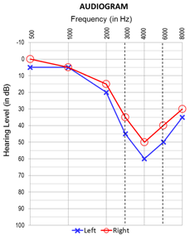
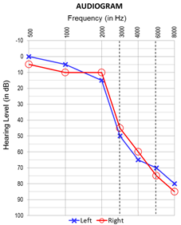
Pure Tone Air Conduction Threshold Testing

Slide 4
Definitions
Threshold of hearing
The lowest level of sound a person can hear in a series of ascending, pure tone presentation trials at least 50% of the time
Audiometric Zero (0 dB HL)
The sound pressure level at which the threshold of audibility occurs for average normal listeners
Audiogram
A record of an individual’s hearing sensitivity
For occupational testing, a record of the pure-tone air-conducting hearing threshold levels

Slide 5
Definitions
Significant/Standard Threshold Shift (STS)
An average change of plus or minus 10 dB at 2000, 3000, and 4000 Hz, relative to the reference audiogram, in either ear, without age corrections (DoDI 6055.12)
Temporary Threshold Shift (TTS)
An STS that resolves on follow-up test after auditory rest (≥14 hours)
Permanent Threshold Shift (PTS)
An STS that doesn’t resolve on follow-up testing after auditory rest (≥14 hours)
Confirmed by an audiologist or physician (Professional Supervisor)

Slide 6
Definitions
Early Warning Shift (EWS)
A difference of plus 15 dB at 1000, 2000, 3000, and 4000 Hz, relative to the reference audiogram, in either ear, without an STS.
If an STS is present in the same ear, the STS takes precedence

Slide 7
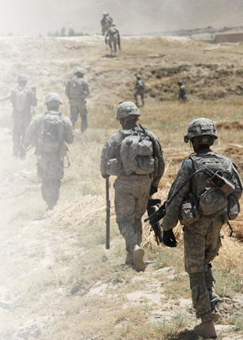
Audiometry Testing
Comply with Federal, DoD and Service specific regulations
Monitor the effectiveness of the local hearing program
Identify significant threshold shift(s) in hearing level
Process medical referrals for proper diagnoses
Establish individual’s fitness for duty
Notes:
Image: Defense Imagery Digest www.defenseimagery.mil

Slide 8
Audiometric Monitoring
Purpose: conduct routine hearing tests to identify changes in hearing related to noise exposure
Creation of initial baseline hearing thresholds
DD Form 2215 required for all military and all DoD civilians exposed to hazardous noise (HCP Stressors)
Determine disposition, referral needs, and fitness for duty
Baseline re-establishment
Termination - removal from the HCP
Notes:
Reference audiogram - required of all military, and civilian personnel in the HCP; obtained during first 30 days of employment.
DD 2216 – Annual, Required of all military and civilian personnel routinely exposed to noise, and all Army/USMC military; enrollment in HCP.
DD 2216 current test compared to reference audiogram to determine if a change (STS) has occurred.

Slide 9
Audiogram Testing
Service members are at a much greater risk for noise-induced hearing loss compared to the general population
Noise induced hearing loss is a bloodless/painless injury
Hearing tests are a reliable way to identify a noise induced injury
Early identification is the goal
Identified earlier, the injury is easier to halt hearing loss progression
Enables access to preventive/rehabilitative services
Limits permanent impact on career/job performance

Slide 10
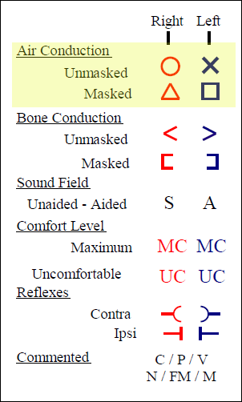
Types of Audiogram Recordings (Graphic)
Graphic representation of hearing thresholds
Frequency and intensity
Symbols to represent right ear, left ear, bone conduction and masked thresholds (legend)
Frequently used in a clinical/diagnostic setting

Slide 11
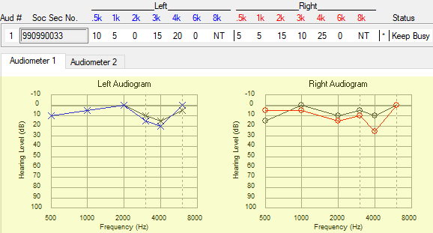
Types of Audiogram Recordings Graphic (highlighted portion)
Thresholds are measured and recorded in 5 dB increments
Notes:
In student database, 990990033, Annual test (December 2019)

Slide 12
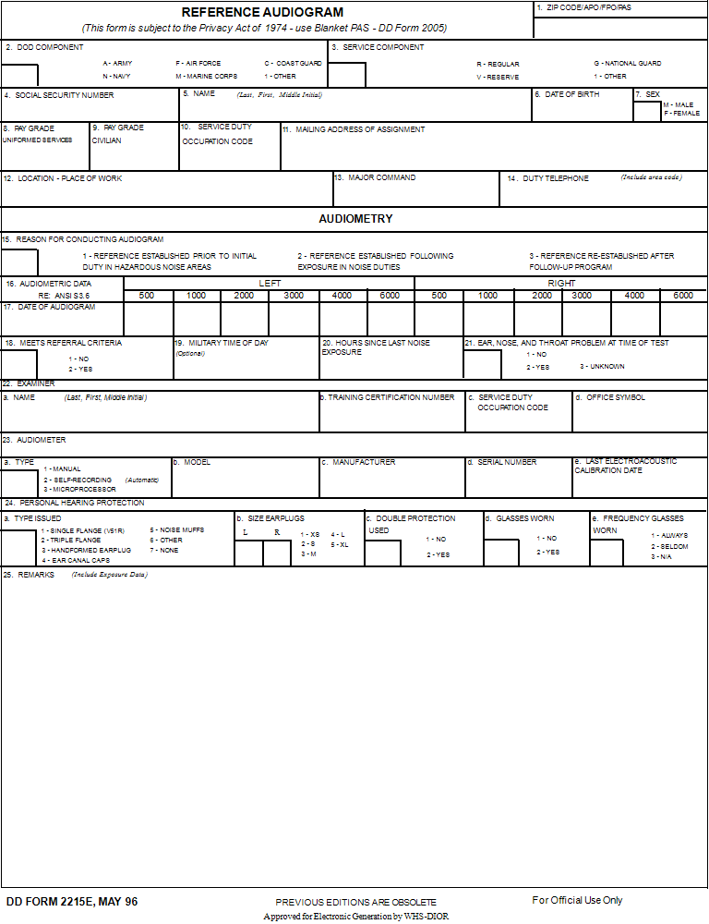
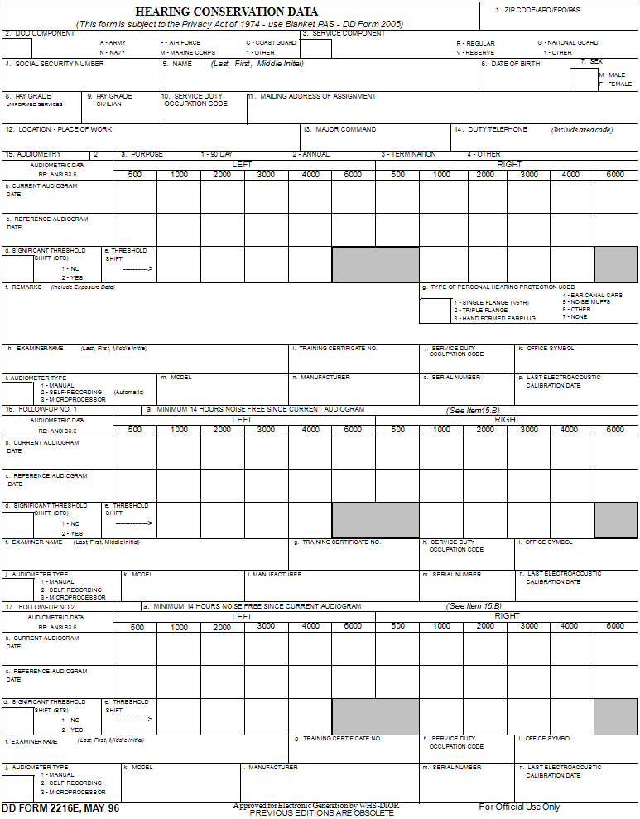
DD Form 2215/2216 (Serial Audiograms)

Slide 13
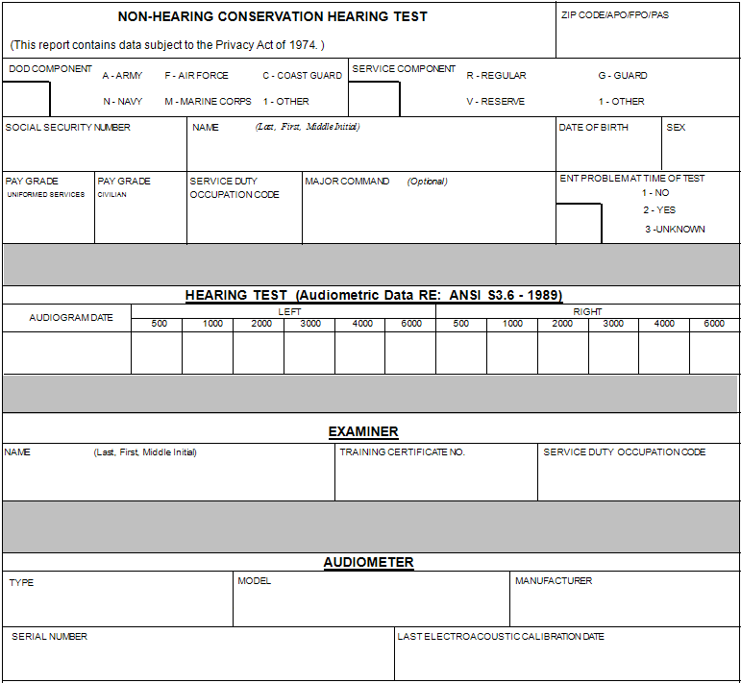
Non-Hearing Conservation (Serial Audiogram)
Notes:
Does not have a form number
Personnel that are not in the HCP: pre-employment, non-DoD employees or not associated with DoD

Slide 14
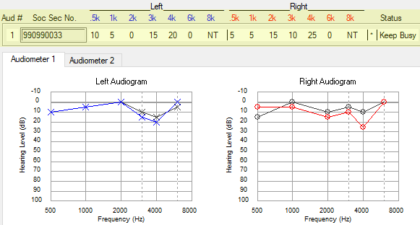
Types of Audiogram Recordings Serial/Numeric (highlighted portion)
Used on DD 2215, DD 2216 and Non-Hearing Conservation tests
Notes:
In student database, 990990033, Annual test (December 2019)

Slide 15
Required Field/Sub-Field Information (DOEHRS-HC Audiogram)
Examiner information
Comes from user logged into DOEHRS-HC
Name, certification number, SDOC, office symbol
Date/Time of test
Auto entered from date/time on computer
Audiometer
Auto created from calibration baseline/saved audiometer
Make, model, serial number, calibration date, facility
Type - microprocessor or manual (selected by technician)

Slide 16
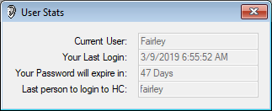
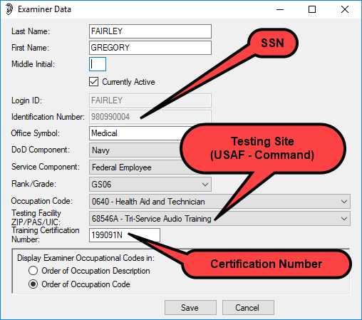
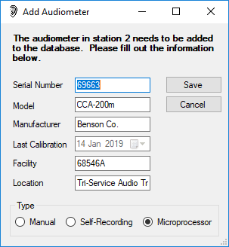
Audiogram DOEHRS-HC Sub Fields
Audiometer (saved/created with calibrations)
Examiner key fields (logged in user)

Slide 17
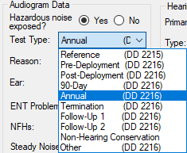
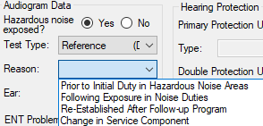
Audiogram Test Selection
Very important that the technician select the correct test type
Correct test type selection will ensure correct patient counseling/training
Test type changes once records has been exported to the DR cannot be locally accomplished
Notes:
Review of the test types are on the following slides; ensure students understand they need to know when to do what type of test.

Slide 18
DD Form 2215 Reference (Baseline) Audiogram
Required for all military and noise exposed civilians
Patient must be 14 hours noise free
Should be obtained prior to noise exposure, but at least within 30 days of employment
No ENT (Ear, Nose and Throat) problems the day of the test
OSHA allows 6 months and up to 1 year, if using a mobile testing service
Reference required (comparison) for all periodic exams (DD Form 2216 tests)
Referral may be generated depending on the threshold results and reference reason
Notes:
OSHA requires use of hearing protection at 85 dBA TWA until a baseline is obtained; once baseline is obtained, exposure level for required HPD use increases to 90 dBA TWA. If a referral is generated by test selection you may not want to create the 2215, example - masking requirement is present (possible invalid thresholds)

Slide 19
DD Form 2215 Reference Audiogram Reasons
Prior to initial duties in noise hazardous areas
Type 1 (< 30 days hazardous noise exposure)
Following exposure in noise duties
Type 2 (> 30 days hazardous noise exposure)
Re-established after follow-up program
Type 3 (over rides previous references - ear specific)
Change in service component (break in service)
Type 4 (over rides previous references)
Type 0 (non-2215) is inputted if DOEHRS-HC DR is down or at a non-internet connected testing site

Slide 20
DD Form 2215 Reference Audiogram Reasons
Very important that the technician selects the correct reason when a 2215 test type is conducted
All future 2216 tests will compare to the earliest electronic reference audiogram within DOEHRS-HC
Only type 3 or 4 reference audiograms can over-ride this application policy
Reason type 1 or 2 tests are completed as the initial reference for all military personnel or civilians in the HCP

Slide 21
DD Form 2215 Reference Audiogram Reasons
Reason type 3 are only used if the patient has an STS on the previous test series
Only reference reason that could be single ear
May require an electronic remark for re-establishment authorization (SOP, audiologist) or who is entering the data (manual entry)
Reason type 4 is only used if a previous reference is present in DOEHRS-HC and the patient has had a career change (military/civilian) or break in service
Takes the place of a type 1 or 2 so future 2216 tests can be compared to this 2215
Notes:
Re-enforce an electronic remark for all type 3 re-establishments; re-established per… or input by if transcribing results from an audiologist evaluation

Slide 22
Reference Reason Selection
Technician is required to make a decision on the test type and/or reason
Has to be knowledgably on selection to negate future testing data errors
Data may be transferred to medical readiness applications
Notes:
If the wrong reference test reason is selected, future 2216 tests may not be compared to the correct 2215

Slide 23
DD Form 2216 Monitoring Audiograms Types
Requires a reference audiogram for comparison
Annual
Pre and Post-Deployment
Termination
90 Day
Other
Follow-up 1 and 2
Notes:
Images: Defense Imagery Digest www.defenseimagery.mil
Review when to do each type of 2216
Follow-up 1 or 2 are the only 2216 tests that can be single ear; requires STS on previous test within follow-up time frame

Slide 24
DD Form 2216 Selection
Technician has to be knowledgably on test selection to negate future testing data errors
Identifies STS/EWS and referral criteria
STS/EWS require patient signature on the 2216

Slide 25
DD Form 2216 Selection
Selection of a 2216 test type requires a reference audiogram
If a reference audiogram is not in the local database, a type 0 reference is required to be entered in the run test window
Type 0 references come from a DD Form 2215 only
Date and thresholds are entered for DD Form 2216 comparison
Never enter a type 0 reference from a physical, NHC or a MEPS audiogram
If connected to the internet and DOEHRS DR is accessible, ensure patient SSN is correct

Slide 26
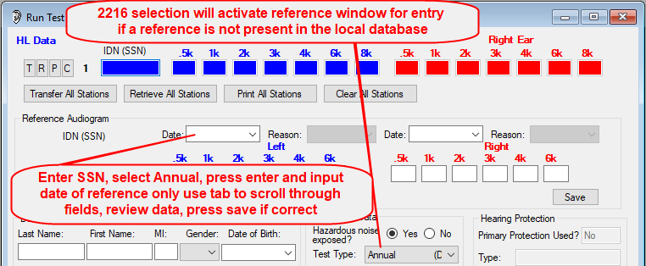
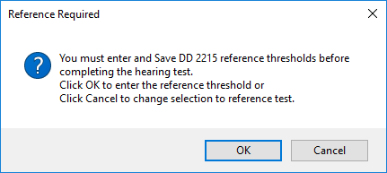
Reference Audiogram Type 0
If students have a DD Form 2215, enter their own SSN, select test type of annual and enter their own reference audiograms
Notes:
Ensure when entering type 0 reference data, do not use the calendar function, it will enter a time stamp from the local computer
Use the tab to go from one date field to the other or the date may change between ears
Verify all information prior to saving type 0 reference

Slide 27
DD Form 2216 - Follow-up Testing
Follow-up test selection can only occur if a patient has an +/- STS on the initial 2216 or for a follow-up 2 test a +STS on follow-up 1 and the follow-up testing window has not expired
Only the most recent test results will be reflected in the DD Form 2216 remarks section
Negative STSs do not have a noise free requirement
Positive STSs have a 14 noise free requirement
If a positive and a negative STS exists, check headphone placement/auditory history

Slide 28
DD Form 2216 - Follow-up Testing Negative STS
Thresholds are better than the reference
Normally occurs early in the audiometric history
Review the audiometric summary
Was the baseline recent or re-established by an audiologist
Is there a masking requirement
If the reference is probably invalid immediately re-test the ear that had the negative STS
If the negative STS is confirmed on follow-up 1, software will re-establish the baseline (ear specific)

Slide 29
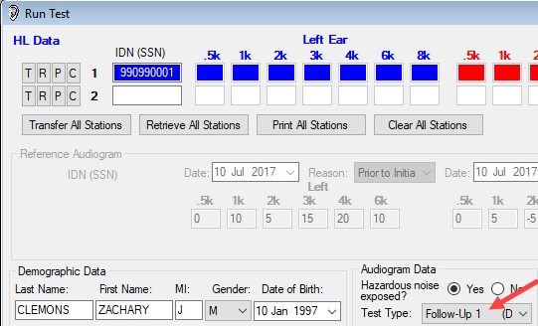
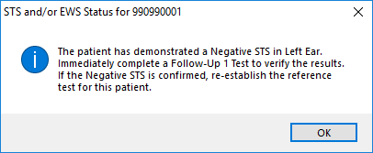
DD Form 2216 - Follow-up Testing Negative STS - Follow up 1
Clear Run Test station after initial 2216 test, input SSN and Follow-up 1 test will be auto-selected
Notes:
In student database, 990990001, Annual test December 2019, identifies negative STS left ear; follow-up 1 confirms the negative STS; baseline for left ear re-established 1 minute after series. Have student view in their own database, in the edit audiogram window.

Slide 30
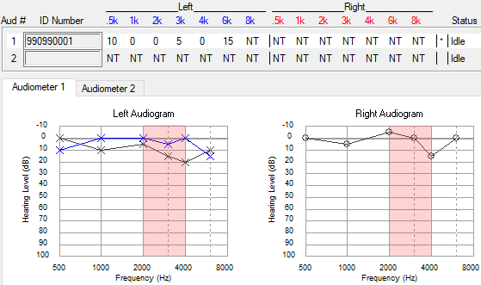
DD Form 2216 - Follow-up Testing Negative STS - Follow up 1 Confirmed
Notes:
In student database, 990990001, Annual test dated December 2019, identifies negative STS left ear; follow-up 1 confirms the negative STS; baseline for left ear automatically re-established 1 minute post test series.

Slide 31
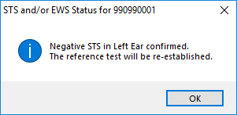
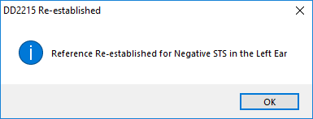
Run Test Retrieval on Follow-up 1
If the negative STS is confirmed on the Follow-up 1 retrieval DOEHRS-HC will auto re-established the baseline
Review patient history prior to conducting any follow-up testing for a negative STS

Slide 32
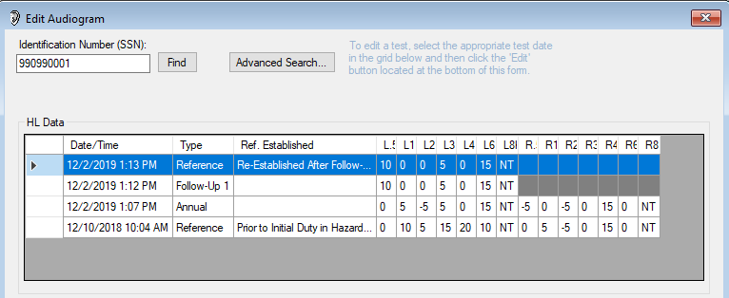
DD Form 2216 - Follow-up Testing Negative STS Confirmed Auto Re-established Baseline
Notes:
Student can look at data in their own database, viewing the 990990001 DD Form 2216 initial, follow-up and re-established baseline in the edit audiogram window to observe/review

Slide 33
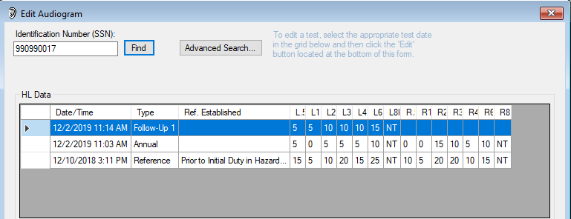
DD Form 2216 - Follow-up Testing Negative STS - Follow up 1 Resolved
Notes:
Student can look at data in their own database, viewing the 990990017 DD Form 2216 initial, follow-up in the edit audiogram window to observe/review

Slide 34
DD Form 2216 - Follow-up Testing Positive STS
Thresholds are worse than the reference
Requires 14 noise free hours
Cannot be done the same day as the initial 2216 test
Follow-up 1 and Follow-up 2 can be accomplished on the same day (ear specific)
If conductive issues (ENT) are suspected, consider referring to a medical provider prior to conducting further testing

Slide 35
Follow up Testing Scheduling
Time frames for follow-up testing
From initial audiogram on the 2216
30 days – all civilians and USAF Regular
60 days – USAF Reserves and National Guard
90 – All USA, USN, USMC military
Do not mention time frame for return to patients
Question them on the earliest they can return noise free

Slide 36
DD Form 2216 - Follow-up Testing Positive STS (TTS)
If the STS resolves on the Follow-up 1 (TTS after auditory rest) Follow-up 2 cannot be accomplished
Counsel/Educate
Refit HPDs (patient may not be wearing them properly or they are the wrong size)
Return in a year
If the STS is still present on the Follow-up 1, complete a Follow-up 2 test
If the STS resolved on Follow-up 2
Follow instructions as above

Slide 37
DD Form 2216 - Follow-up Testing Positive STS - Follow up 1 Resolved Early Warning Shift (EWS)
Notes:
Student can look at data in their own database, viewing the 990990018 DD Form 2216 initial and follow-up tests in the edit audiogram window to observe/review If an STS and an EWS are both present the STS takes precedence

Slide 38
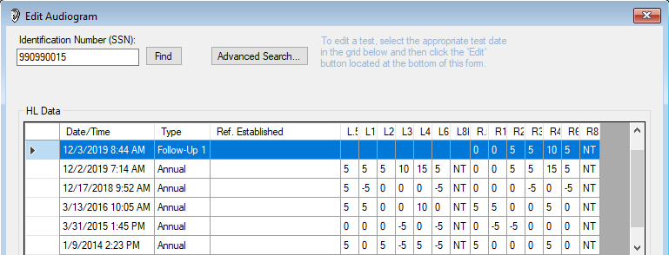
DD Form 2216 - Follow-up Testing Positive STS - Follow up 1 Confirmed
Notes:
Student can look at data in their own database, viewing the 990990015 DD Form 2216 initial and follow-up tests in the edit audiogram window to observe/review

Slide 39
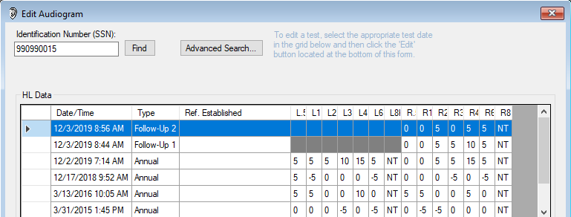
DD Form 2216 - Follow-up Testing Positive STS - Follow up 2 Resolved
Notes:
Student can look at data in their own database, viewing the 990990015 DD Form 2216 initial and follow-up tests in the print window to observe/review

Slide 40
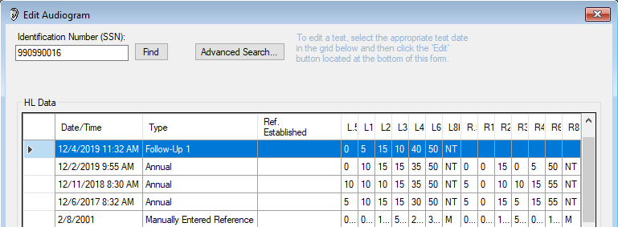
DD Form 2216 - Follow-up Testing Positive STS - Follow up 1 Confirmed
Notes:
Student can look at data in their own database, viewing the 990990016 DD Form 2216 initial and follow-up tests in the edit audiogram window to observe/review

Slide 41
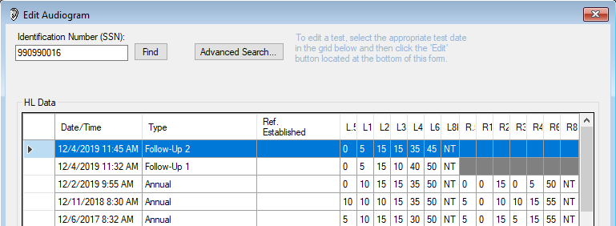
DD Form 2216 - Follow-up Testing Positive STS - Follow up 2 Confirmed
Notes:
Student can look at data in their own database, viewing the 990990016 DD Form 2216 initial and follow-up tests in the edit audiogram window to observe/review

Slide 42
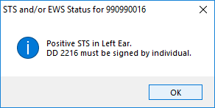
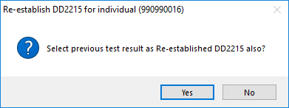
DD Form 2216 - Follow-up 2 Test Positive STS Confirmed
Application will ask if re-establishment using previous test results is requested
Always select “No” unless you have been authorized to re-establish baselines

Slide 43
DD Form 2216 - Follow-up Testing Positive STS (PTS)
If the STS is still present on the Follow-up 2
Refer to the proper echelon of care (PS - Professional Supervisor) for evaluation or administrative processing
Only re-establish baselines that you are authorized to
With the approval of the PS, follow-up test or audiological evaluation results may be used to create a (type 3) re-established reference
Add an electronic remark on the 2215 with who (PS) or what (SOP) authorized the baseline re-establishment

Slide 44
Non-Hearing Conservation Test
Performed on individuals who are not enrolled in the Hearing Program
Physical, Pre-commissioning, Separation History and Physical Examination (SHPE), Non-DoD employees, Etc.
Performed on individuals requesting a hearing test before their periodic evaluation who are concerned about changes in hearing due to possible illness, medical condition, etc.
Consult with Professional Supervisor to determine how these encounters should be handled
Notes:
SHPE added as an electronic remark for USAF military personnel who are leaving the service and may not have a DD Form 2215

Slide 45
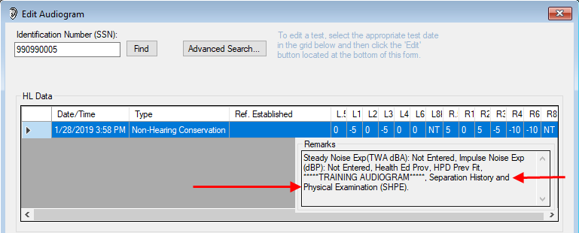
Non-Hearing Conservation Test
Patient history
Notes:
Student can look at data in their own database, viewing the 990990005 NHC in the edit audiogram window to observe/review, SHPE, Separation History and Physical Examination

Slide 46
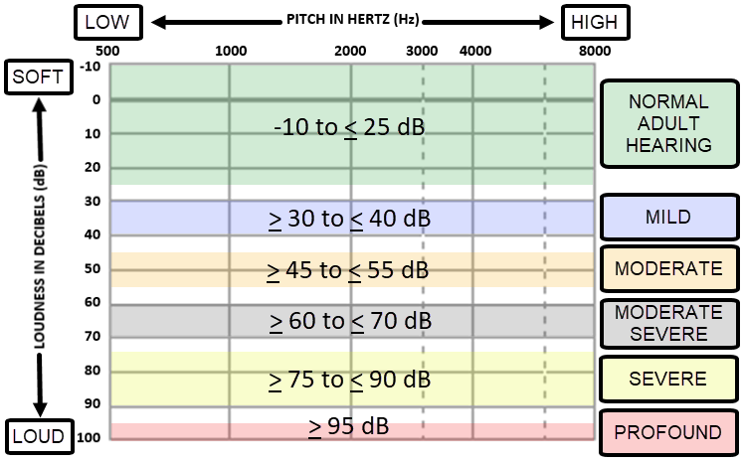
Degree of Hearing Loss
Notes:
Graphic created by USN

Slide 47
Post-Audiometric Testing Review
Technician is required to counsel patient on results
Early warning shift (EWS)
Change in hearing, Significant/Standard Threshold Shift (STS) return for follow-up testing
Temporary Threshold Shift (TTS)
Permanent Threshold Shift (PTS)
Process automated referrals
Create referrals for conductive or other issues
Physician
Audiologist

Slide 48
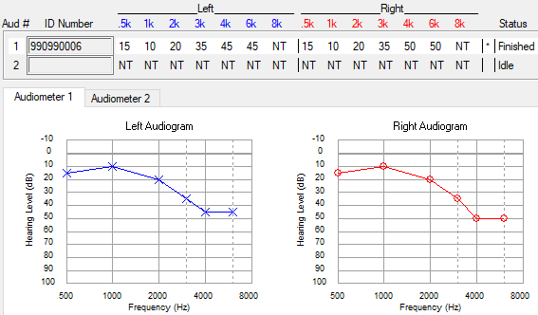
Audiometric Configurations Sloping High Frequency Hearing Loss
Notes:
Most common audiometric configuration
Associated with aging (Presbycusis), ototoxicity, diseases (meningitis, measles), and can be congenital
Audiogram in local database under 990990006, 2215 and 2216 same date (December 2019)

Slide 49
High Frequency Hearing Loss Notched - Noise Induced Hearing Loss
Notes:
Noise Notch often first observed at 4000 Hz, but could begin at 3000 Hz or 6000 Hz; Hearing loss spreads to adjacent frequencies as noise exposure continues
Audiogram in local database under 990990007, 2215 and 2216 (December 2019)

Slide 50
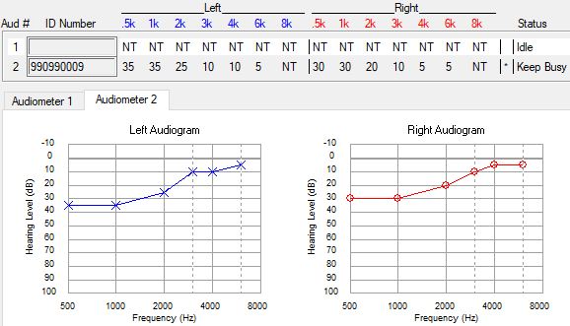
Low Frequency Hearing Loss Rising Audiometric Configuration
Notes:
Can be caused by ear disease or middle ear dysfunction (Conductive issues - Otoscopic Exam)
Audiogram in local database under 990990009, (December 2019) 2215 (Created a Low Frequency Hearing Loss Referral) and 2216 (no referral)
Technician should never establish or re-establish baseline until conductive issues are resolved

Slide 51
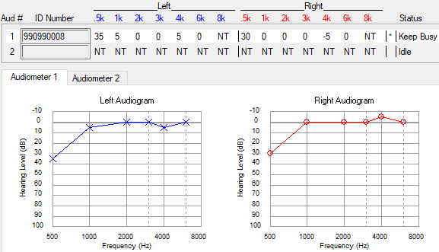
Low Frequency Hearing Loss Rising Audiometric Configuration
Notes:
Can occur as a result of background noise; 500 Hz threshold will often be elevated in these instances
Audiogram in local database under 990990008, (December 2019) 2215 and 2216

Slide 52
Audiogram Considerations Problem Audiograms - Cross Over
Can occur when a ≥ 40 dB difference in thresholds exists between ears at a given frequency
Sound energy from the test ear stimulates the non-test ear causing non-test ear to respond to the stimulus
DOEHRS-HC performs an automatic re-check when threshold difference is ≥ 40 dB between ears at a given frequency
If difference confirmed, DOEHRS-HC will generate a referral
Notes:
Technician should never establish or re-establish baseline at their level

Slide 53
Audiogram Considerations Problem Audiograms - Masking
Performed during diagnostic hearing evaluation when cross-over is suspected
Masking noise presented in the non-test ear while thresholds are being recorded for test ear
Prevents the non-test ear from detecting the sound presented to the test ear
DOEHRS-HC will generate a referral if masking is required
Follow PS guidance on automated referrals for masking
Notes:
Technician should never establish or re-establish baseline at their level

Slide 54
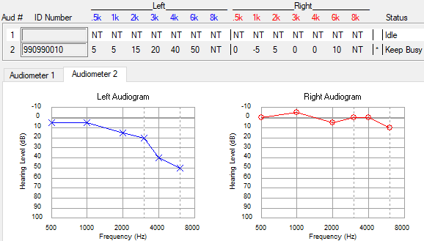
Audiometric Configurations Unilateral Hearing Loss
Notes:
Hearing loss in one ear; other ear is normal
May be associated with unilateral noise exposure, sudden SNHL, or acoustic neuroma/vestibular schwannoma
Always considered a problem audiogram; audiogram should always be reviewed by Professional Supervisor
Audiogram in local database under 990990010, (December 2019) 2215 and 2216 (Created an Asymmetric Hearing Loss and Masking Required Referral)
Technician should never establish or re-establish baseline with a masking requirement without approval of an audiologist.

Slide 55
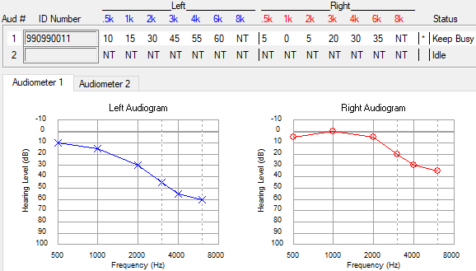
Audiometric Configurations Asymmetrical Hearing Loss
Notes:
Hearing loss in both ears, thresholds in one ear are better than thresholds in the opposite ear
May be associated with unilateral noise exposure, sudden SNHL, or acoustic neuroma/vestibular schwannoma
Always considered a problem audiogram; Audiogram should always be reviewed by Professional Supervisor
Audiogram in local database under 990990011, (December 2019) 2215 (Created an Asymmetric Hearing Loss and High Frequency Hearing Loss Referral) and 2216 (Created an Asymmetric Hearing Loss Referral)
Technician should never establish or re-establish baseline with a masking requirement without approval of an audiologist.

Slide 56
Audiogram Considerations Problem Audiograms Functional and/or Non-Organic HL
Lack of crossover
Flat audiogram
Inconsistent responses
Behavior
Known motivation
50 dB or above
Notes:
Crossover occurs around 40-45 dB; lack of cross over patient may have a much higher variance between ears

Slide 57
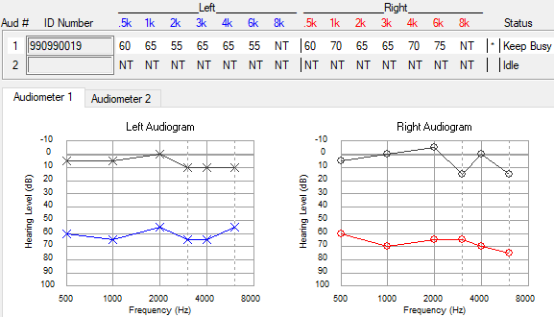
Audiometric Configurations Flat Hearing Loss
Notes:
Thresholds are approximately the same across the test frequencies – Mixed hearing loss
Common audiometric configuration of non-organic hearing loss/malingering; Have it reviewed by PS
Audiogram in local database under 990990019, (December 2019) 2216 – Termination, Follow up 1 and 2 with re-established baseline
Ask students, should the baseline have been re-established by the technician?

Slide 58
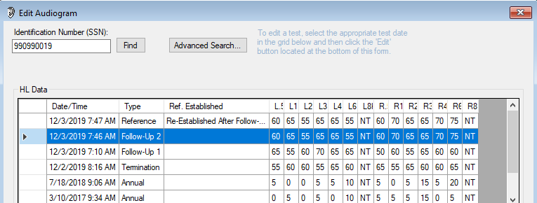
Audiometric Configurations Flat Hearing Loss
Should the baseline have been re-established by technician?
Notes:
Thresholds are approximately the same across the test frequencies - Mixed hearing loss Inconsistent responses
Common audiometric configuration of non-organic hearing loss/malingering; Have it reviewed by PS
Audiogram in local database under 990990019, 2216 – Termination, Follow up 1 and 2 with re-established baseline

Slide 59
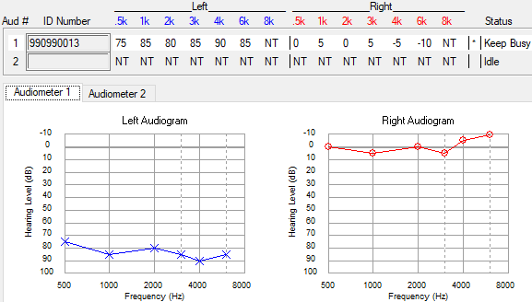
Audiometric Configurations Asymmetric Flat Hearing Loss
Notes:
Thresholds are approximately the same across the test frequencies – one ear
Common audiometric configuration of non-organic hearing loss/malingering
Have it reviewed by PS; Technician should never establish or re-establish baseline at their level
Audiogram in local database under 990990013, (December 2019) 2215 (Created High Frequency Hearing Loss, Low Frequency Hearing Loss, Asymmetric Loss, Masking Required Referral) and 2216 (Created an Asymmetric Loss, Masking Required Referral)

Slide 60
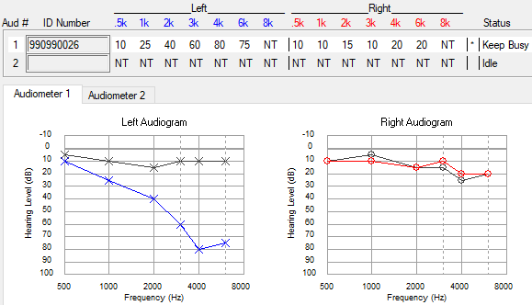
Sudden Hearing Loss Always a Medical Emergency
Get patient evaluated the same day
If sensorineural, time to treatment is critical
Notes:
Audiogram in local database under 990990026, Annual (December 2019)

Slide 61
Audiogram Referrals
DOEHRS-HC referral flags - some are listed below
Positive STS - conduct Follow-up testing
Asymmetrical hearing loss
Low and/or high frequency hearing loss
Masking
Tinnitus
Fitness and Risk Evaluation
Review the audiometric history to determine what happened and what needs to occur
Notes:
Not limited to above issues

Slide 62
Audiogram Referrals
DOEHRS-HC may not create a referral but further examinations/care may need to occur
Conductive issues suspected - do an otoscopic examination and/or refer for evaluation/care
If Follow-up testing is required, delay until issue resolves
Notes:
Not limited to above issues

Slide 63
Profile Change
Pertains to military personnel only
Profile change does not auto generate a referral
Service Specific
Review the audiometric history
Determine if patient was previously evaluated
Refer to an audiologist if needed

Slide 64
Physical Profile Serial System (PULHES)
P = Physical capacity/stamina
U = Upper body
L = Lower body
H = Hearing and ears
Focused on hearing and any diseases of the ear
E = Eyes
S = Stability/Psychiatric

Slide 65
PULHES Numerical Grade System
1 = a high level of medical fitness; fully ​qualified
2 = possesses some medical condition or physical defect that may require some activity limitations
3 = one or more medical conditions or physical defects that may require significant limitations; may still be able to stay in the military with limited duties
4 = one or more medical conditions or physical defects of such severity that the performance of military duty must be drastically limited; disqualifier for continued military service

Slide 66
PULHES “H”
DOEHRS-HC test is not a diagnostic hearing test, a profile should not be created from this test alone
DOEHRS-HC tests indicate projected profiles
If a DOEHRS-HC test projects a profile of > H2, a referral for a diagnostic hearing evaluation is necessary (check audiometric history)
Hearing profiles will be documented IAW Service specific guidelines

Slide 67
Summary
Graphic/Serial audiogram
Patient demographic
Audiograms types
DD Form 2215
DD Form 2216
Follow-up testing
Non-Hearing Conservation test
Audiometric configurations
Problem Audiograms
Baseline re-establishment

Slide 68
Questions

