Slide 1
Hearing Program Team Roles
Department of Defense Hearing Program
Tri-Service Hearing Technician Certification Course

Slide 2
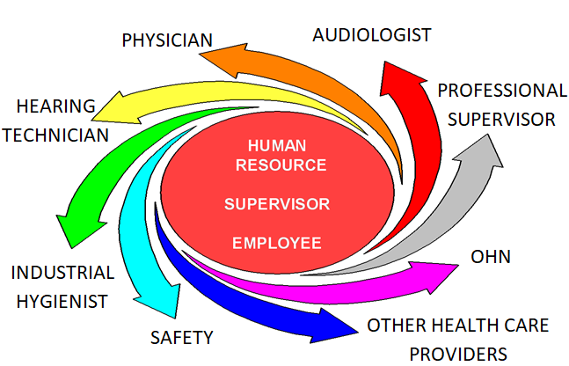
Learning Objectives
3.4.1 Identify and explain the roles of the key members of the Occupational Hearing Conservation (OHC) team

Slide 3
Team Members
Noise professionals
Industrial Hygienist (IH)
Bio-Environmental Engineers (BEE)
Audiologist
Occupational medicine physician
Flight medicine physician
Occupational health nurse
Occupational Hearing Conservationist (OHC) also known as hearing technician

Slide 4
Team Members
Leadership/Commanders
Safety officer
Workplace supervisor
Employee
Other personnel
Public Health
Professional Supervisor
Notes:
Team members may include the following, depending on the installation and the Service; team work together to address different aspects of the HCP, in their individual roles and scope of practice

Slide 5
Industrial Hygienist
Conduct noise surveys
Determine what type of work is performed by whom
Take sound level measurements of area & equipment
Take personal dosimetry when SLM measurements > 85 dBA
Analyze all noise data

Slide 6
Industrial Hygienist
Provide report to supervisor, Installation Safety Manager & Occupational Health
Sample results
Recommendations to the workplace supervisor regarding engineering and/or administrative controls
Noise hazard maps
Recommendations on hearing protection
Provide by-name roster of noise exposed personnel to Hearing Program Manager and/or Public Health
provide copy to Installation Safety Manager and workplace supervisor
Maintain information in DOEHRS-IH by Similar Exposure Groups (SEG)

Slide 7
Audiologist
Serve as the Professional Supervisor
Ensure hearing protection is fitted to all noise-exposed personnel
Ensure annual hearing health education is provided
Ensure monitoring audiometry (including follow-ups) are performed
Conduct diagnostic and fitness for duty evaluations
Ensure personnel performing audiograms are certified and maintain related skills
Report quality assurance and program effectiveness measures through command channels
Report STS and OSHA recordable hearing loss data
Conduct worksite/shop visits to ensure hearing readiness compliance

Slide 8
Occupational/Flight Medicine Physician
Determine if workers possess the minimum physical abilities required to perform essential duties
Conduct evaluations to detect signs and symptoms of noise-induced hearing loss at an early stage
Initiate fitness and risk evaluations and make medical recommendations
Determine if hearing shift is related to an ear, nose, throat condition
Determine appropriate additional referral criteria

Slide 9
Occupational Health Nurse
Client history/perform audiometric monitoring
Collaborate with industrial hygiene and safety
Enroll identified employees into the HCP
Provide health education - individual/group
Service/Site specific
Maintain log of OSHA recordable hearing loss
Develop and maintain OH SOP for the hearing conservation program
Conduct worksite/shop visits to ensure compliance

Slide 10
Occupational Hearing Conservationist (OHC)
Maintain current DoD hearing technician certification
Document/Coding in the electronic health record (EHR)
Recordkeeping
Equipment preparation
Equipment maintenance
Stocking and fitting of hearing protective devices
Notes:
OHC is the backbone of the HCP - you test 100% of the patient pool, educate/motivate
Recordkeeping - shop rosters, OSHA recordable, fitness & risk, STS/PTS, electroacoustic and daily calibrations, booth certifications
Equipment preparation - daily functional, biologic checks
Equipment maintenance - annual calibration, test booth maintenance

Slide 11
Occupational Hearing Conservationist (OHC)
Schedule hearing services (initial/follow-up)
Patient histories
Conduct audiometry
DOEHRS data entry
Audiogram test selection
Explanation of test results, counseling
Process referrals
Provide individual and group hearing health education
Notes:
Schedule hearing services - initial, follow-up testing, appointments
Patient histories - new/updates
Conduct audiometry - DD Form 2215/2216 and NHC (audiogram for personnel not in the HCP or pre-hires)

Slide 12
Commanders/Leadership
Ensure a comprehensive HCP is in place and resourced
Ensure workplaces and workplace supervisors comply with all HCP, DoD, and/or OSHA requirements
Ensure HCP personnel meet training requirements
Participate in the review of workplace hazards

Slide 13
Safety Officer
Ensure areas are posted with noise hazardous signs and equipment is posted with decals
Conducts spot inspections for HPDs availability and utilization
Chairs installation safety meetings
Accompanies HCP personnel on shop visits, contributes to fitness & risk evaluations
Maintain appropriate records
OSHA recordable hearing losses
Maintain rosters

Slide 14
Workplace Supervisor
Ensure personnel comply with all Service-level HCP, DoD, and/or OSHA requirements
Use recommendations for noise controls as the primary means of eliminating exposure
Mark hazardous noise areas and equipment
Maintain a supply of HPDs
Ensure personnel carry HPDs and wear them properly in hazardous noise areas
Update and maintain current rosters of personnel exposed to hazardous noise or in the HCP

Slide 15
Workplace Supervisor
Notify IH/BEE/PH personnel if workplace equipment, practices or procedures involving change to potentially hazardous noise
Ensure workers complete audiograms
Conduct/Document initial and annual workplace specific HC training
Notify each employee exposed at or above 8-hour TWA of 85 dBA
Notes:
IH = Industrial Hygiene; BEE = Bio-Environmental Engineer; PH = Public Health

Slide 16
Employee/Patient
Comply with all hazardous noise control measures
Maintain hearing protection devices (HPDs)
Always carry HPDs when working
Wear HPDs upon entering hazardous noise areas
Bring HPDs to the audiometric testing appointment
Attend all required audiometric evaluations
Report to supervisor any new or changes in operating procedures that affect workplace noise
Notes:
Hazardous noise control both at work and/or off-duty (non-occupational); Personnel due to environment hazards or ototoxic drugs may be in the HCP and not exposed to hazardous noise

Slide 17
Professional Supervisor
Defined as an audiologist or an appropriately trained physician
Establishment and supervision of an audiometric monitoring program
Management of an audiometric database
Review of problem audiograms
Determination of work-relatedness for hearing shifts and/or OSHA recordable hearing loss
Follow up of work-related auditory disorders
Perform program evaluation to monitor effectiveness

Slide 18
Summary
Noise professionals
Audiologist
Occupational and flight medicine physician
Occupational health nurse, occupational hearing conservationist
Leadership/Commanders, safety officer, workplace supervisor, employee
Other personnel

Slide 19
Questions

