Slide 1
Naval Aerospace Medical Institute
Aeromedical Electronic Resource Office (AERO)
trainer for
AVTs and Flight Surgeons

Slide 2
Using this Trainer
Advance slides WITH MOUSE CLICKS ONLY. If you use forward/ back keyboard buttons, space bar, or any other method of navigating the slides, the information presented here will not flow correctly and will be confusing.
This trainer is designed to be interactive.
Look for the Red text for prompts on how to proceed.
Most slides can be forwarded with mouse click. However, look for the buttons:
for prompts on how to proceed and flow from one training topic to another.

Slide 3
Flight Surgeon Role
Click on Role to begin Trainer
AVT Role
Your AERO Tools

Slide 4
AVT Role
Click the to jump to that section:
Introduction
Getting Started: Entering the patient into AERO,
and transcribing preliminary studies
Tracking Patient exams from AERO
AERO uses codes to identify Classes of Exams. You can review them here.

Slide 5
Introduction
AVT Role is called “NCOIC” in AERO
Purpose is to transcribe completed physical exams into AERO Program.
NCOIC Role CANNOT submit examinations to NAMI.
AVTs with NCOIC role must notify the Flight Surgeons that the patient is ready to be seen, once data entry is completed. There are no queues that the patient’s encounter will automatically flow into.

Slide 6
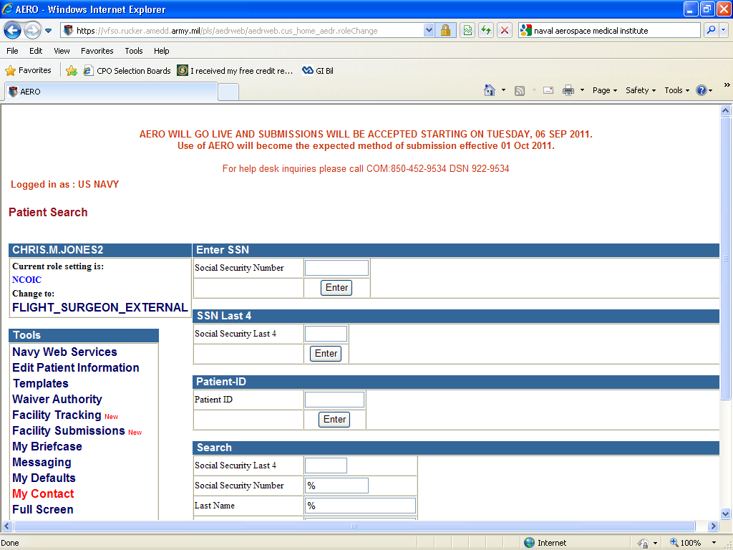
Entering Patients into AERO
-The Home Screen
--Confirm that you are “Logged in as US NAVY”
--If you have only 1 role, you will not have “Change to:”
--Enter the patient SSN. Click Enter

Slide 7
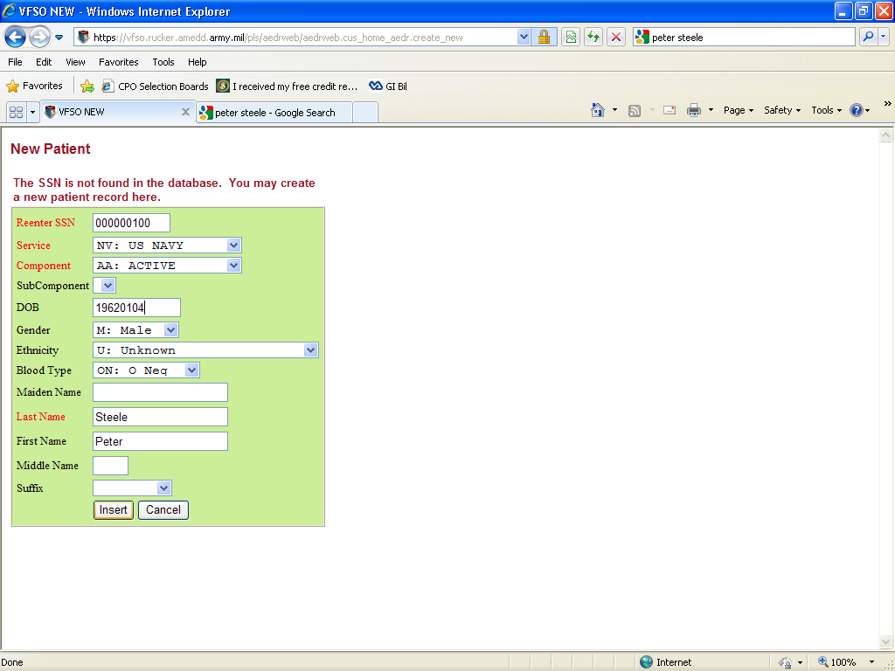
Entering Patients into AERO, cont…
-If this is a new patient, you will be taken to this screen to enter Patient information
--All dates entered into AERO must be in YYYYMMDD format
Click :Insert
(You will be asked to confirm branch of service after clicking "insert”)

Slide 8
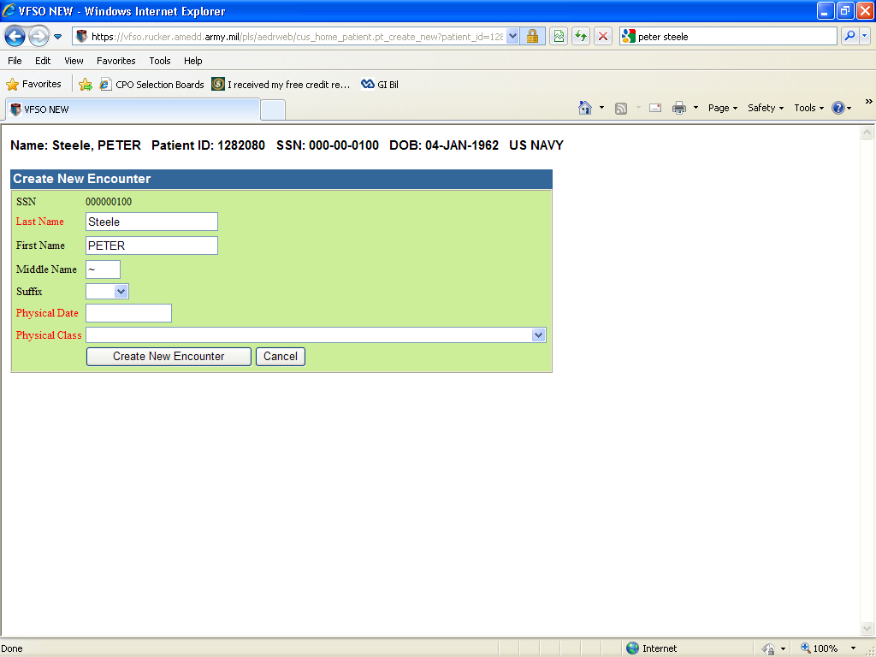
Entering Patients into AERO, cont…
Enter the pertinent data into the appropriate fields:

Slide 9
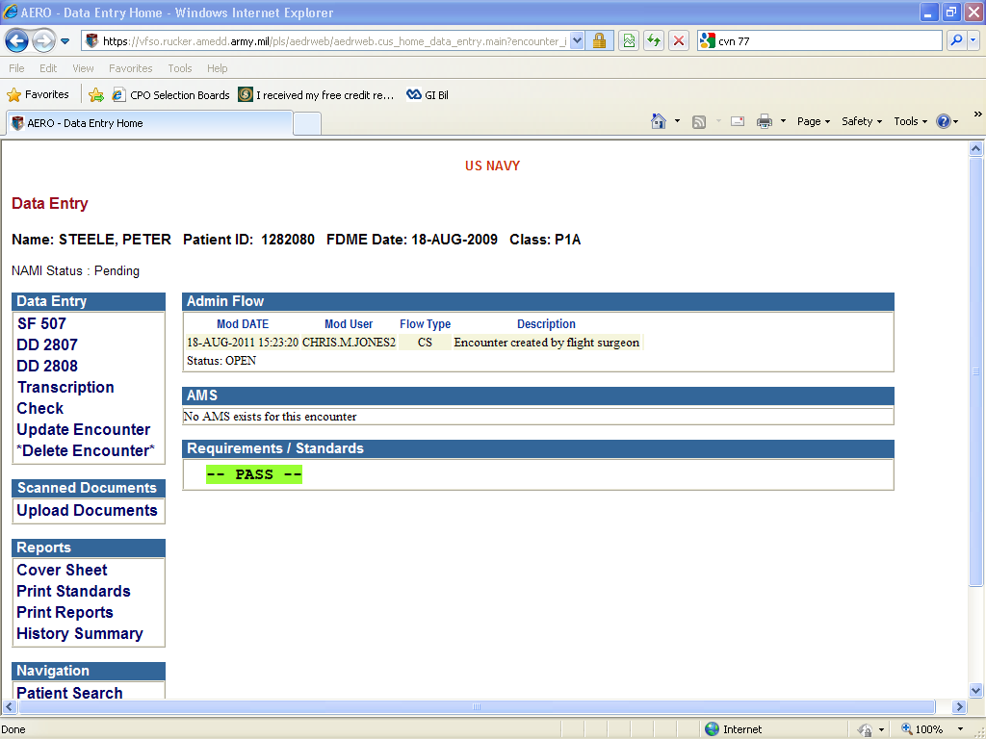
Entering Patients into AERO, cont…
From the exam, transcribe the data onto the forms here
The information will
correspond into AERO fairly accurately. To access each form, click the titles.
Or, if entering the data while performing the studies on the patient, you may want to use the “Transcription” option for data entry
Both methods will get the job done equally well.

Slide 10
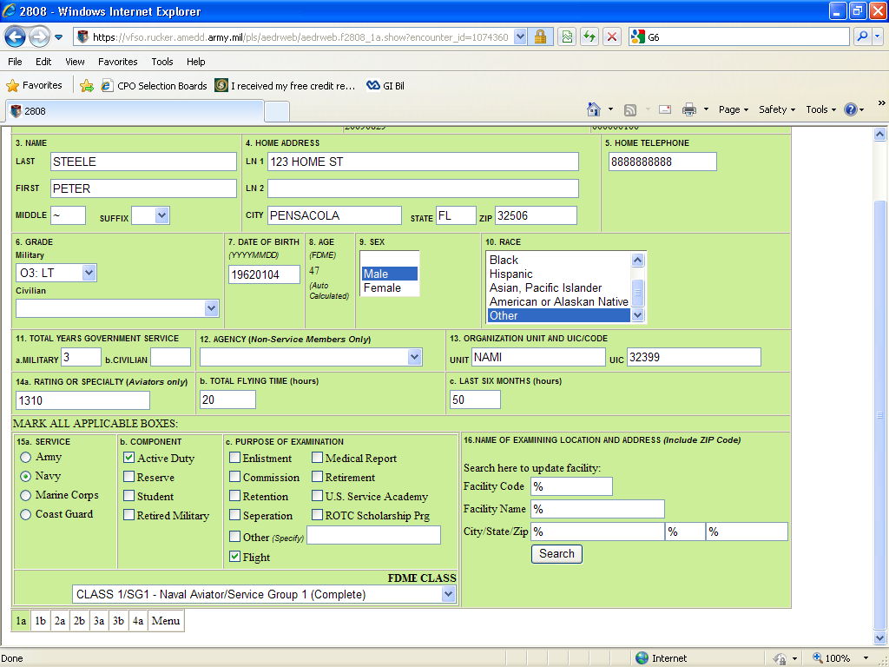
Entering Patients into AERO, cont…
One item to note: When entering patient data into the DD2808, on screen 1a, you may encounter some difficulty with finding the examining facility. The most efficient method to locate your clinic is to enter your Zip Code and select from the options.

Slide 11
Entering Patients into AERO, cont…
If everything is transcribed correctly, you will see:
NOTE: there is NO “submit”, “completed”, etc… button. AERO will automatically save your work for the submitting Flight Surgeon to review and endorse!
From here, make sure you pass this exam off to the Flight Surgeon to submit to NAMI. You can track by SSN, Name, or Patient ID

Slide 12
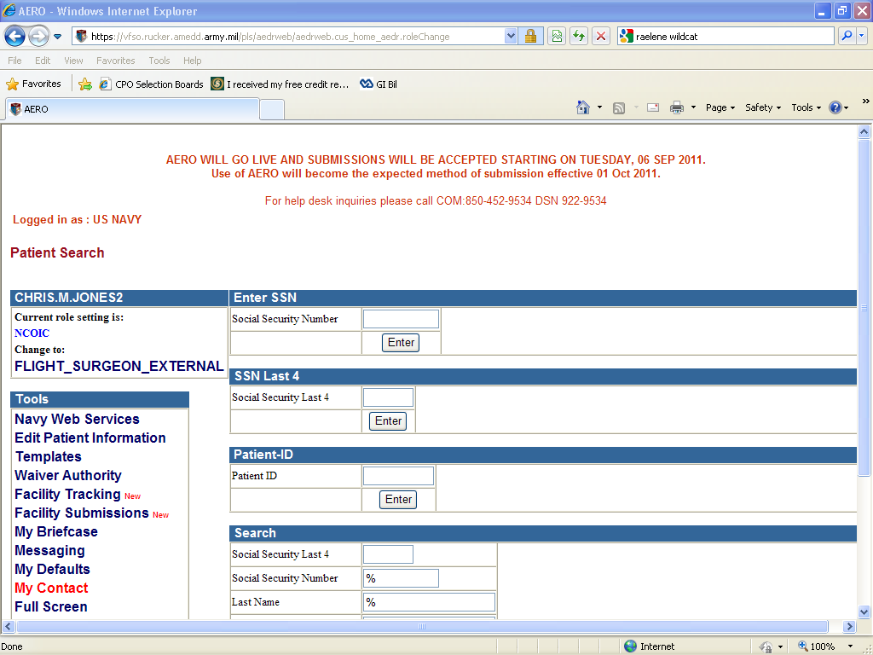
Tracking Patients
From the Home Screen:
Enter the Patient’s SSN, Click Enter
(Click enter to
continue trainer…)

Slide 13
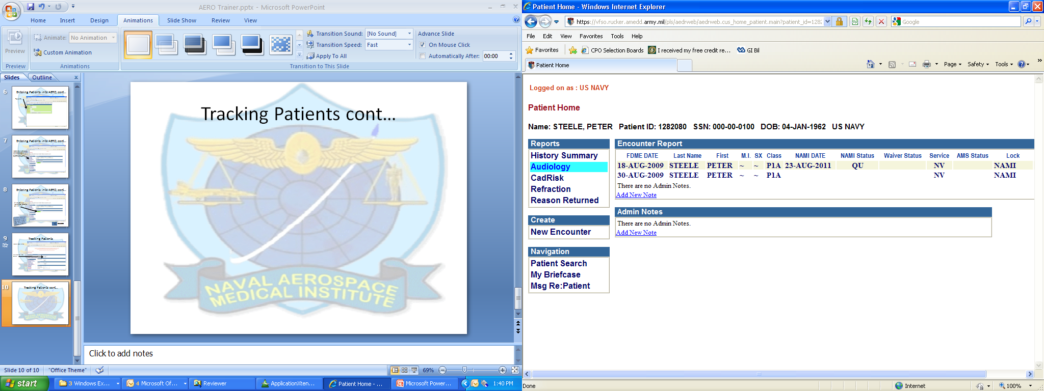
Tracking Patients cont…
There are 2 exams on file for this patient. One has had a response from NAMI, and the other is pending. (Click on the “QU” to see the Admin Flow)
NOTE: Classes of exams have AERO-specific names. Click here to view a list of Exams

Slide 14
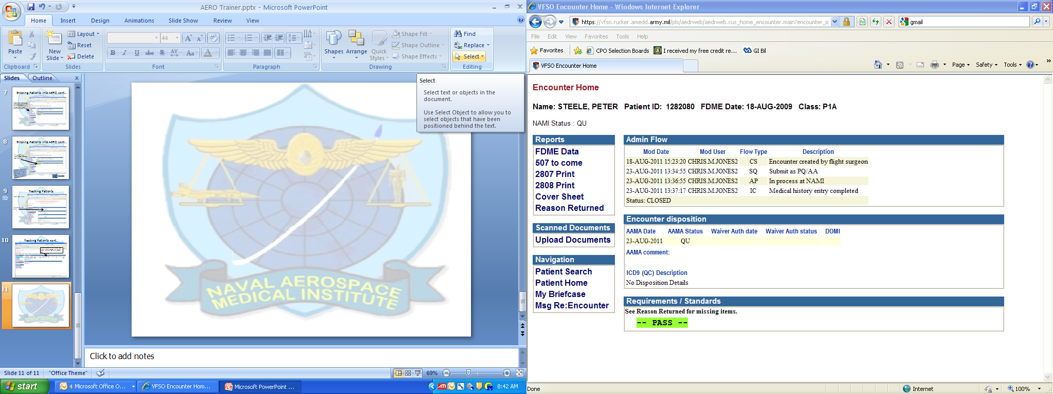
Here you can see the dates that the Exam was submitted, and the Admin Flow showing dates that the Reviewer at NAMI worked on it.

Slide 15
Flight Surgeon Role
Flight Surgeons are called “FLIGHT_SURGEON_EXTERNAL” in AERO.
-Only this Role can submit examinations to NAMI.
-Review AVT Role Trainer to learn the steps to transcribe data and
track patients in AERO.
-Flight Surgeons also create Aeromedical Summaries (AMS) using
the templates.
-Click here to search for your Facility. As is prone to happen,
another Flight Surgeon may deploy without being able to
complete all examinations started. To take control / cosign or
follow up on exams returned in a “DI” status, you will need to be
able to look up your facility’s submissions.
-AERO uses codes to identify Classes of Exams. You can review them here

Slide 16
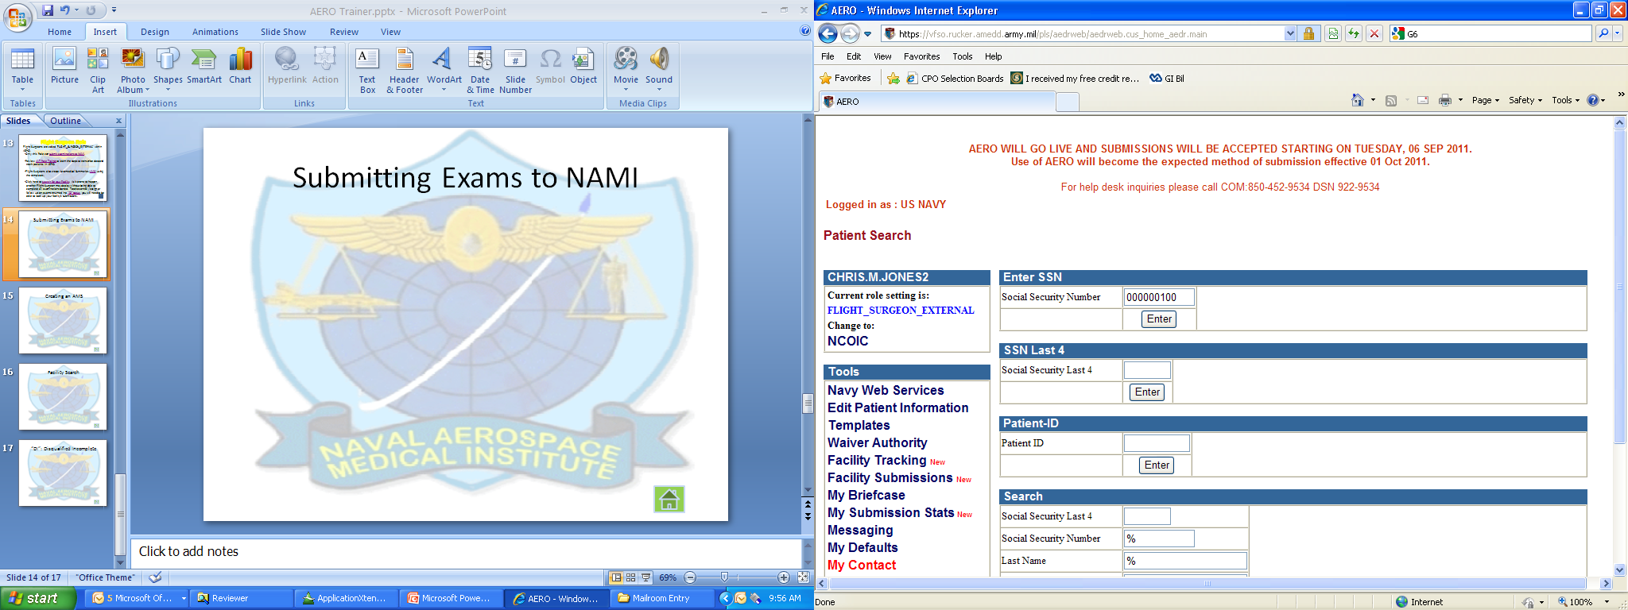
Submitting Exams to NAMI
To locate a patient, entering the full SSN is the most accurate method

Slide 17
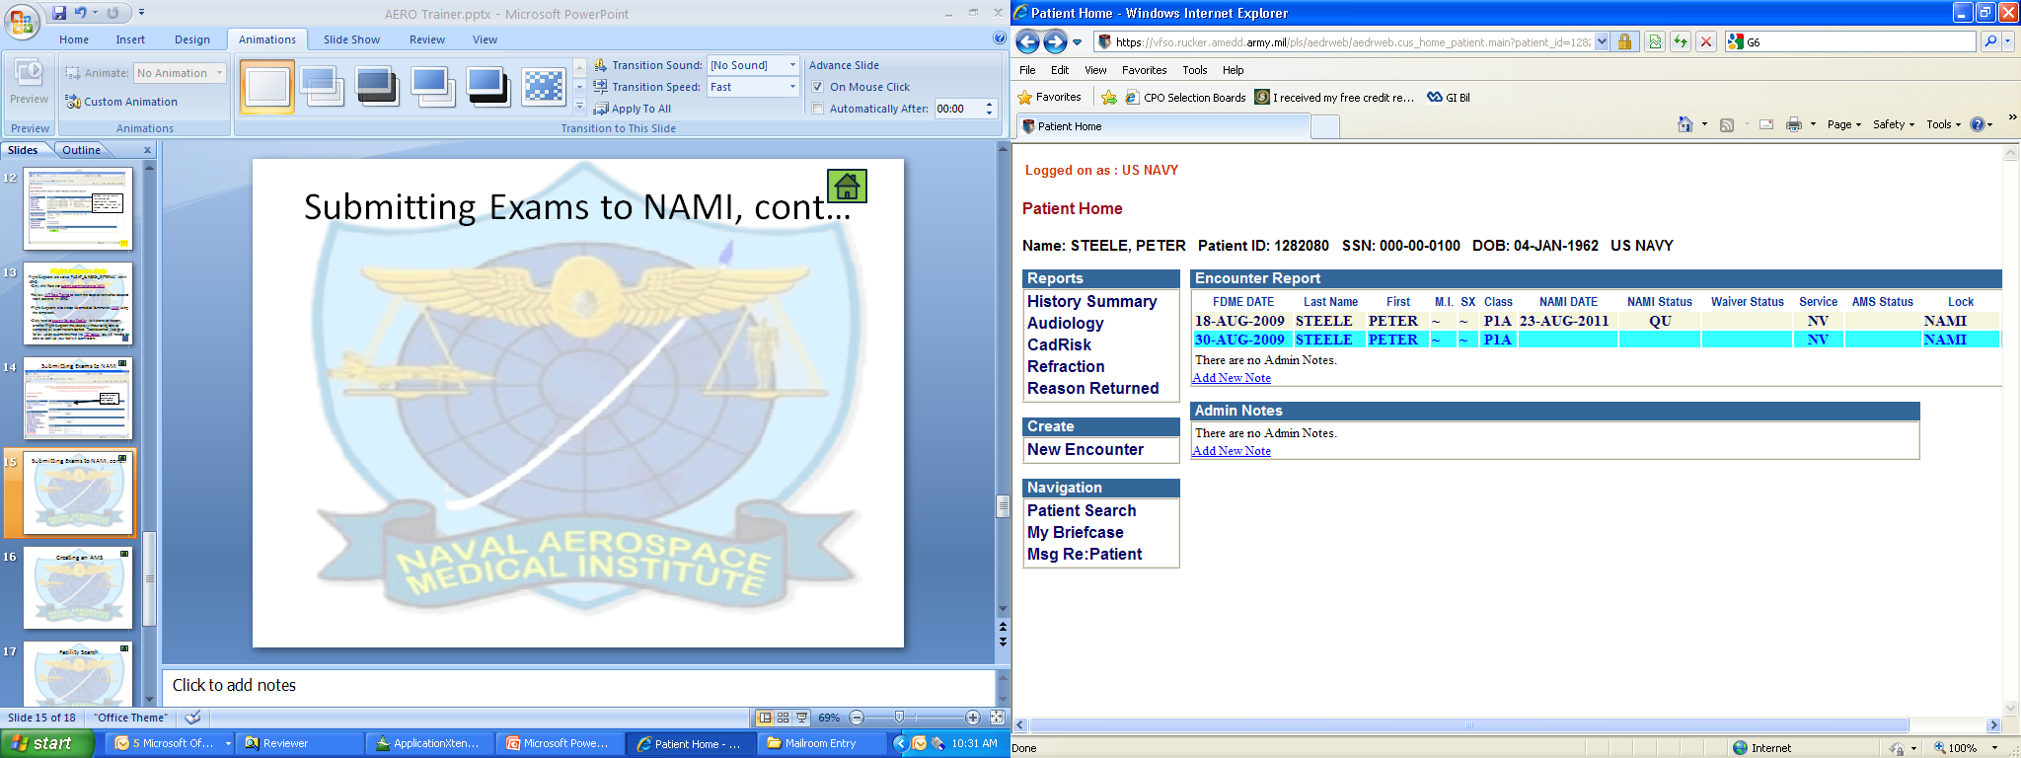
Submitting Exams to NAMI, cont…
For training purposes, we will proceed assuming that the AVT transcribed the data for you.
To cover start-to-finish data entry click on the Home button in the upper right corner and select “AVT Role Trainer” .
Once the preliminary studies are entered, proceed IAW the next slide.
Select the exam your AVT had entered the preliminary studies in…
or if you are entering the exam in entirety yourself, choose
New Encounter

Slide 18
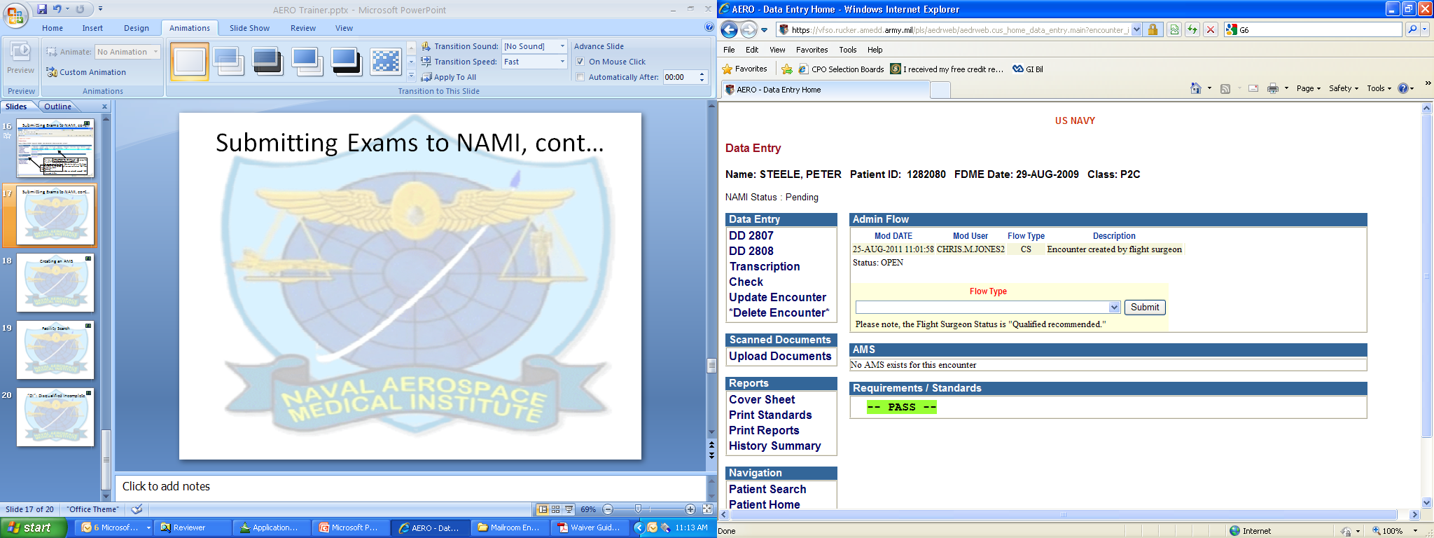
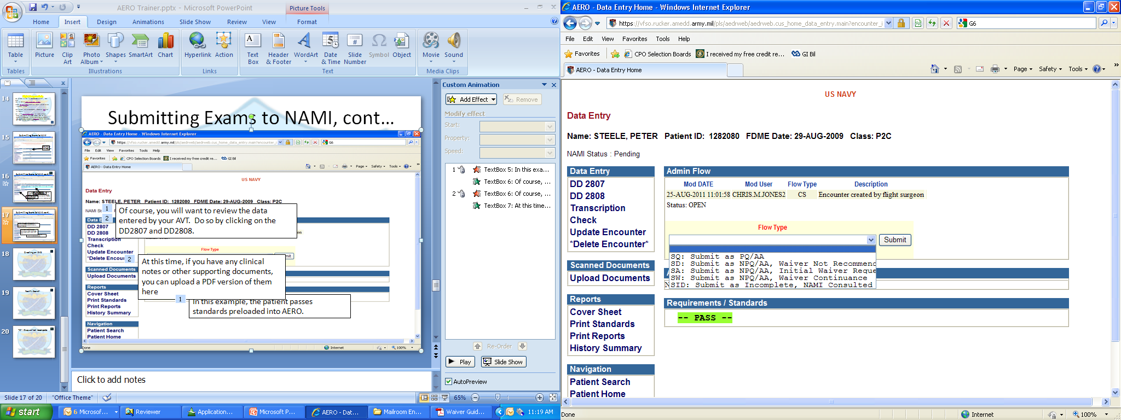
Submitting Exams to NAMI, cont…
Of course, you will want to review the data entered by your AVT. Do so by clicking on the DD2807 and DD2808.
Final step after checking that everything is accurate and you are ready to submit, is to select the “Flow Type” as appropriate, then Click the “Submit” button. Doing this will step you back to the Patient Search screen.
At this time, if you have any clinical notes or other supporting documents, you can upload a PDF version of them here
In this example, the patient passes standards preloaded into AERO.

Slide 19
Submitting Exams to NAMI, cont…
Once the exam is submitted, and you are on the Patient Search screen, reenter the patient’s SSN.
You will see a list of all exams pending and approved for your patient. Select the one you just submitted.
On the LEFT side of the screen, you will see new options to “2807 Print” and “2808 Print”
The print option will only be available after submitting the exam to NAMI!

Slide 20
Creating an AMS
Some notes on AMS business practices
-An Aeromedical Summary in AERO requires that you have a completed exam on file
for the same or an earlier date as the AMS you are submitting.
-THIS IS VERY IMPORTANT to keep in mind when submitting AMS, as you will not be
able to submit an AMS without linking it to a Physical Exam on file.
-THE GOOD NEW IS, the exam you link the AMS to can be a short flight; does not
have to be a complete DD2808/DD2807 exam.
-The actual AMS module is fairly comprehensive, with straight-forward fill in the
blanks.
***keep in mind that the standards above are only guidance in regards to navigating the AERO system. None of the above is intended to be taken as NAMI or BUMED policy. For clarification on policy, refer to the ARWG and MMD found on the NAMI web site.***

Slide 21
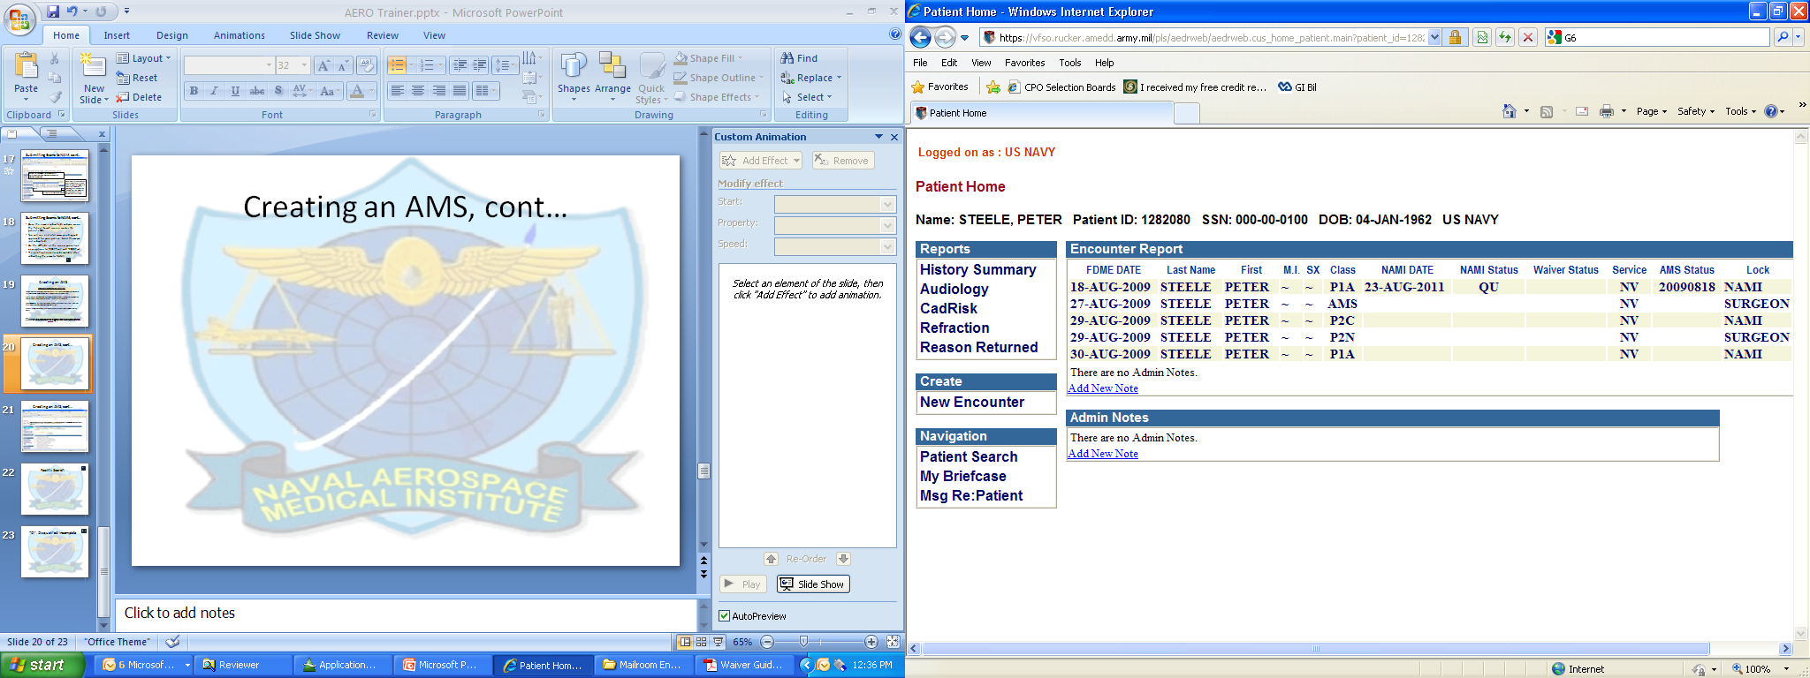
Creating an AMS, cont…
From the Patient Home page, click on New Encounter
(Click New Encounter to Continue)

Slide 22
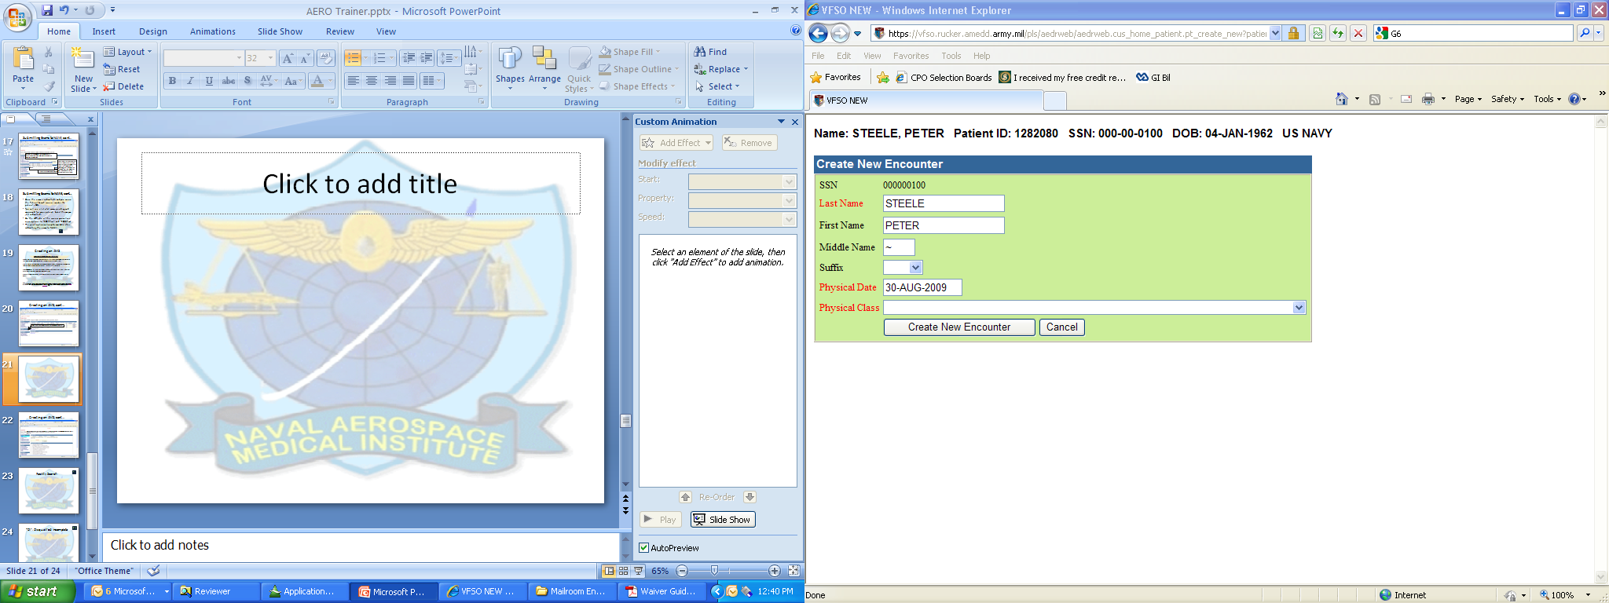
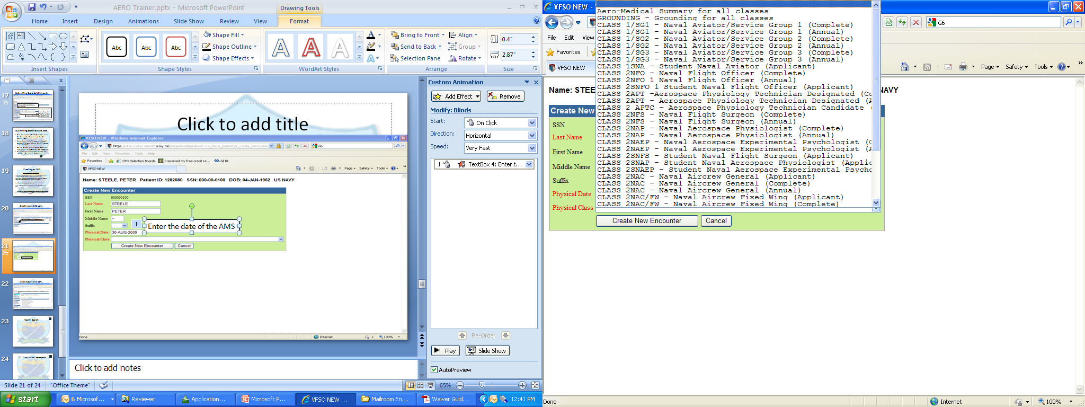
Creating an AMS, cont…
Enter the date of the AMS
Choose Aero-Medical Summary for all classes, as the Physical Class,
Then click “Create New Encounter”

Slide 23
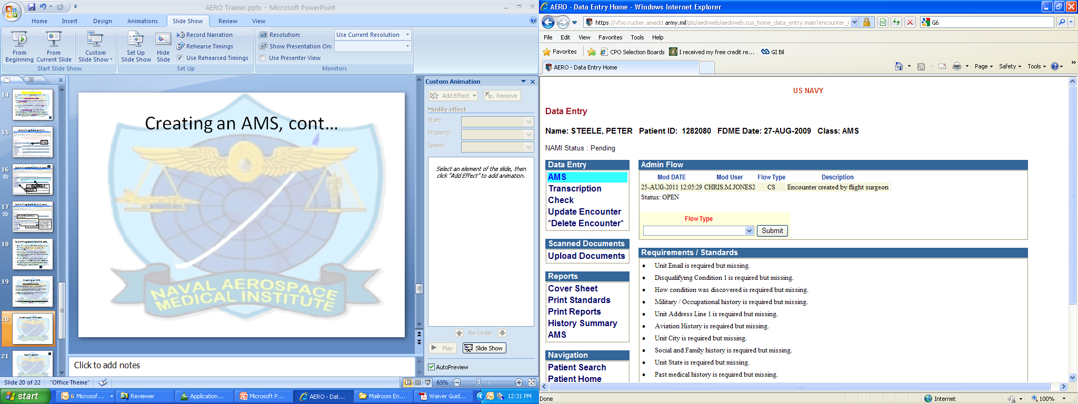
Creating an AMS, cont…
Once you have created the AMS, start by clicking on the AMS module under Data Entry.

Slide 24
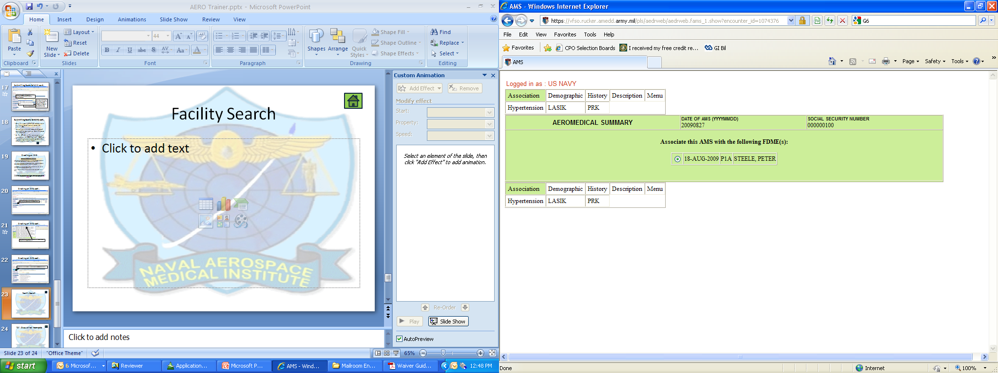
Creating an AMS, cont…
When finished, click Menu to return to the Encounter Home
Click through the tabs to complete the AMS .

Slide 25
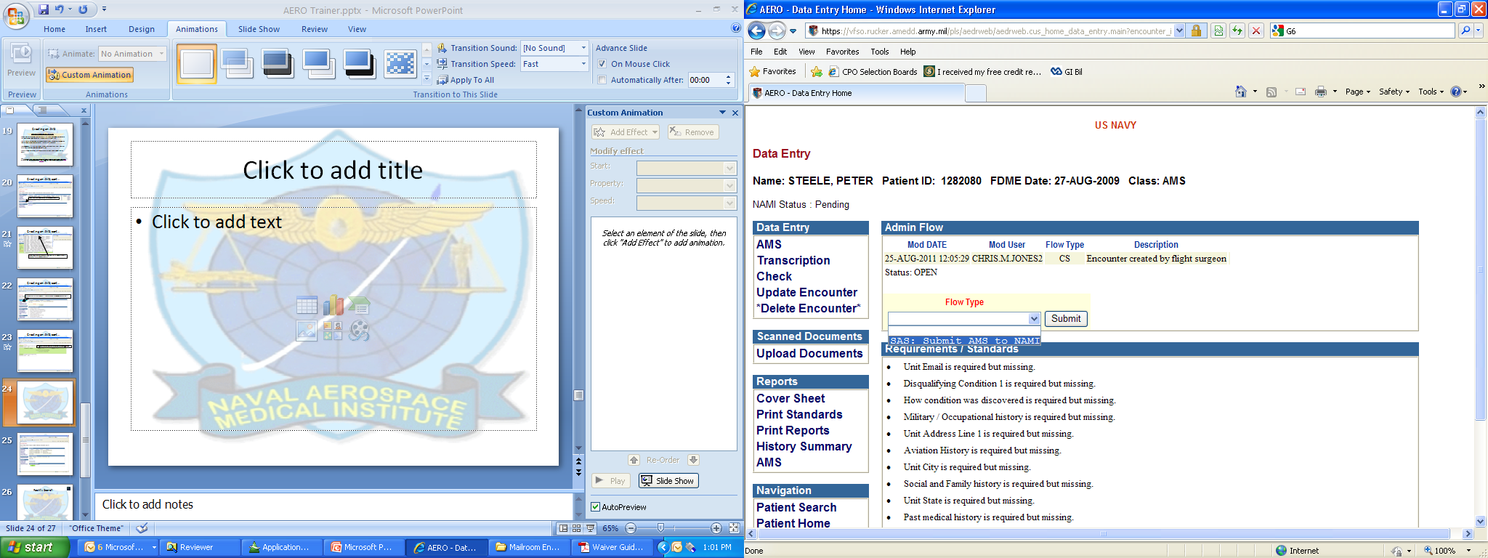
Creating an AMS, cont…
If you have any documents to upload (ie clinical notes, etc…) upload them now
Once finished entering the AMS data, choose “SAS: Submit AMS to NAMI” as the Flow Type, and click Submit

Slide 26
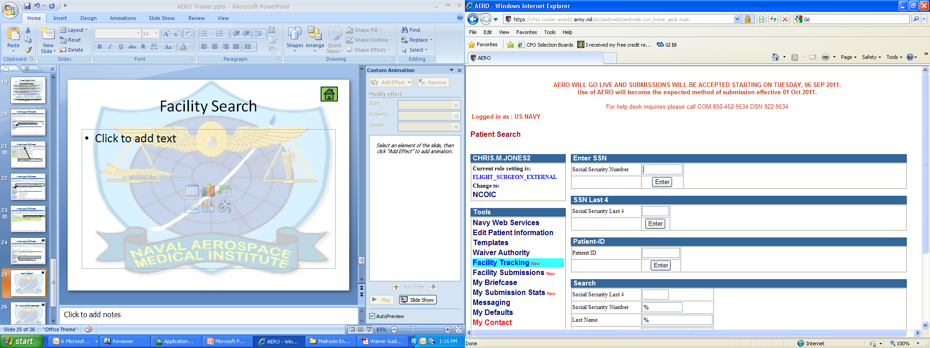
Facility Search
To track submissions from your facility, choose “Facility Submissions”.

Slide 27
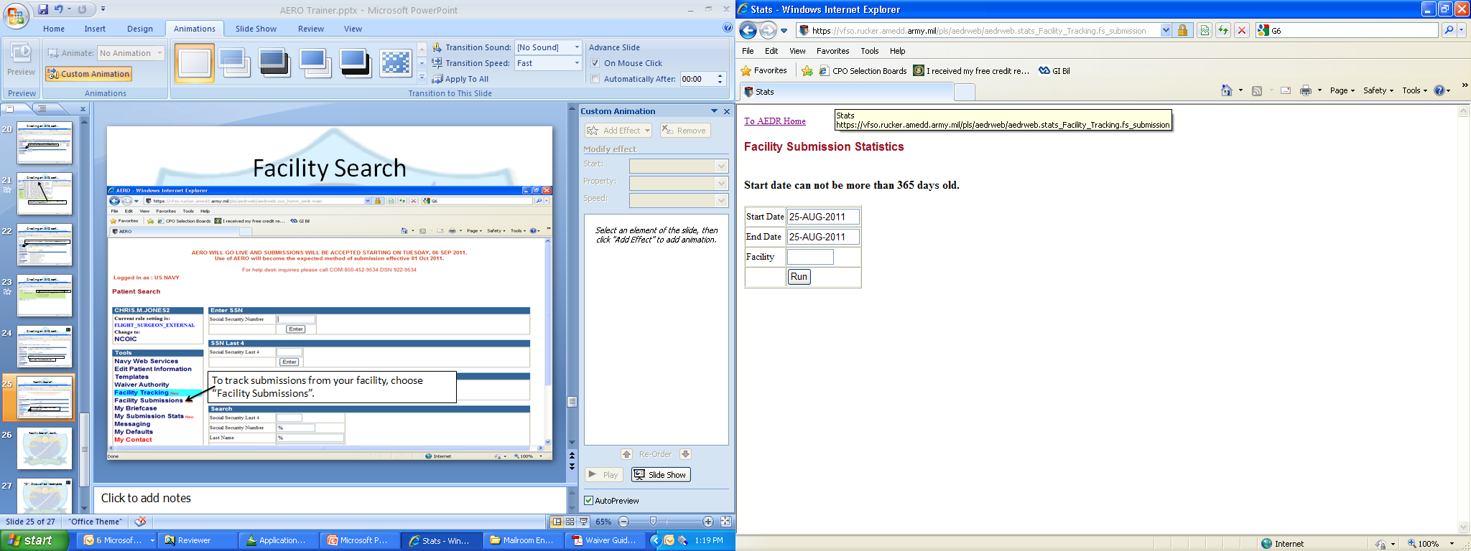
Facility Search, cont…
Enter the AERO Facility Code, and date range to search for (max 365 days)
**Note that the AERO Facility Code is not always going to be your UIC**
The report run will show all submissions by your facility, and show their disposition date if completed

Slide 28
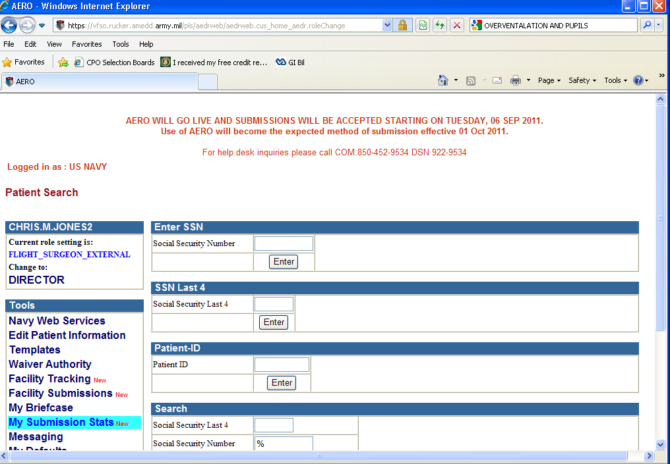
“DI”: Disqualified Incomplete
Search for the status of your submissions, regardless of Facility you submitted them from, HERE

Slide 29
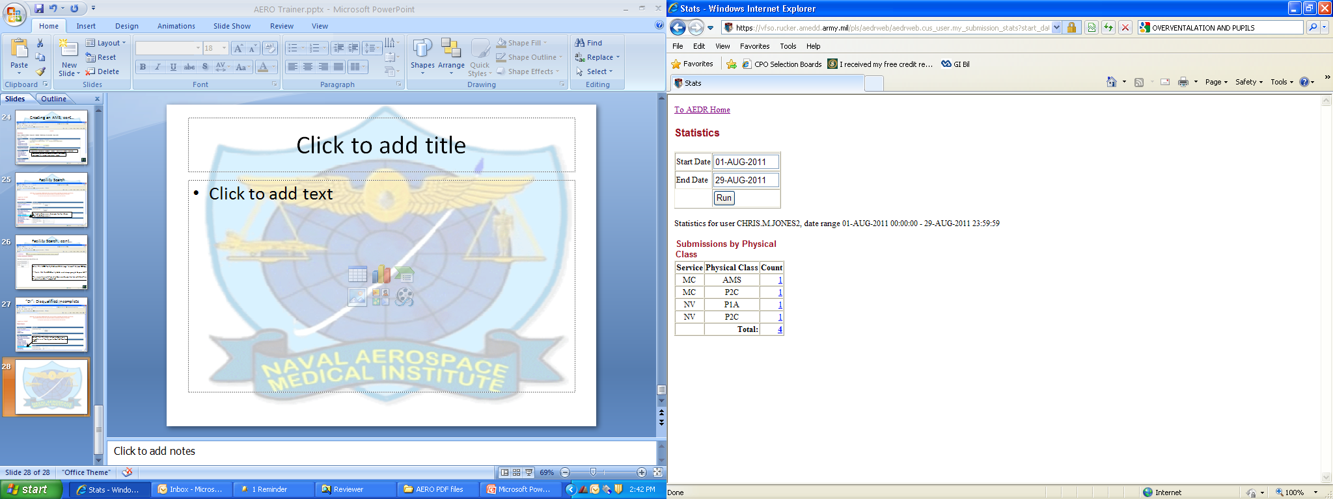
“DI”: Disqualified Incomplete, cont
Enter the Date Range to search for, click “Run”
Here is a list of the Physicals completed during the time period specified. (click “Total” to view them all)

Slide 30
“DI”: Disqualified Incomplete, cont
** The next screen shot is omitted as it contains actual patient information**
The next screen will show a list of all the submissions you have made during the time period specified. There are toggle-able columns that you can specify what to search by. One of those columns is called “AAMA Status” (soon to be renamed as “NAMI Status”). This will list your patient’s dispositions from NAMI. Status “DI” indicates that we need the exam to be resubmitted. Click your mouse to show the next screen you will see after selecting an encounter that has been reviewed:

Slide 31
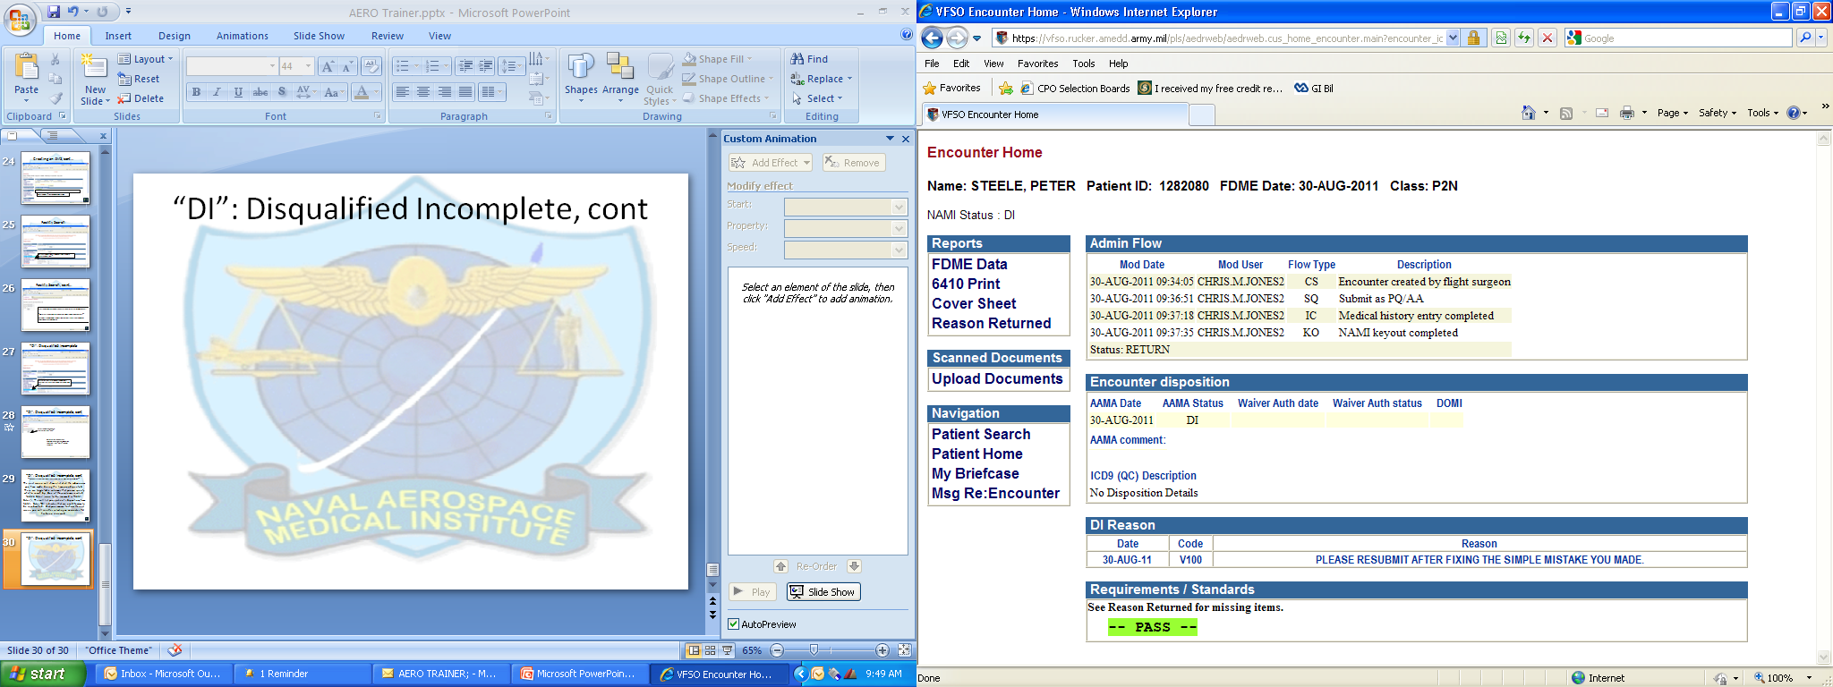
“DI”: Disqualified Incomplete, cont
It shows step-by-step NAMI’s processing, and dates the processes were completed.
The Flow type is shown here:
The final disposition made on this encounter is shown here.
And down here are listed the instructions for resubmission

Slide 32
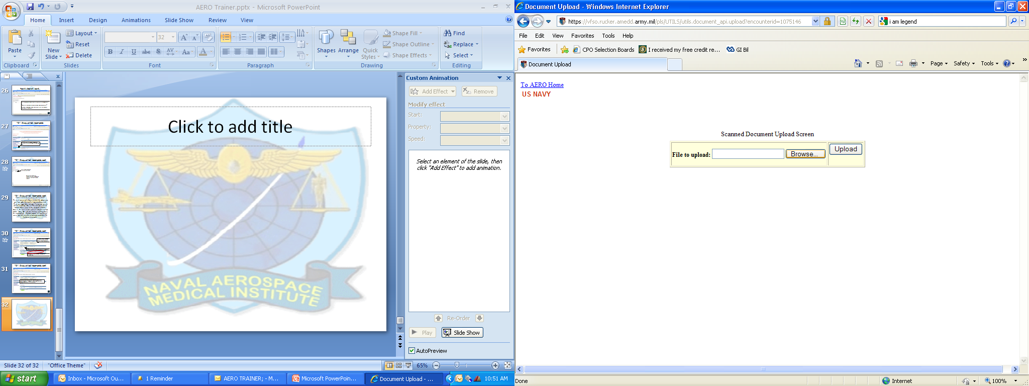
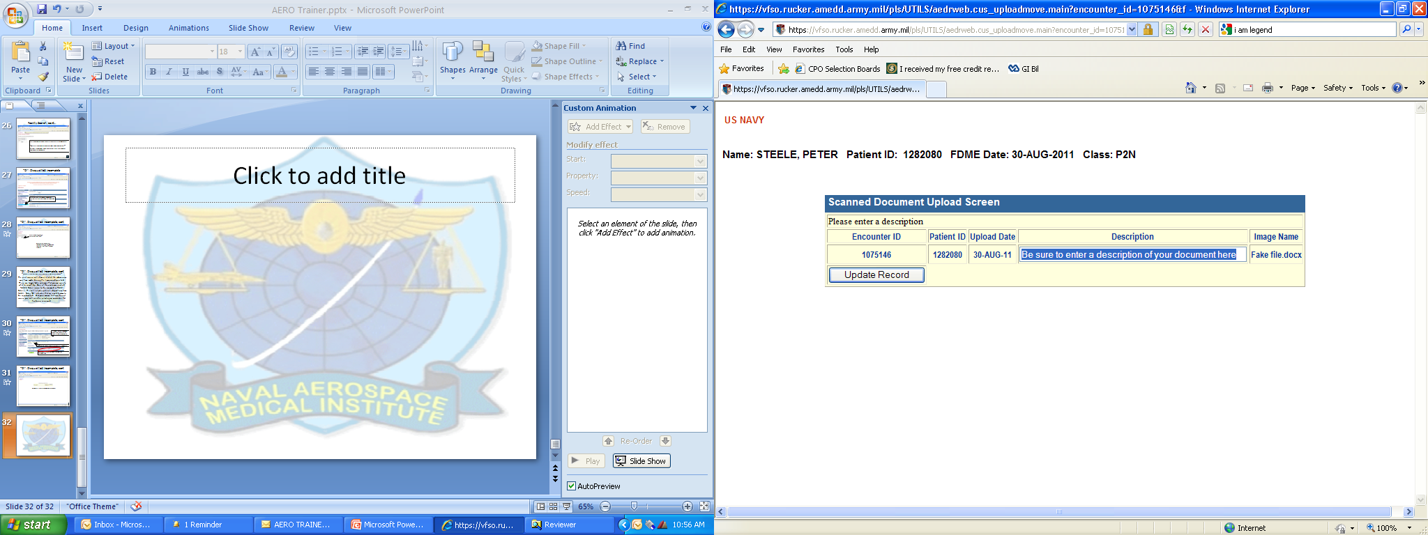
“DI”: Disqualified Incomplete, cont
If you need to add some information or documents to this exam to complete it, IAW NAMI Instructions below, you can use the Upload Document feature to the left.
AERO uses standard file uploading techniques
Be sure to enter a description of your document here. Remember that AERO accepts all file types, but NAMI can retrieve PDF documents ONLY!!! Please only submit PDF

Slide 33
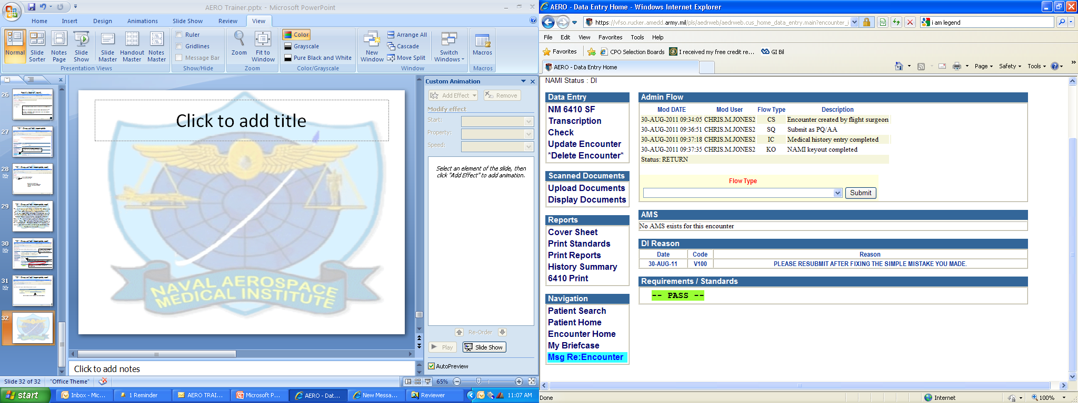
“DI”: Disqualified Incomplete, cont
Once any supporting documents are uploaded, you will be brought back to the encounter home. Your next step is to send an AERO Message to Mrs. Pam Greuling:
“Please clone the referenced encounter for resubmission purposes”
AERO uses standard Microsoft Office type email messaging, where you will search for the name you are sending to (Pam Greuling), type in a subject, and type in text for the message.

Slide 34
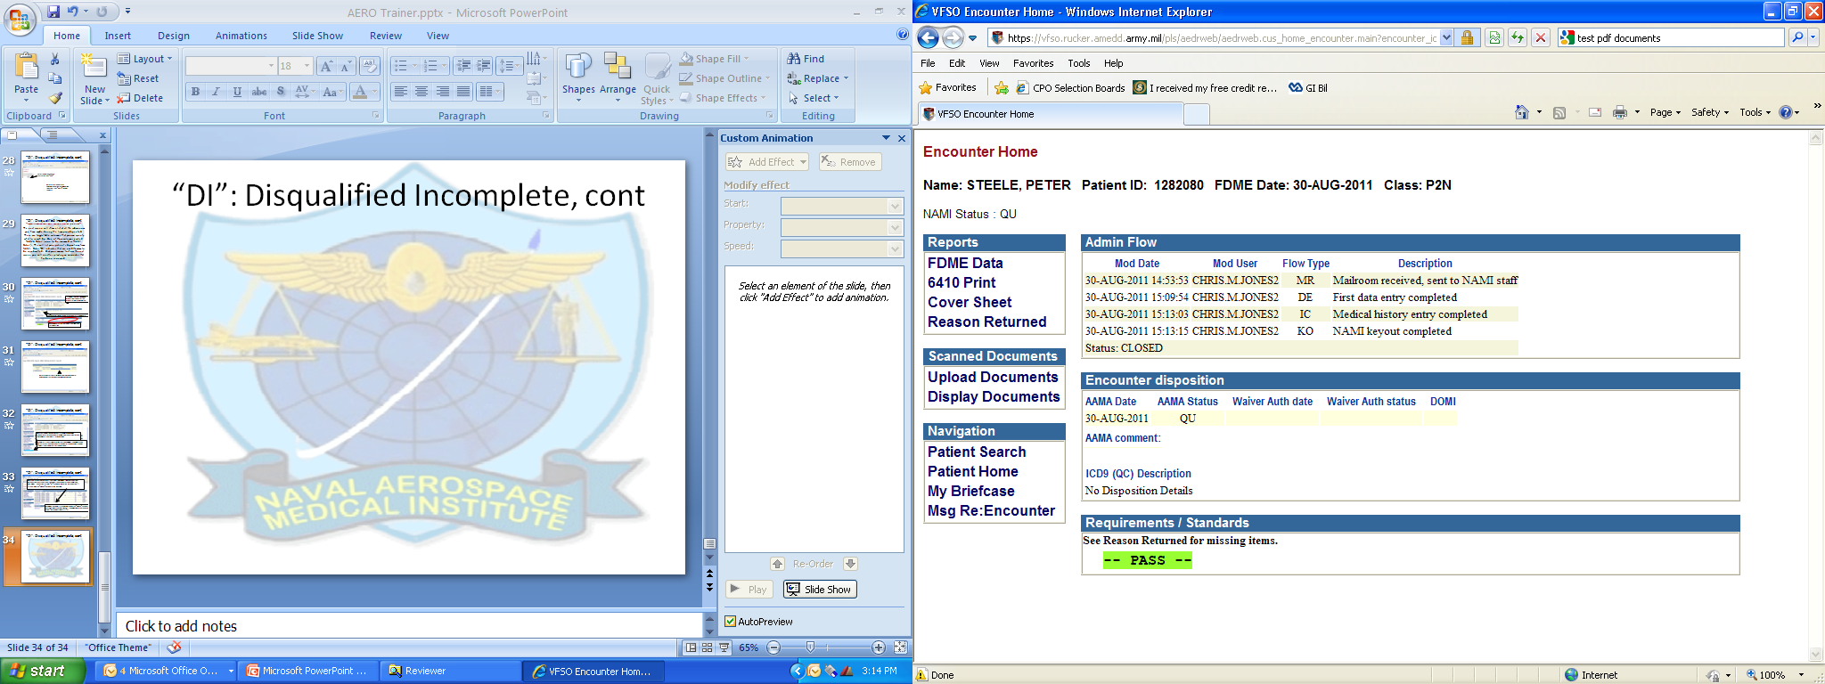
“DI”: Disqualified Incomplete, cont
Once NAMI Reviewers are completed with the “Cloned” Encounter (meaning, we have dispositioned it), you will be able to see the encounter on your “My Submission Stats” list, and pull it up to view NAMI work flow

Slide 35
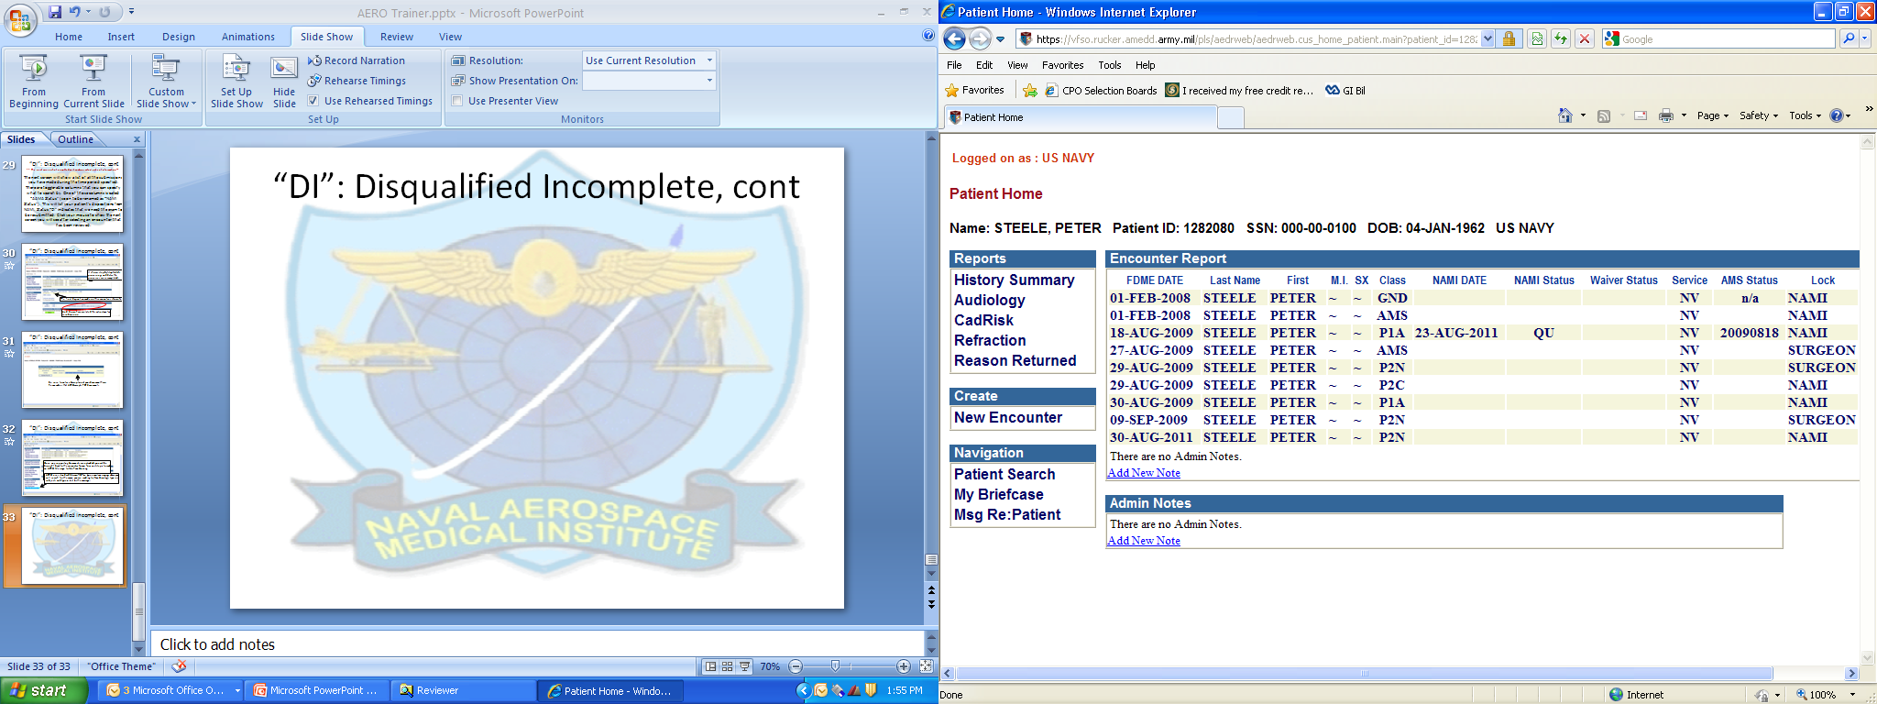
“DI”: Disqualified Incomplete, cont
When you receive an AERO Message reply from NAMI, you can look up the patient on the Patient Search Screen, and select the encounter you are working with. NOTE: The exam that was “DI”-ed will no longer be on the patient’s screen. Only the “Cloned” encounter will be visible.
It will be dispositioned internally in AERO with no further information needed from you, unless specified by the Aeromedical Reviewer assigned the case.
**As a side note: the first reviewer who worked on the encounter that was DI-ed, may not be the same to work on your cloned encounter**

Slide 36
Your AERO Tools
AERO is designed to assist with tracking patients, and to improve NAMI’s responsiveness to the Fleet via our External Flight Surgeons.
AERO will allow NAMI to be more expeditious with responses to submissions from you, the End Users.
It does not have the same abilities for us to make interpretations on “What the Flight Surgeon MEANT to say…” In other words, if the AERO program tells us that an exam is submitted incorrectly without any expounding on your part, NAMI Reviewers MUST “DI” status the encounter, and ultimately notify the Waiver Authorities of our disposition of “Waiver Not Recommended At This Time” due to non Aeromedical Status Compliance.
Therefore, it is IMPERATIVE that you, as the End User Flight Surgeons and AVTs, familiarize yourself thoroughly with the AERO Tools described in this section of the trainer!

Slide 37
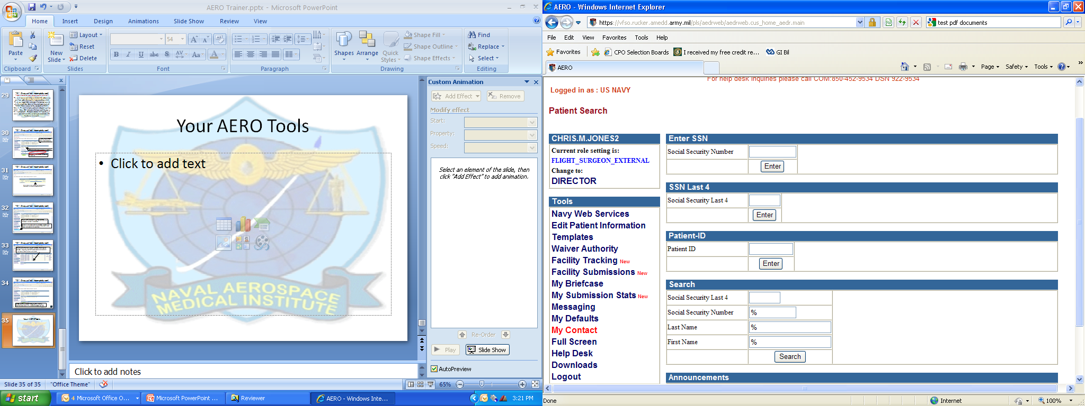
Your AERO Tools, cont
Navy Web Services will give a “Snapshot” of your Patient’s historical Waivers and Current Flight Status
“Edit Patient Information” is used to correct Patient Demographics TO INCLUDE SSN’s!! Be careful, as there is no enduser error checking
Facility Tracking, Facility Submissions, and My Submission Stats are all tools to find patients and track work completed. Each of these 3 tools are essential to familiarize yourself with, as AVT or Flight Surgeon, to ensure that your patients receive proper follow up care in regards to their dispositions. NAMI WILL NO LONGER BE SENDING OUT ADD-INFO REQUESTS VIA OUTLOOK! Proper follow up and tracking of dispositions provided by NAMI are solely the responsibility of the External Flight Surgeons, and will completely rely on you and your facility’s patient tracking systems.
Messaging is an email-type client for communications within AERO only; you will not be able to send emails to any addressees outside the AERO system. The messaging client allows for you to send PPI without any special steps to encrypt the information, as the entire server AERO is on is Secure.
Ensure that as you get started with using AERO, you take the time to review and set your defaults, update your Contact information, and view our Downloadable documents

Slide 38
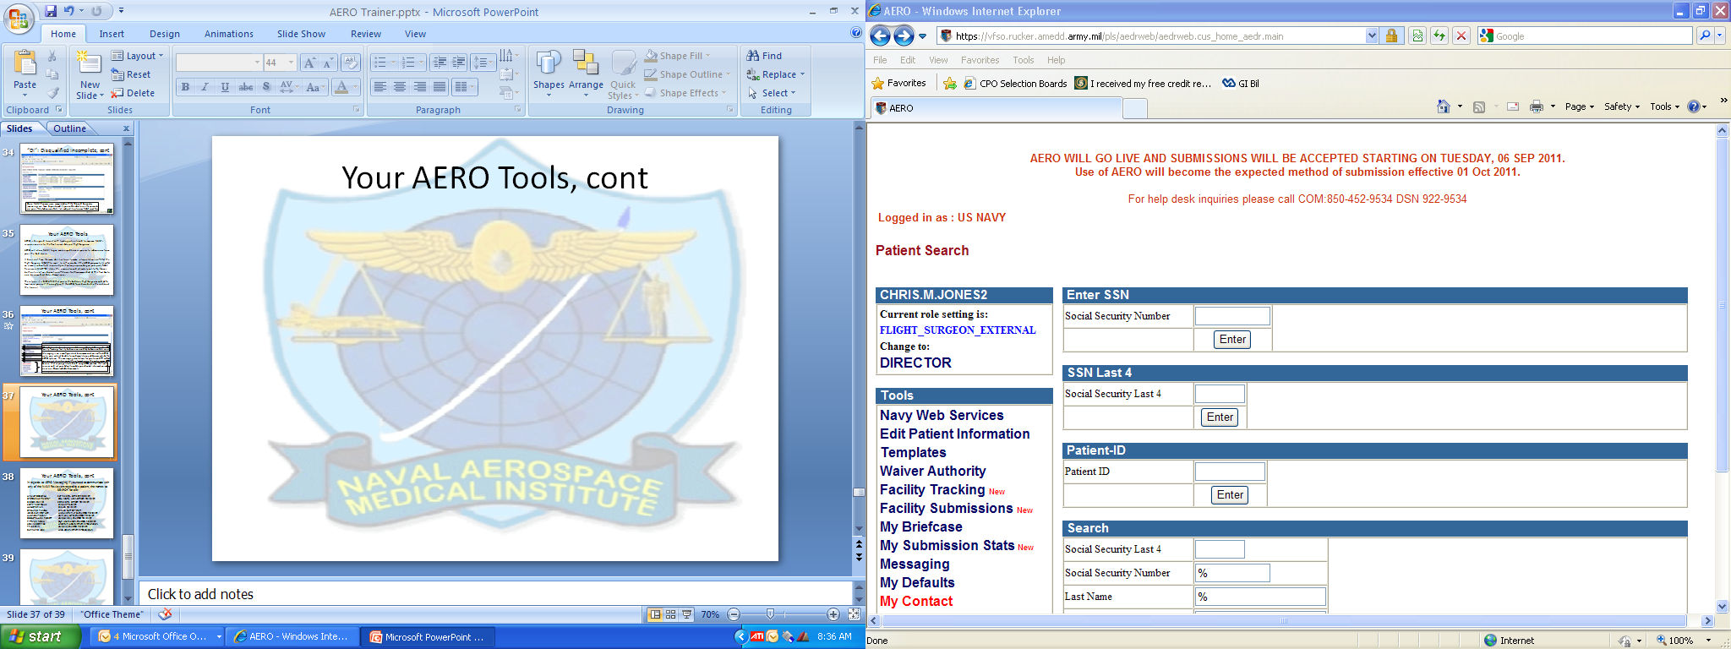
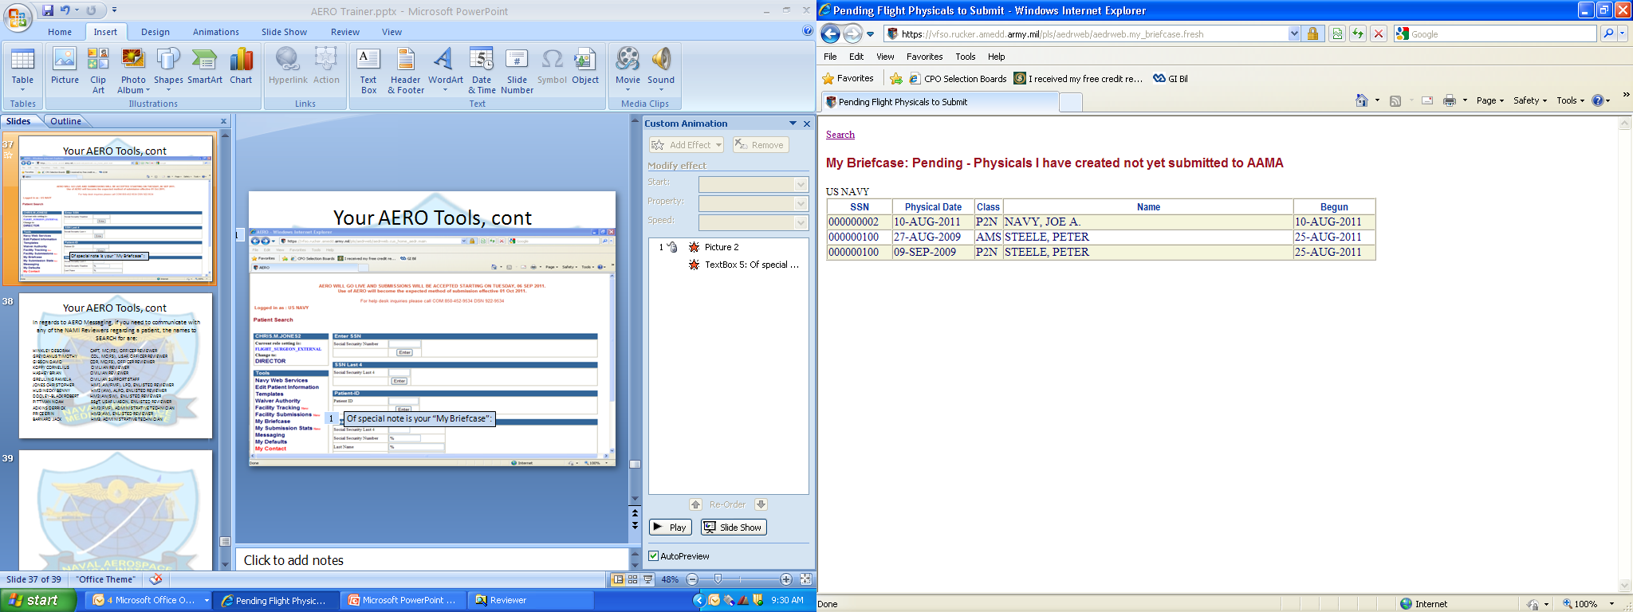
Your AERO Tools, cont
My Briefcase is where Pending cases are stored; the Physicals you have created, but
not yet submitted to NAMI.
(It seems very self explanatory, since it is. But, you, the end-user Flight Surgeons and AVTs, will be using this tool often enough that it deserves it’s own Slide)
Of special note is your “My Briefcase”:

Slide 39
Your AERO Tools, cont
In regards to AERO Messaging, if you need to communicate with any of the NAMI Reviewers regarding a patient, the names to SEARCH for are:
HINKLEY DEBORAH CAPT, MC (FS), OFFICER REVIEWER
GREYDANUS TIMOTHY COL, MC(FS), USAF, OFFICER REVIEWER
GIBSON DAVID CDR, MC(FS), OFFICER REVIEWER
KOPPY CORNELIUS CIVILIAN REVIEWER
HASHEY BRIAN CIVILIAN REVIEWER
GREULING PAMELA CIVILIAN SUPPORT STAFF
JONES CHRISTOPHER HM1(AW/FMF), LPO, ENLISTED REVIEWER
HUSINECKY BENNY HM2 (AW), ALPO, ENLISTED REVIEWER
DOOLEY-BLACK ROBERT HM2(AW/SW), ENLISTED REVIEWER
PITTMAN NOAH SSgT, USAF LIASON, ENLISTED REVIEWER
ADKINS DERRICK HM2(FMF), ADMINISTRATIVE TECHNICIAN
PRICE ERIN HM3(AW), ENLISTED REVIEWER
BARNARD JACK HM3, ADMINISTRATIVE TECHNICIAN

Slide 40
AMS | AEROMEDICAL SUMMARY |  |  |  |  |  | AM6N | CLASS | 2 | NAEP |  | (ANNUAL)
GND | GROUNDING FOR ALL CLASSES |  |  |  |  |  | AM1A | CLASS | 2 | SNFS |  | (APPLICANT)
P2C | CLASS | 1 | SG | 1 | (COMPLETE) |  | AM2A | CLASS | 2 | SNAP |  | (APPLICANT)
P2N | CLASS | 1 | SG | 1 | (ANNUAL) |  | AM3A | CLASS | 2 | SNAEP |  | (APPLICANT)
P3C | CLASS | 1 | SG | 2 | (COMPLETE) |  | A1A | CLASS | 2 | NAC |  | (APPLICANT)
P3N | CLASS | 1 | SG | 2 | (ANNUAL) |  | A1C | CLASS | 2 | NAC |  | (COMPLETE)
P4C | CLASS | 1 | SG | 3 | (COMPLETE) |  | A1N | CLASS | 2 | NAC |  | (ANNUAL)
P4N | CLASS | 1 | SG | 3 | (ANNUAL) |  | A2A | CLASS | 2 | NAC/FW |  | (APPLICANT)
P1A | CLASS | 1 | SNA |  | (APPLICANT) |  | A2C | CLASS | 2 | NAC/FW |  | (COMPLETE)
F2C | CLASS | 2 | NFO |  | (COMPLETE) |  | A2N | CLASS | 2 | NAC/FW |  | (ANNUAL)
F2N | CLASS | 2 | NFO |  | (ANNUAL) |  | C1A | CLASS | 3 | ATC |  | (APPLICANT)
F1A | CLASS | 2 | SNFO |  | (APPLICANT) |  | C1C | CLASS | 3 | ATC |  | (COMPLETE)
AM8C | CLASS | 2 | APT |  | (COMPLETE) |  | C1N | CLASS | 3 | ATC |  | (ANNUAL)
AM8N | CLASS | 2 | APT |  | (ANNUAL) |  | P7A | CLASS | 3 | UAV |  | (APPLICANT)
AM7A | CLASS | 2 | APT |  | (APPLICANT) |  | P7C | CLASS | 3 | UAV |  | (COMPLETE)
AM4C | CLASS | 2 | NFS |  | (COMPLETE) |  | P7N | CLASS | 3 | UAV |  | (ANNUAL)
AM4N | CLASS | 2 | NFS |  | (ANNUAL) |  | WSA | CLASS | 3T | WATER SURVIVAL (APPLICANT)
AM5C | CLASS | 2 | NAP |  | (COMPLETE) |  | WSC | CLASS | 3T | WATER SURVIVAL (COMPLETE)
AM5N | CLASS | 2 | NAP |  | (ANNUAL) |  | WSN | CLASS | 3T | WATER SURVIVAL (ANNUAL)
AM6C | CLASS | 2 | NAEP |  | (COMPLETE)

