Slide 1
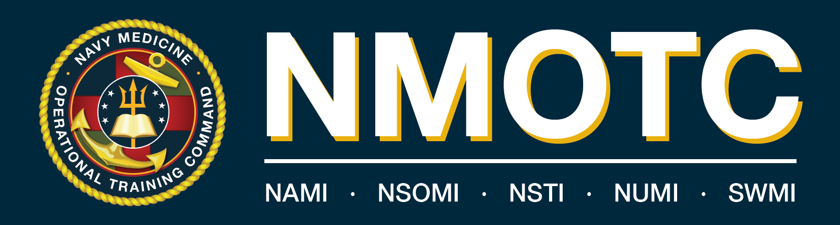
Command Brief

Slide 2
Mission
Develop, educate, train, and qualify healthcare professionals and warfighters to optimize human performance, survivability, and trauma response, enabling operational readiness and maritime dominance.
Vision
Recognized as the center of excellence in operational medicine and warfighter & aircrew survivability across the range of military operations through innovative and evidence-based education and training.
Website: Navy Medicine Operational Training Command

Slide 3
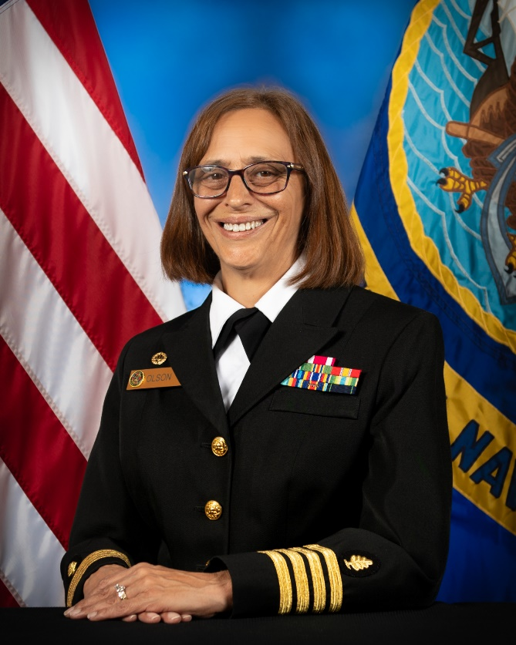
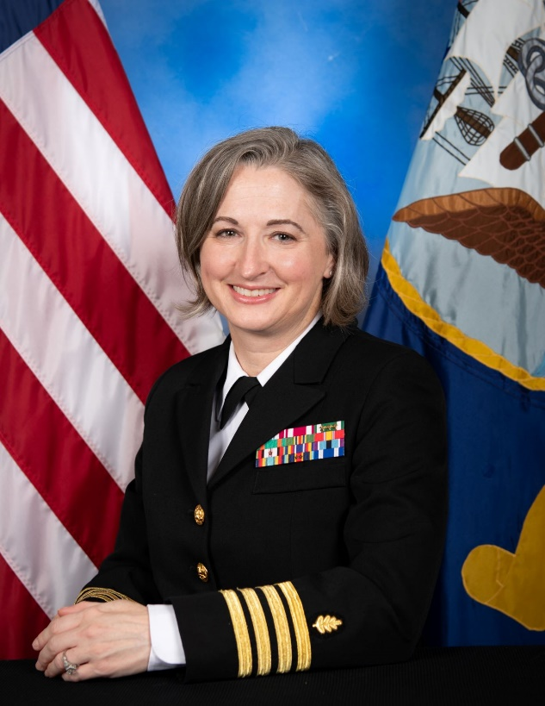
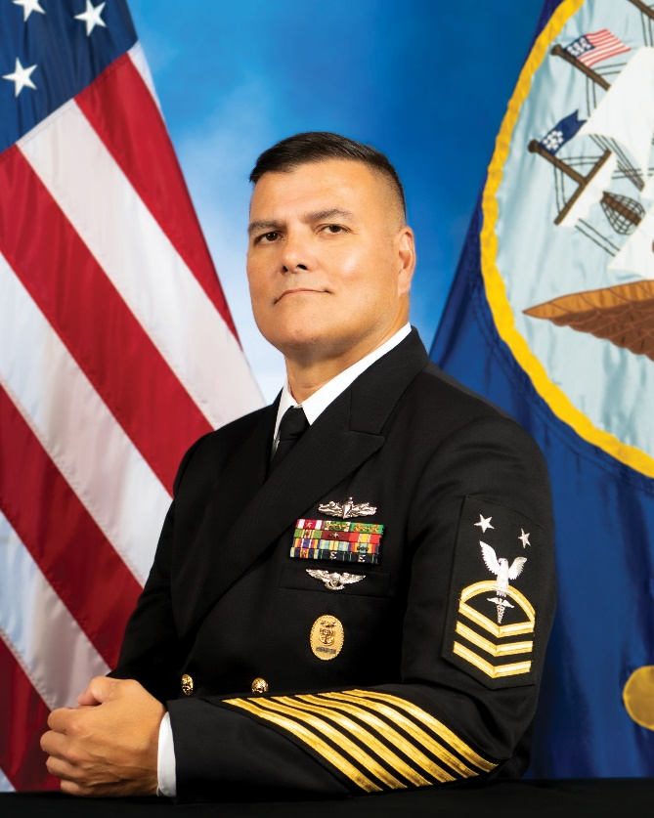
Leadership Triad
CAPT Lacy L. Gee
Nurse Corps
Executive Officer
CAPT Nichole Olson
Medical Service Corps
Commanding Officer
HMCM (FMF/AW)
Charles R. Hickey
Command Master Chief

Slide 4
CO’s Philosophy
C4
Character
Commitment
Competency
Culture

Slide 5

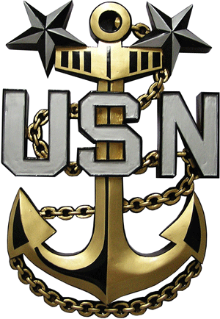





COMMANDING OFFICER
COMMAND MASTER CHIEF
EXECUTIVE OFFICER
NMOTC HEADQUARTERS
Director for Administration (DFA)
Director of Operations (DOO)
Director of Training (DOT)/ Chief Nursing Officer (CNO)
Director for Resource Management (DRM)
Director of Trauma Programs (DTP)
Pensacola, FL
Officer in Charge
NAVAL SURVIVAL TRAINING INSTITUTE
(NSTI)
Pensacola, FL
Trauma Programs
HM TRAUMA TRAINING (HMTT) &
NAVY TRAUMA TRAINING CENTER (NTTC), Jacksonville, FL / Chicago, IL / Cleveland , OH / Raleigh, NC / Los Angeles, CA
Officer in Charge
NAVAL AEROSPACE MEDICAL INSTITUTE
(NAMI)
Pensacola, FL
Officer in Charge
NAVAL UNDERSEA MEDICAL INSTITUTE
(NUMI)
Groton, CT
Officer in Charge
NAVAL SPECIAL OPERATIONS
MEDICAL INSTITUTE (NSOMI)
FT Bragg, NC
Officer in Charge
SURFACE WARFARE MEDICAL INSTITUTE
(SWMI)
San Diego, CA

Slide 6
Enterprise Map

Slide 7
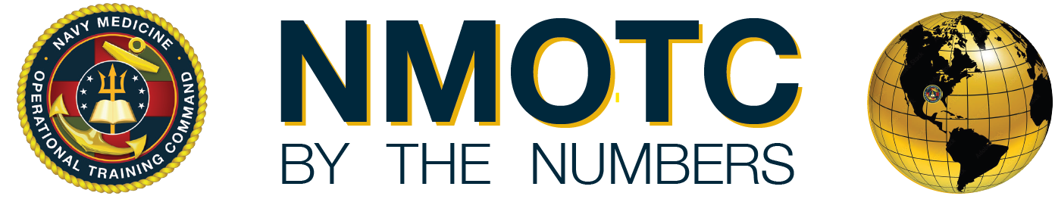
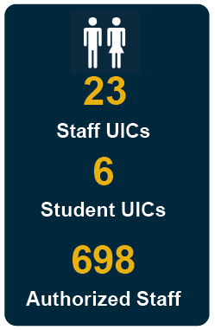
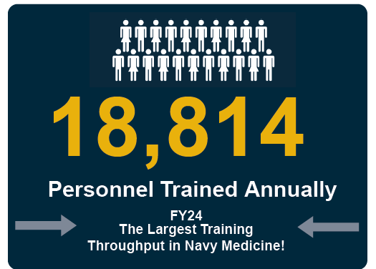
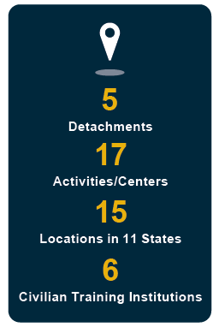
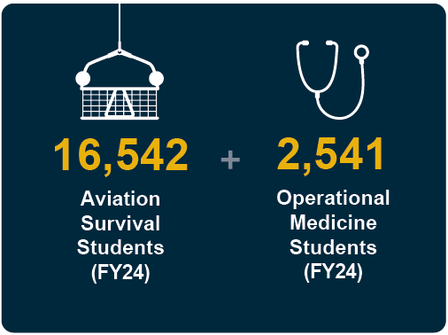
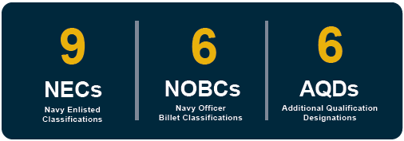
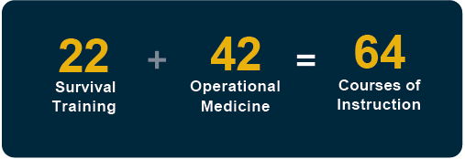
22
16
14
10
5
Back-to-back recipients of the Bureau of Medicine and Surgery (BUMED) Retention Excellence Award (FY23 & FY24)
Notes:
UPENN Transitioned under NMFL (NMRTC Great Lakes) on 1 Jun 2025. UIC, Activities/Centers, Locations, States, and Civilian Training Institutions #’s updated.

Slide 8
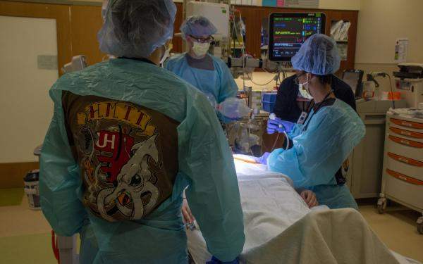
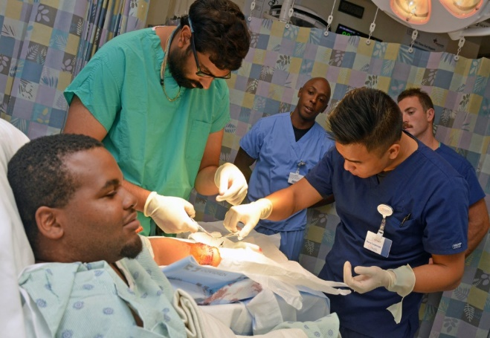
Director of Trauma Programs (DTP)
NMOTC HQ
Hospital Corpsman Trauma Training (HMTT) & Navy Trauma Training Center (NTTC) LA General
Mission: To provide enhanced, real-world trauma experience for Navy hospital corpsmen, nurses, and providers who deliver advanced life-saving care to Sailors and Marines in the field through innovative partnerships with private-sector health systems.
Locations: HMTT - Chicago, IL; Cleveland, OH; Jacksonville, FL; Raleigh, NC; NTTC - Los Angeles, CA
NTTC Course of Instruction:
Two-week clinical immersion for ERSS teams prior to NEMWDC training
Advanced Surgical Skills for Exposure in Trauma (ASSET)
Israel Defense Force (IDF) surgical training
Cadre augment LA General + USC staff in the care of critically ill/injured patients year-round.
HMTT Course of Instruction:
Two weeks didactic & 5 weeks clinical immersion
All HMs E-5 and bellow with PCS orders to operational billet
Notes:
Authorized 33
Onboard 25 (to include 2 Reservist)

Slide 9
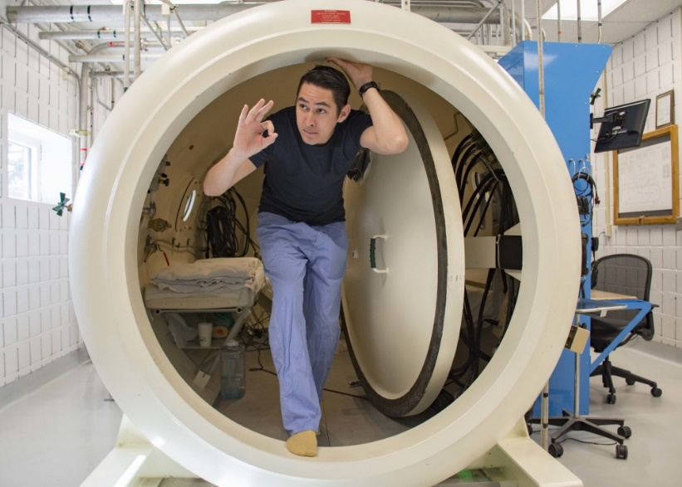
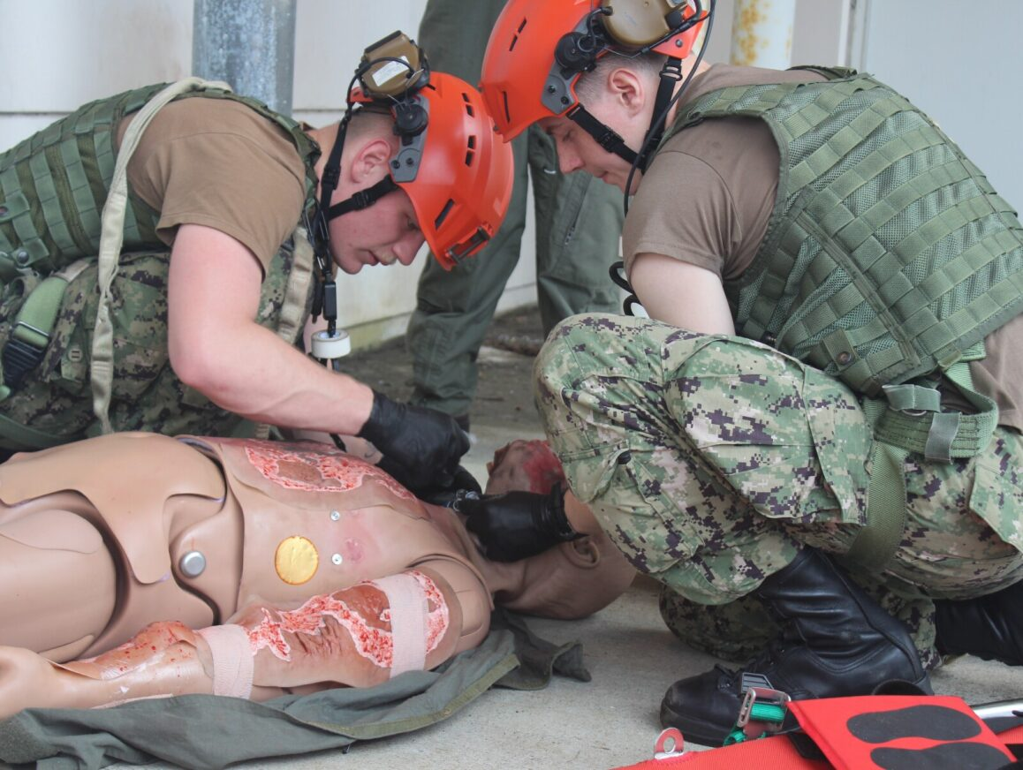
Naval Aerospace Medical Institute (NAMI)
Mission: Train aeromedical personnel for operational assignment and requirements. Develop, validate, apply, and administer aeromedical standards for Naval Aviation. Provide aeromedical technical, consultative support services and operational support for high-risk training in the Pensacola AOR via regional recompression chamber (RCC).
Location: Pensacola, FL

Slide 10
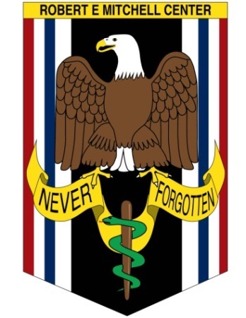
Robert E. Mitchell Center (REMC) for Repatriated Prisoner of War (RPOW) Studies
Mission: The Mitchell Center provides annual clinical evaluations and follow-up studies of RPOWs from Vietnam, Desert Storm, and Operation Iraqi Freedom to evaluate the mental and physical effects of captivity and delineate the predictors of repatriate resilience.
Location: Pensacola, FL (NAMI)
Performs over 200 RPOW evaluations annually. RPOWS from all services, including State Department eligible.
Congressional funding provided in 1995 to establish REMC as a RPOW research center, the program of which is executed per DoDI 3002.03.
Singularly holds all longitudinal data, starting in 1973, for tri-service RPOW physical and psychological evaluations (52 years).
Funding required for digitization of medical and archival data to ensure policy compliance (OMB, M-19-21, Transition to Electronic Record) and development of database for robust research efforts.

Slide 11
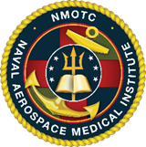
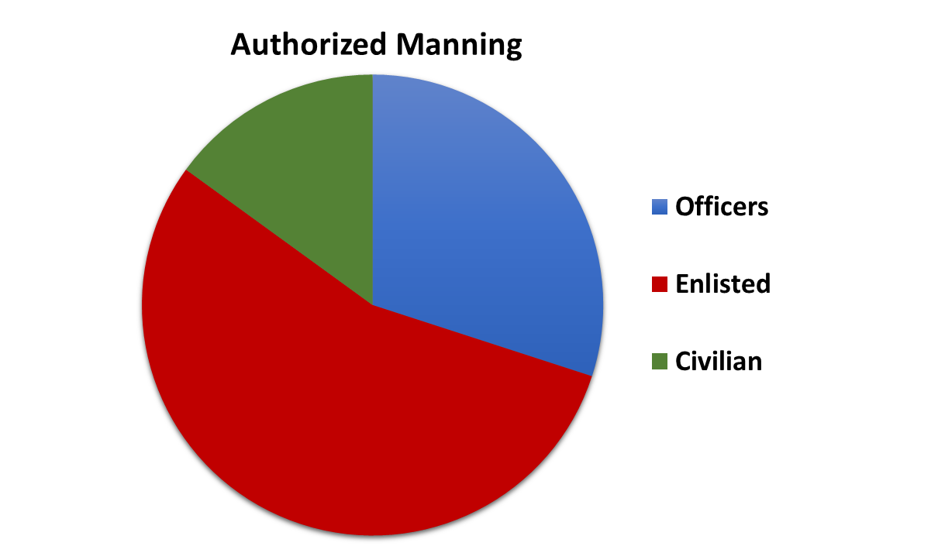
Naval Aerospace Medical Institute (NAMI)
Enlisted Courses of Instruction:
SAR Medical Tech/L00A
Aerospace Medicine Technician/L04A
Aerospace Physiology Technician/L07A
Officer Courses of Instruction:
Aerospace Medical Officer
Aerospace Medicine Flight Surgeon
Aerospace Physiologist
Aerospace Experimental Psychologist
Aerospace Optometrist
Aeromedical Physician Assistant
Naval Aviation Medical Examiner
Residency in Aerospace Medicine
Flight Surgeon Refresher Training
Joint Enroute Critical Care (JECC - Ft. Novosel)
Authorized Manning: 114 Onboard: 99
Includes Ft Novosel (JECC)
Notes:
*Notes from NAMI 07DEC2021: 122 accounts for AMD manning with new protocol of RAMs counted as staff. We have 114 onboard, missing (1) FS/Clinical Psychiatrist (per AMD, though SL/detailer not tracking gap on their side); (2) Aerospace Experimental Psychologist; (1) Aeromedical Physician Assistant; (2) SAR Med Techs; (1) Dive Med Tech; and (1) Instructional Systems Specialist.*
NSTI: 12. Aerospace Physiologist Internship Program
1. SAR Medical L00A
Aerospace Medicine Technician (NEC L04A)
Aerospace Physiology Technician (NEC L07A)
Aerospace Medical Officer
- Aerospace Medicine Flight Surgeon
- Aerospace Physiologist
- Aerospace Experimental Psychologist
- Aerospace Optometrist
- Aeromedical Physician Assistant
- Naval Aviation Medical Examiner
2. Residency in Aerospace Medicine
3. Flight Surgeon Refresher Training
4. Flight Medic Course
5. Joint Enroute Critical Care (Ft. Rucker)

Slide 12
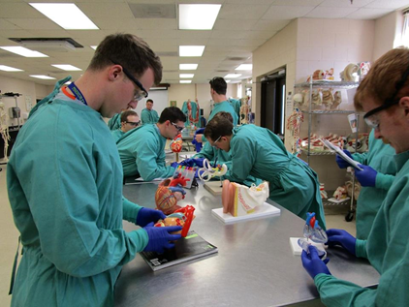
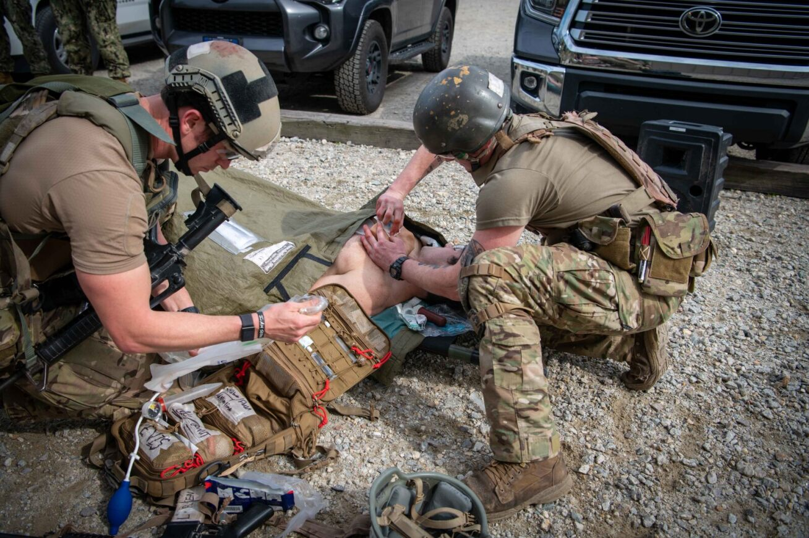
Naval Special Operations
Medical Institute (NSOMI)
Mission: Educate and train the full spectrum of United States Special Operations Command (USSOCOM) combat medics through superior teaching and instruction based on educational goals and curriculum development that is synchronized with the requirements of the force.
Locations: Fort Bragg, NC

Slide 13
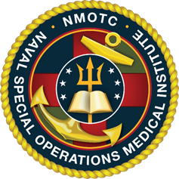
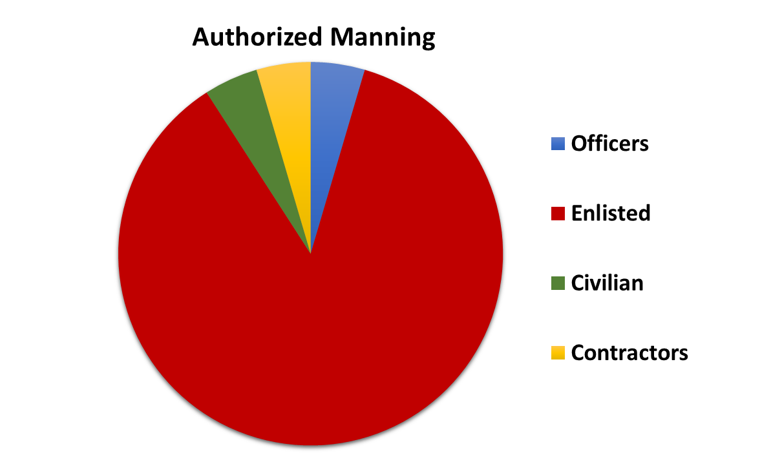
Naval Special Operations
Medical Institute (NSOMI)
Courses of Instruction:
Special Operations Combat
Special Operations Independent Duty Corpsman/L02A
Courses of Instruction:
Special Operations Combat Medical Skills Sustainment Course
Special Forces Medical Sergeant/SOIDC Refresher
Authorized Manning: 22 Onboard: 19

Slide 14
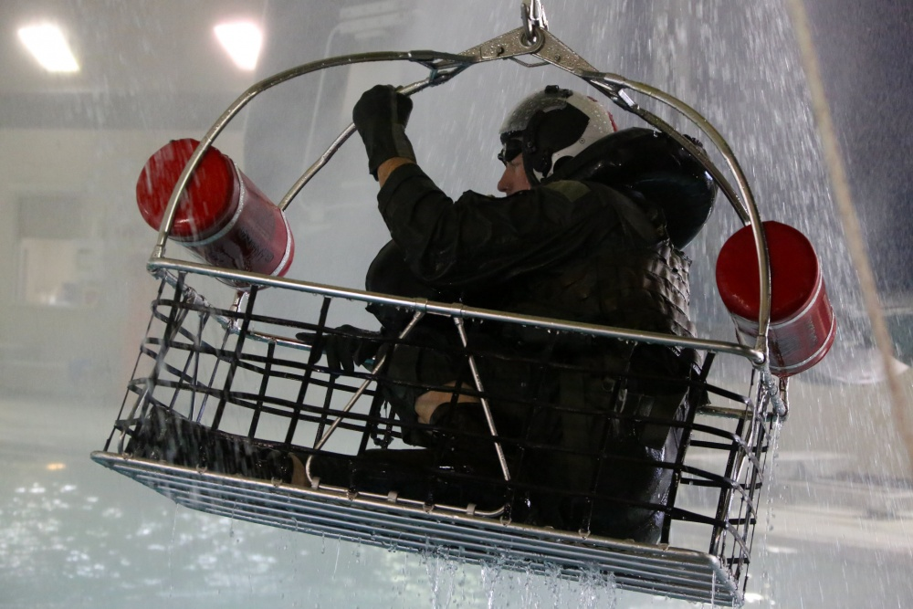
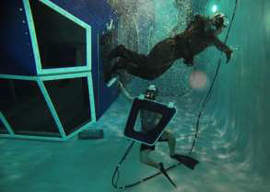
Naval Survival Training Institute (NSTI)
Mission: To provide safe, effective, and relevant aviation survival and human performance training as the execution arm of the Chief of Naval Operations-mandated Naval Aviation Survival Training Program (NASTP).
Locations: Patuxent River, MD; Norfolk, VA; Cherry Point, NC; Jacksonville, FL; Pensacola, FL; Miramar, CA; Lemoore, CA; Whidbey Island, WA

Slide 15
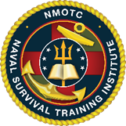
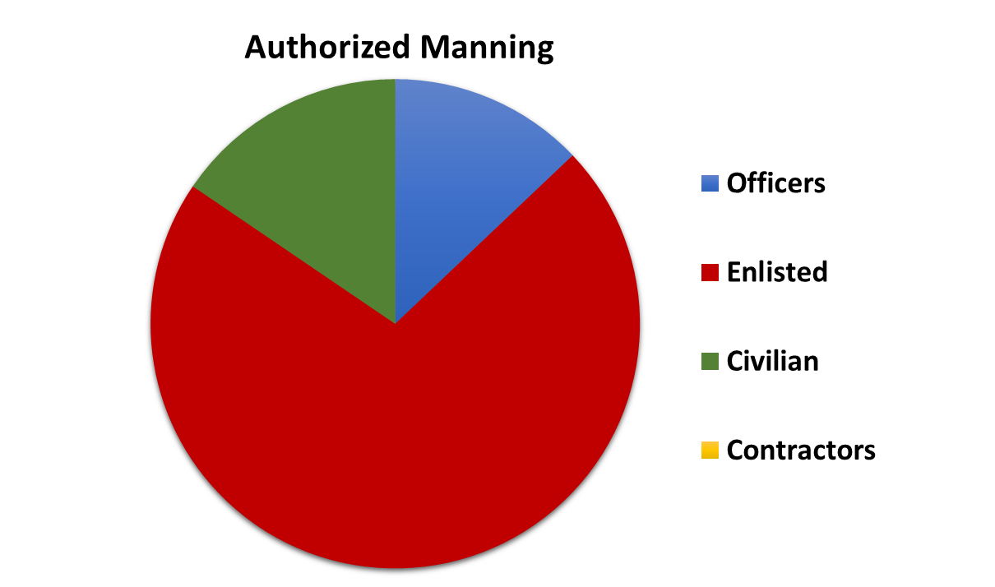
Naval Survival Training Institute (NSTI)
Staff Courses of Instruction:
1. Naval Aviation Water Survival Instructor
(NAWSTI-NEC 806A)
2. Naval Aerospace & Operational Physiologist
Internship Program (B-6H-1301)
Fleet Courses of Instruction:
1. Aircrew Refresher NASTP training x 4
2. Aircrew Initial NASTP training x 4
3. Non-Aircrew NASTP training x 4
4. Non-Aircraft specific NASTP training x 7
Authorized Manning: 282 Onboard: 256
Notes:
5. Naval Aviation Water Survival Instructor
(NAWSTI-NEC 806A)
6. L07A Internship Program

Slide 16
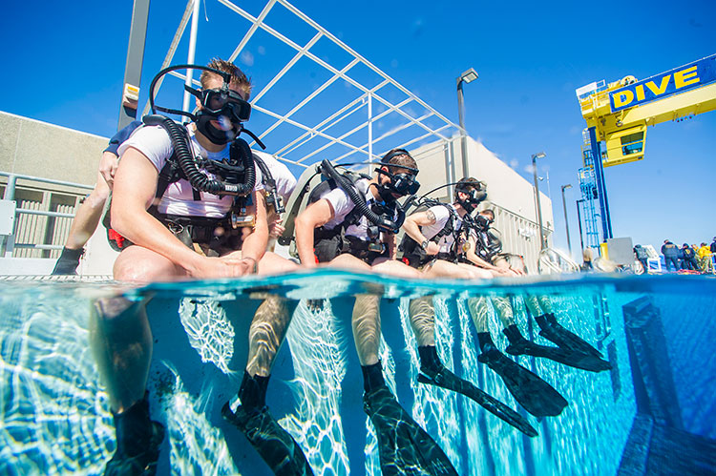
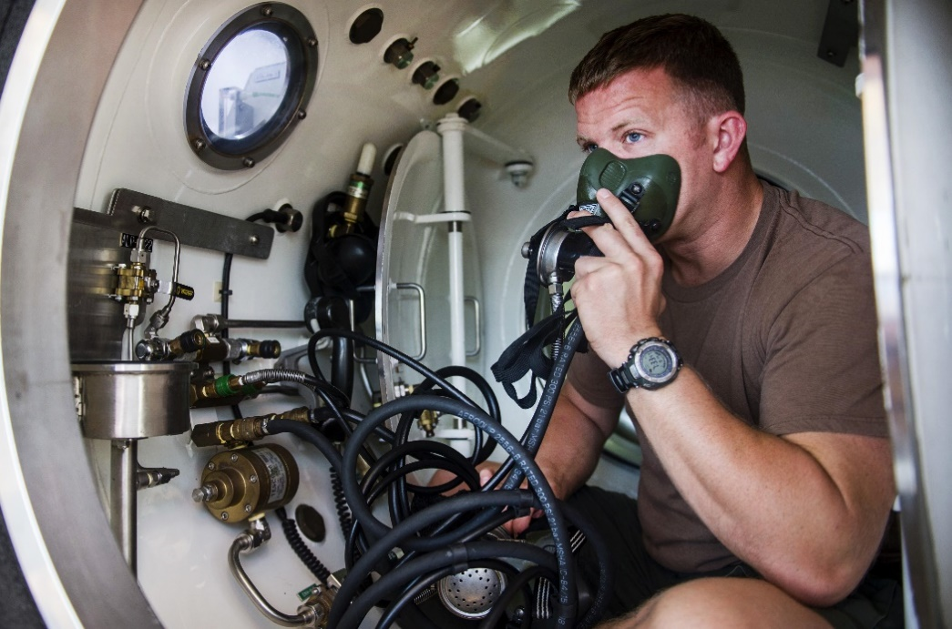
Naval Undersea Medical Institute (NUMI)
Mission: Training detachment for Undersea Medical Officers, Radiation Health Officers, Radiation Health Technicians, Submarine Force Independent Duty Corpsman, Radiation Health Indoctrination, Submarine Force Independent Duty Corpsman Refresher Training and Undersea Medical Officer Refresher Training.
Location: Groton, CT

Slide 17
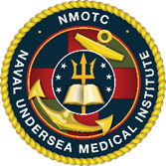
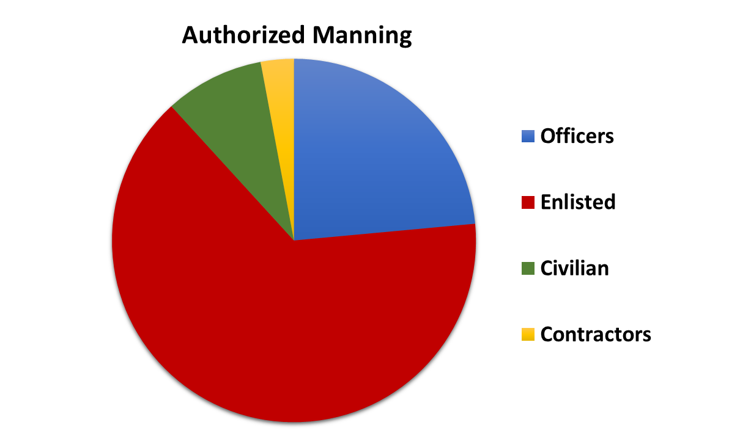
Naval Undersea Medical Institute (NUMI)
Courses of Instruction:
Undersea Medical Officer (UMO)
Submarine Independent Duty Corpsman (IDC)
Submarine IDC Convert
Refresher Training (REFTRA) UMO and IDC
Undersea Medical Examiner (UME)
Courses of Instruction:
Radiation Health Officer (RHO)
Radiation Health Technician (RHT)
Radiation Health Indoctrination
Authorized Manning: 35 Onboard: 26

Slide 18
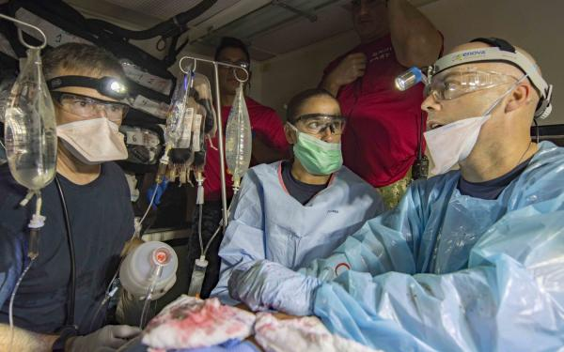
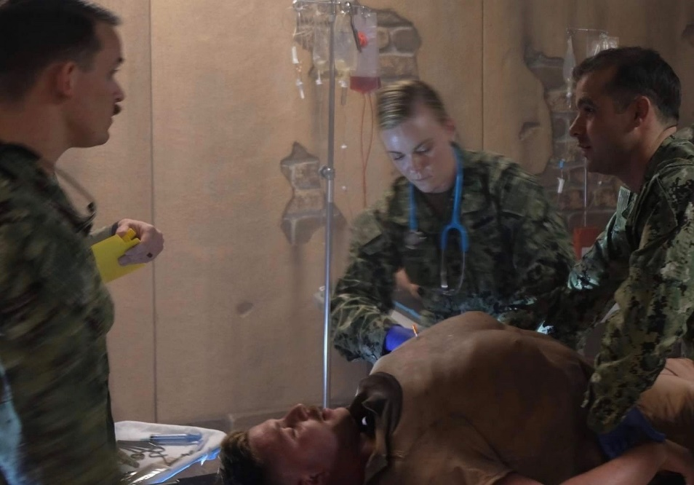
Surface Warfare Medical Institute
(SWMI)
Mission: Support the Department of Defense by developing Navy healthcare professionals with the Character, Competence, and Connections required for global assignments in a variety of operational platforms.
Location: San Diego, CA
Notes:
Change photo on bottom left.

Slide 19
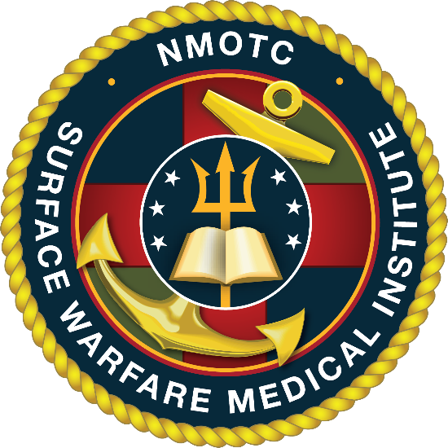
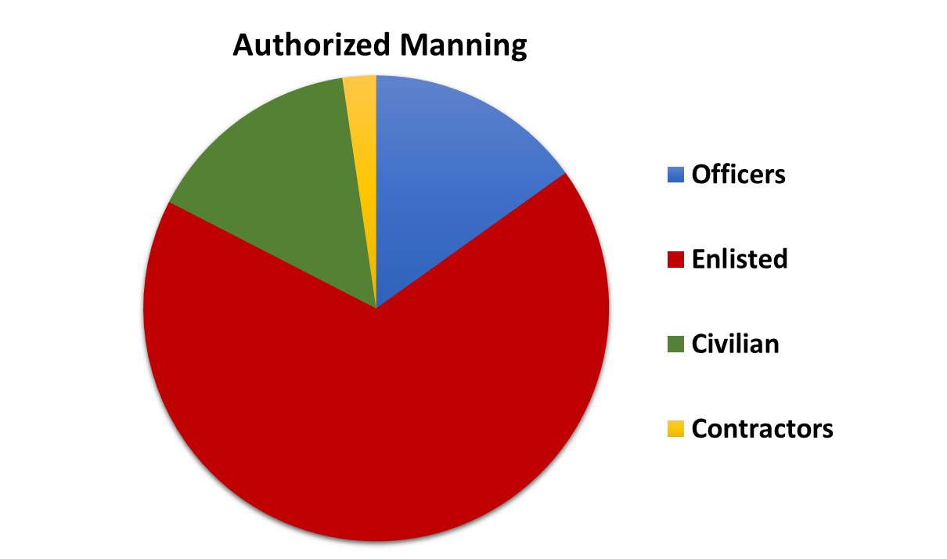
Surface Warfare Medical Institute (SWMI)
Courses of Instruction:
Surface Force Independent Duty Corpsman (SF/Dive IDC-L10A)
Dive Independent Duty Corpsman (SF/Dive IDC-L28A)
SF-IDC Refresher Training (REFTRA)
Navy Drug and Alcohol Counselor School (NDAC/Intern-700D)
Inter-service Physician Assistant, Phase II (IPAP)
Courses of Instruction (Fleet Support Courses):
Surface Force Medical Indoctrination Course (SFMIC)
Surface Warfare Medical Officer Indoc Course (SWMOIC)
Surface Warfare Medical Depart Officer Indoc Course (SWMDOIC)
Medical Regulating (MEDREG)
Dental Operational Force Management Training Course (DOFMT)
Commander Amphibious Task Force Surgeon (CATF Surgeon)
Authorized Manning: 86 Onboard 79

Slide 20
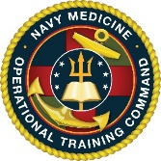
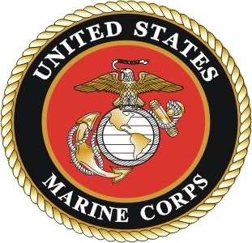
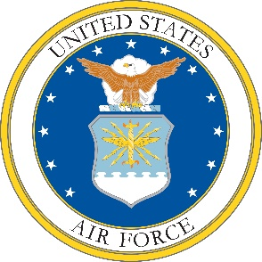

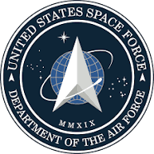
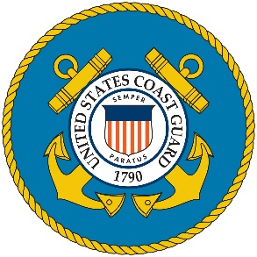
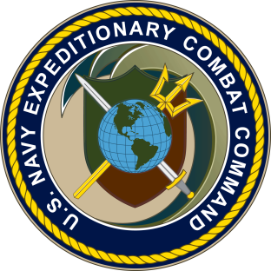
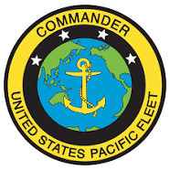
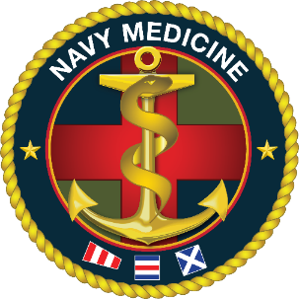
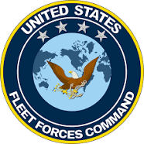
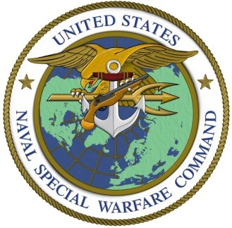
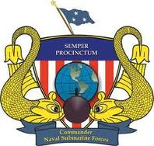
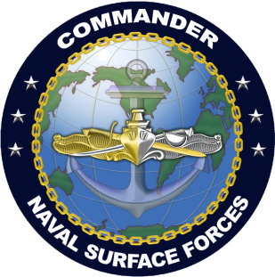
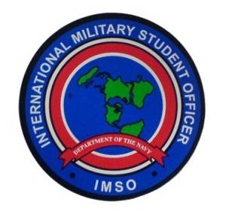
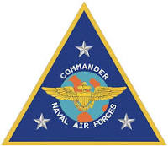
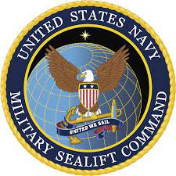
Customers

Slide 21


