Slide 1
Training Symposium Authorized Medical and Dental Allowance List (AMAL/ADAL) Overview HMCS(SW/FMF) MATTHEW CASE Fleet AMAL Change Coordinator SUB/SURFACE/AIR/MSC/NECC

Slide 2
Topics
Update and Overview
Assemblage Management Status (AMAL/ADAL)
File conversion
Customer Interface/Approved Assemblage Web Page
ACR Demonstration

Slide 3
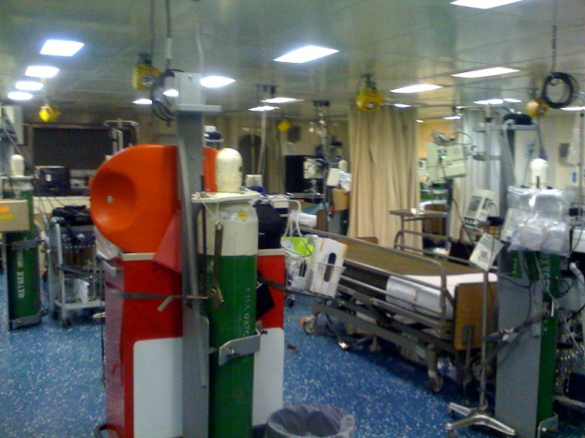
Authorized Medical / Dental Allowance List (AMAL/ADAL)
The “hub” of the medical materiel logistics wheel
Provides for minimum range and depth to
support 60 days sustainment and contingency
materiel requirements
Content Management
Owned by Commander, Fleet Forces Command Surgeon
Managed by Type Commander Surgeons
AMAL and ADAL Technical Data Management
Naval Medical Logistics Command Operational Forces Support Directorate (NMLC-04)
Issued monthly via SPAWAR via Navy Medicine ONLINE
Available at www.nmlc.med.navy.mil in an excel document format
Changes to Lists
AMAL or ADAL Review Chaired by TYCOM Surgeon
Individual Allowance Change Request (ACR) submitted through NMLC web and approved through fleet chain of command
NMLC initiated administrative change based on Class VIII commodity management efforts
Defense Medical Logistics Item Identification System (DMLIIS)

Slide 4
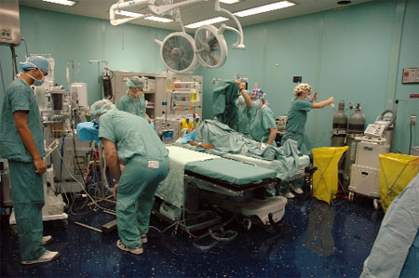
COMUSFLTFORCOM/COMPACFLT INSTRUCTION 6700.13 (DRAFT) - MANAGEMENT AND PROCUREMENT OF AUTHORIZED MEDICAL AND DENTAL ALLOWANCE LISTS
Establishes responsibilities for development, maintenance, and review of AMALs and ADALs, based on the unit’s required operational capabilities and the projected operational environment (ROC/POE).
Applies to Naval Medical Logistics Command (NMLC), Fleet Type Commanders (TYCOMs) and subordinate commands with medical departments under the administrative control of Commander, United States Fleet Forces Command (CUSFFC) or Commander, U.S. Pacific Fleet (CPF).

Slide 5
AMAL and ADAL Numbering
SHIP CLASS CODE + DESCRIPTION CODE
AMAL or ADAL Number
31
3031 X-ray
3032 Lab
3034 Pharmacy
32
30
34

Slide 6
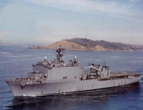
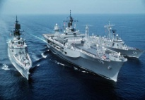
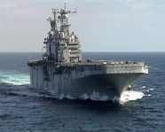
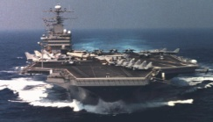
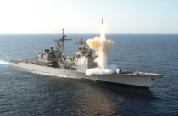
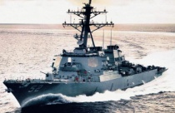
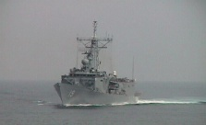
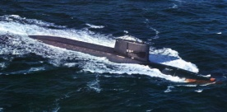
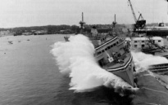
Operational Force Support Directorate “We keep med gear at the tip of the spear”
NMLC
Assemblage Management
5 Full Time Staff (3 CIVPERS/2 MILPERS) at NMLC
1 Part Time Staff(1 MILPERS) collateral duty for USFFC
Fleet AMAL Change Coordinator
AMAL/ADAL Reviews
Scheduled by TYCOM hosted by NMLC on a 12 – 18 month cycle.
Defense Medical Logistics Item Identification System (DMLIIS)
Leveraging use of DSCP Product Data Base (PDB) DMMONLINE Migration
Compliance with and leverage off of Defense Medical Material Program Office (DMMPO) formally Defense Medical Standardization Board (DMSB) Joint Product of Choice (JPOC) listing.
Distribution and Pricing Agreements (DAPA)

Slide 7
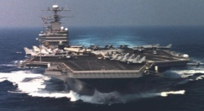
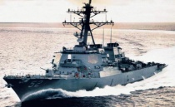
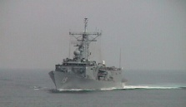
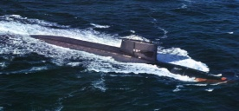
Operational Forces Support Directorate “We keep med gear at the tip of the spear”
NMLC
Operational Forces Support Primary Points of Contact
Name | Position | Phone (301)619-XXXX DSN 343- XXXX | Email
Rich Schlegel | Director | 3075 | Richard.Schlegel@med.navy.mil
LCDR Heather Baldwin | AMAL/ADAL SUPERVISOR | 9336 | Heather.Baldwin@med.navy.mil
Michael Schomer | AMAL/ADAL Mgt (Dental / SUBFOR) | 7228 | Michael.Schomer@med.navy.mil
HMC (SW/AW) Ezra Johnson | AMAL/ADAL Mgt (CVN Platform) | 7117 | Ezra.Johnson@med.navy.mil
Katrina Letman | AMAL/ADAL Mgt (SURFOR Platforms) | 9564 | Katrina.Letman@med.navy.mil
Malinda Scruggs | AMAL/ADAL Mgt (Expeditionary Warfare/MSC) | 9337 | Melinda.Scruggs@med.navy.mil
HMCS(SW/FMF) Matthew Case | AMAL/ADAL Mgt (Fleet ACR Coordiantor) | (619)556-0662 | Matthew.n.case@navy.mil
Unclassified
7
Notes:
7

Slide 9
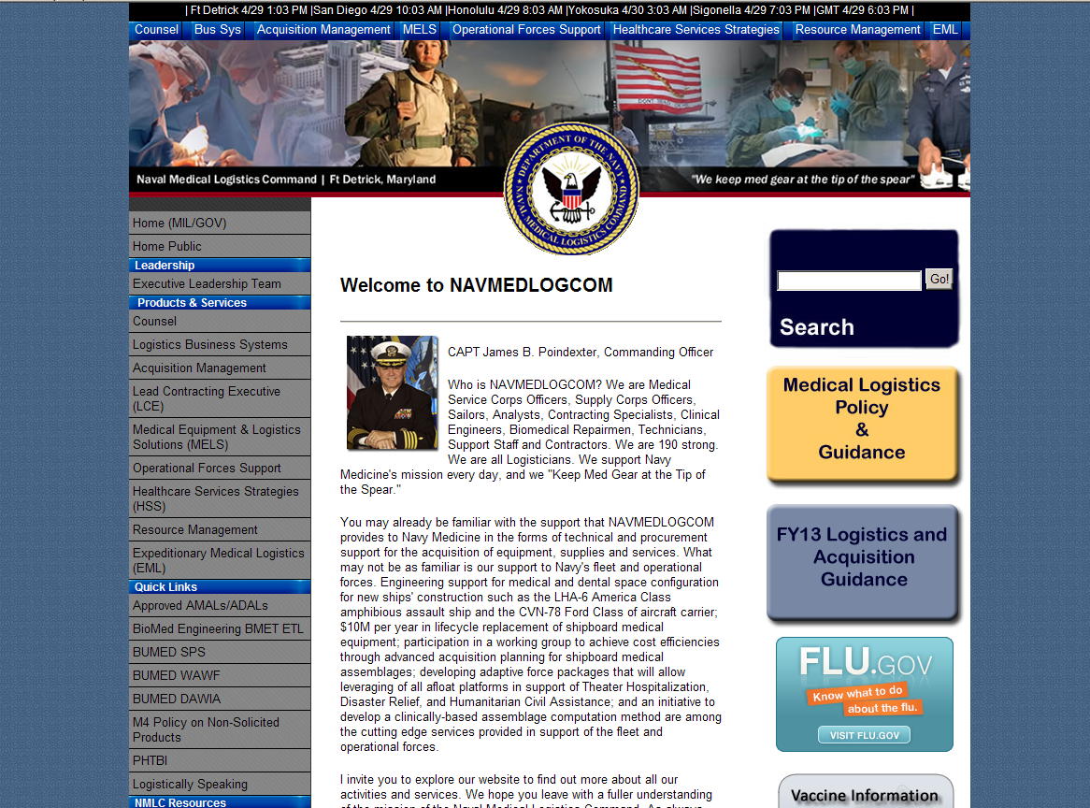

Slide 11
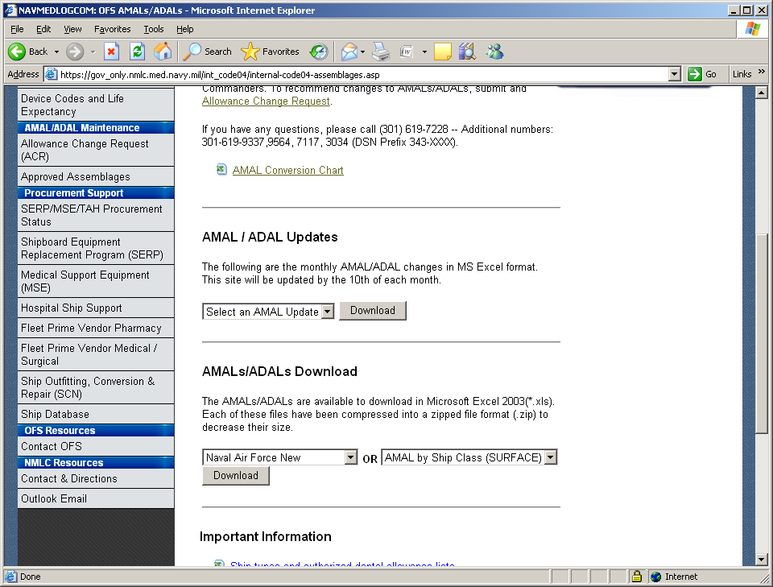

Slide 12
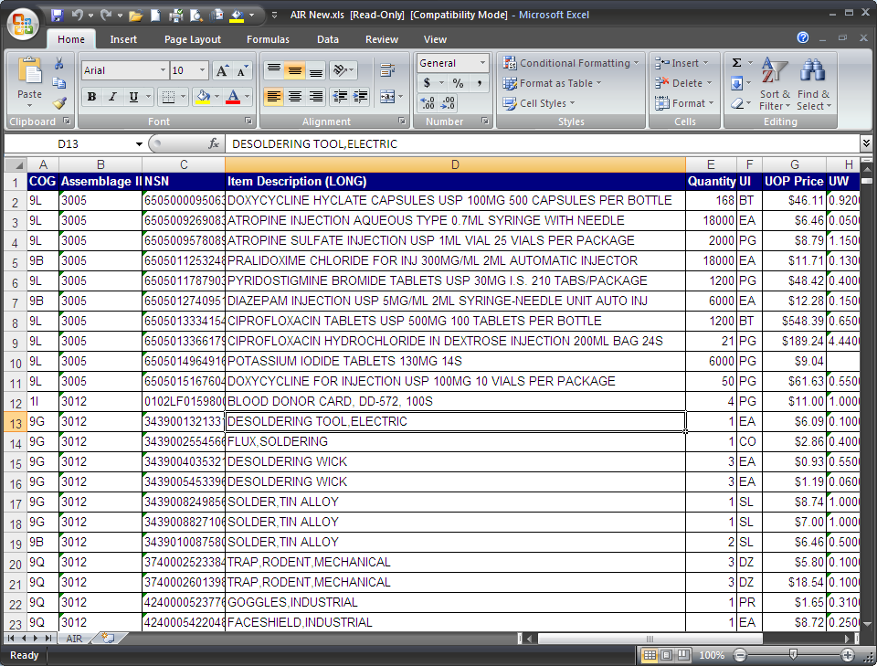

Slide 16
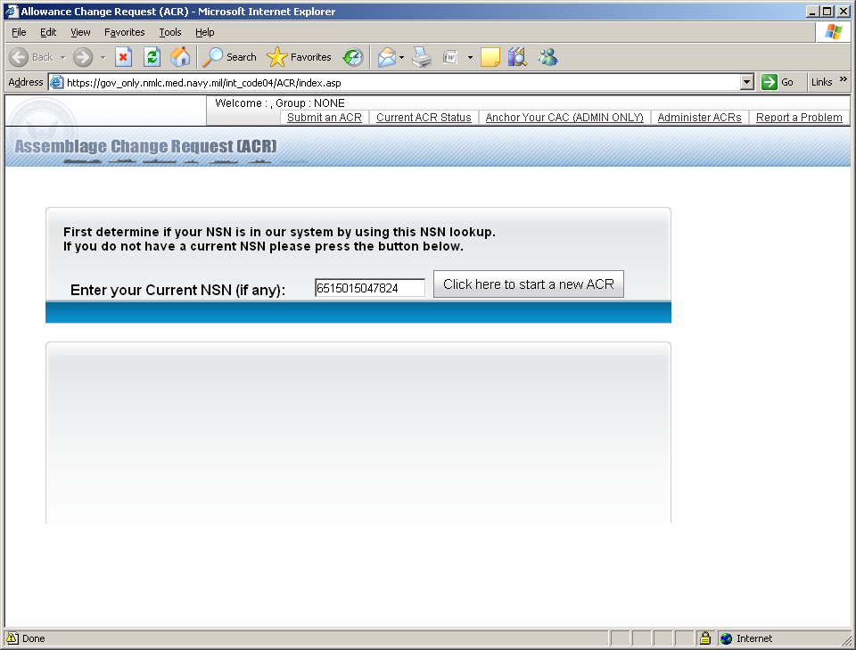

Slide 17
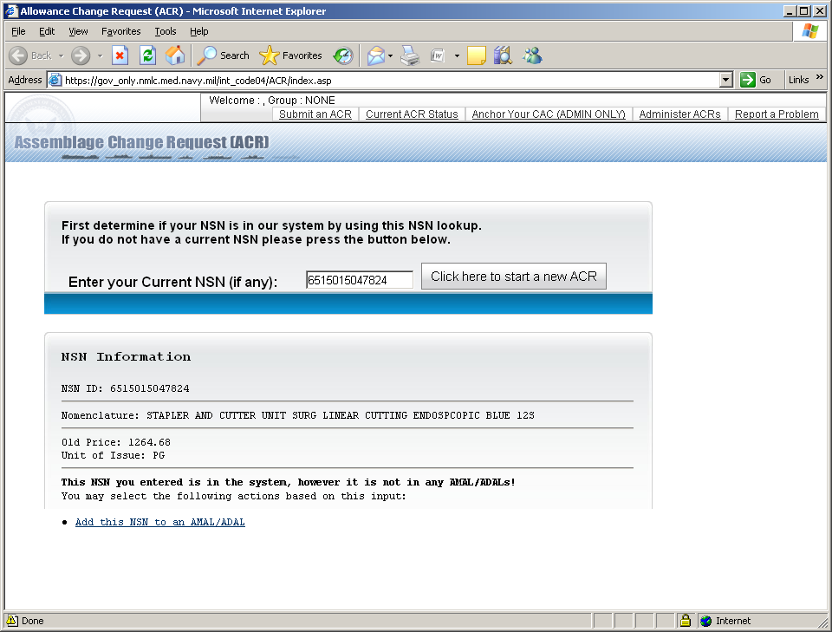

Slide 18
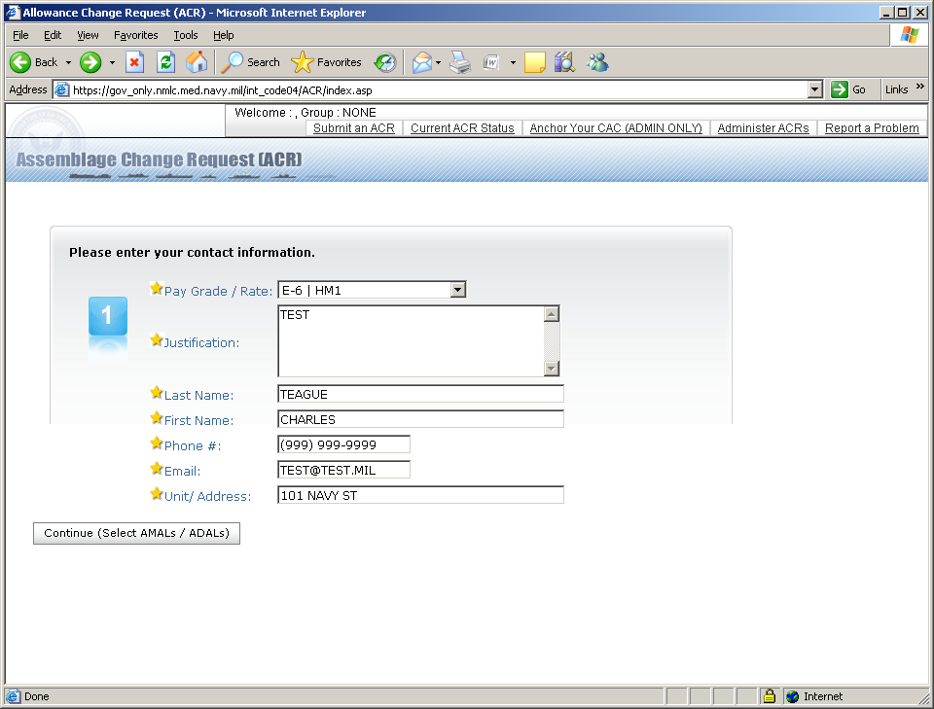

Slide 19
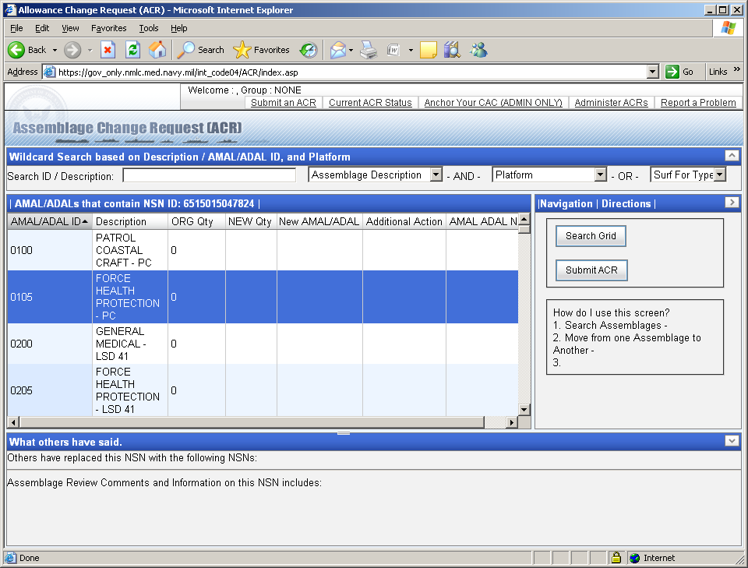

Slide 20
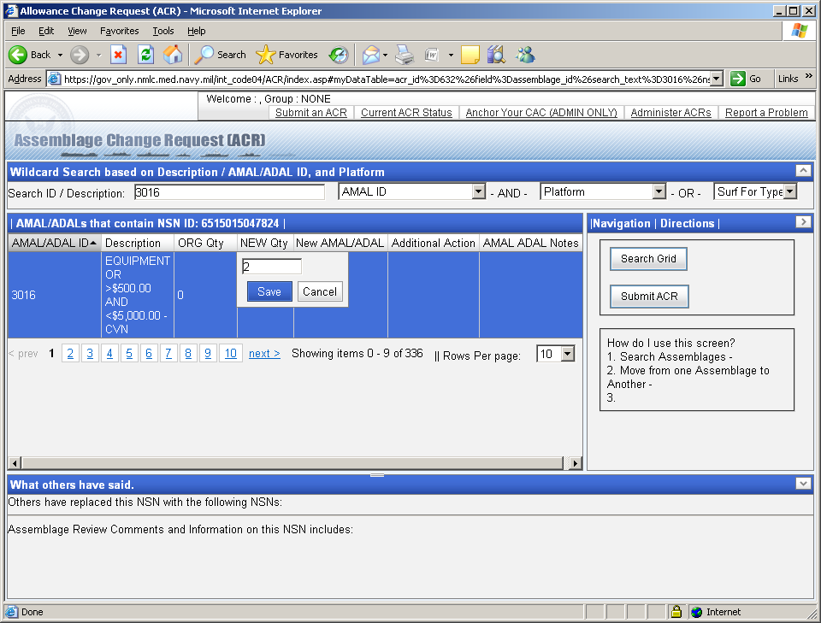

Slide 21
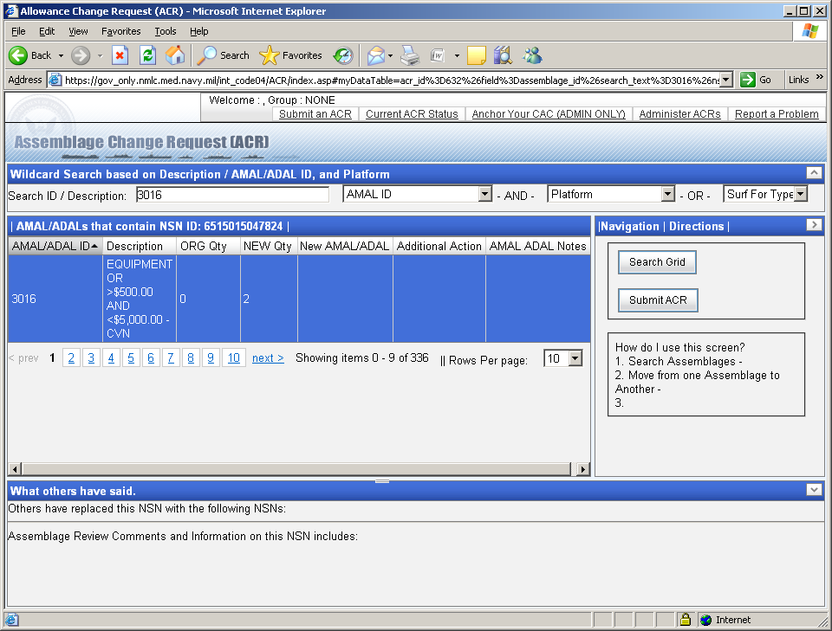

Slide 22
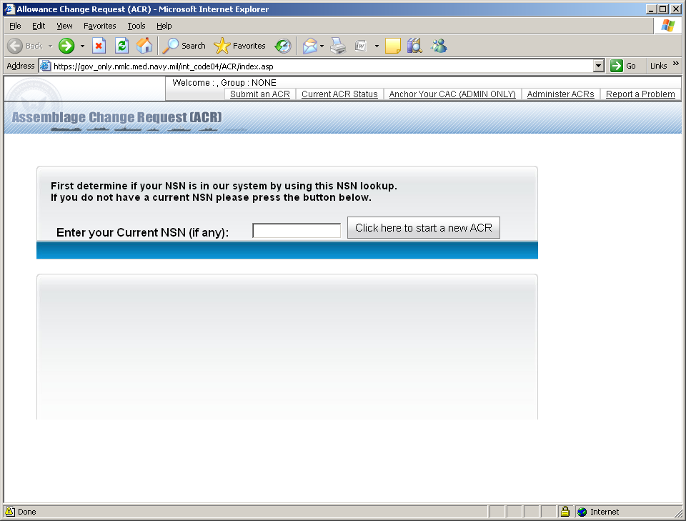

Slide 23
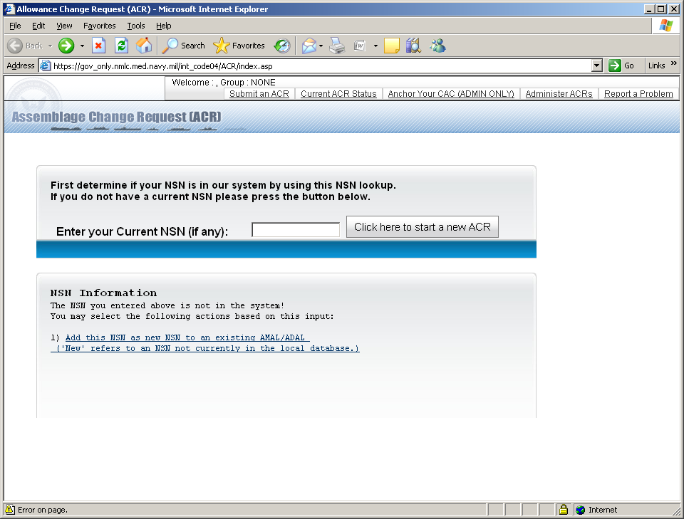

Slide 24
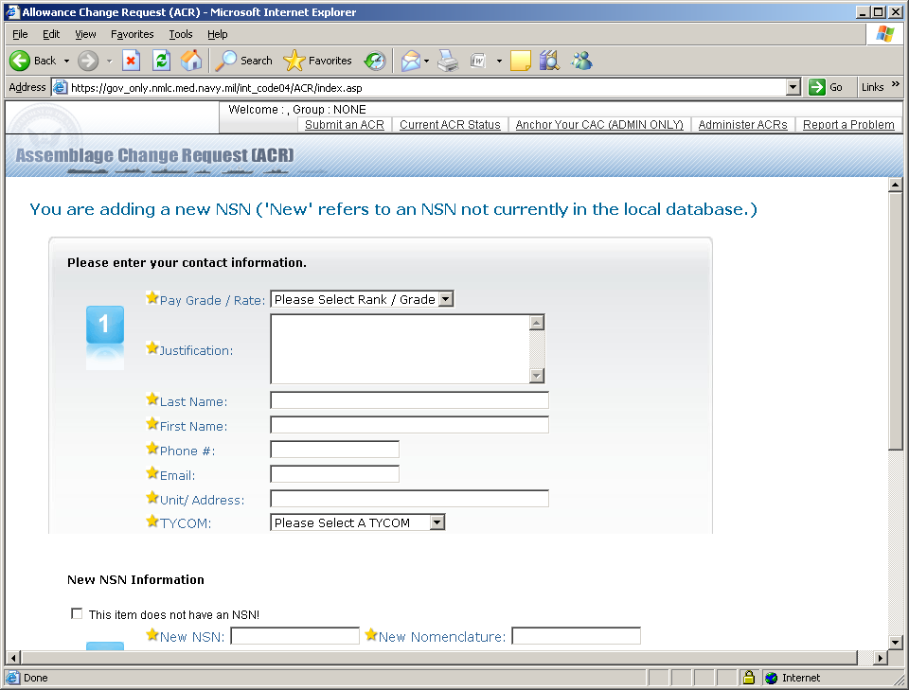

Slide 25
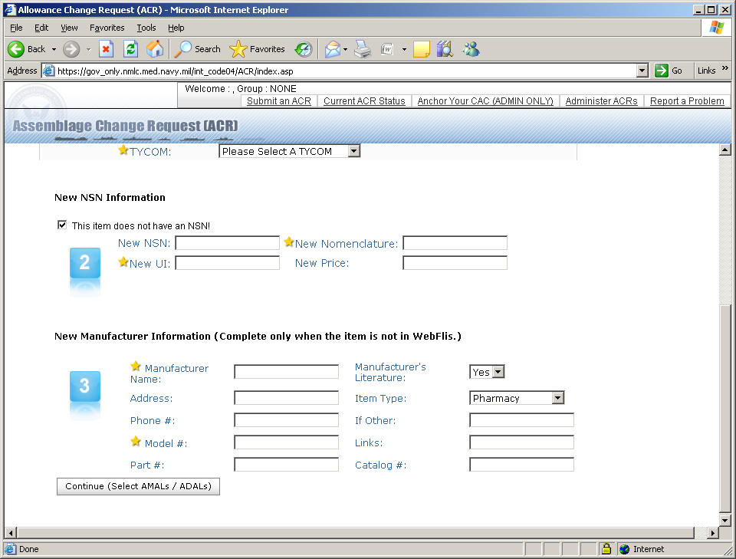

Slide 28
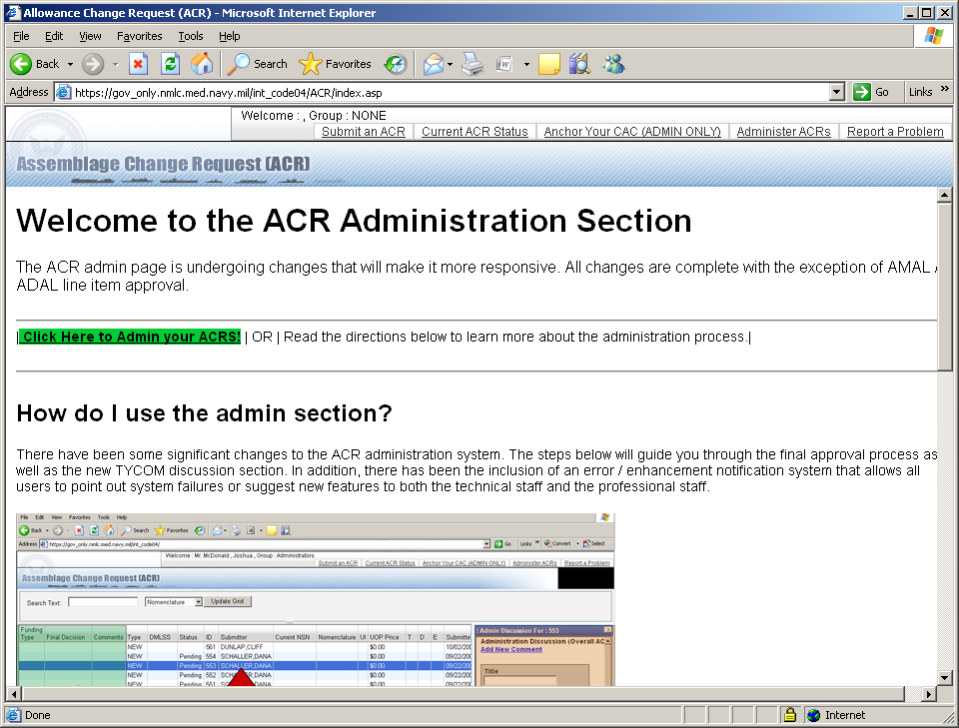

Slide 29
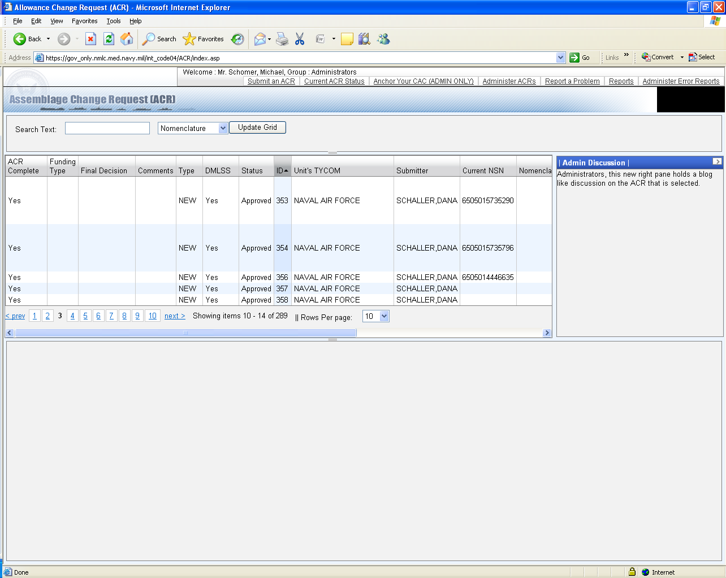

Slide 30
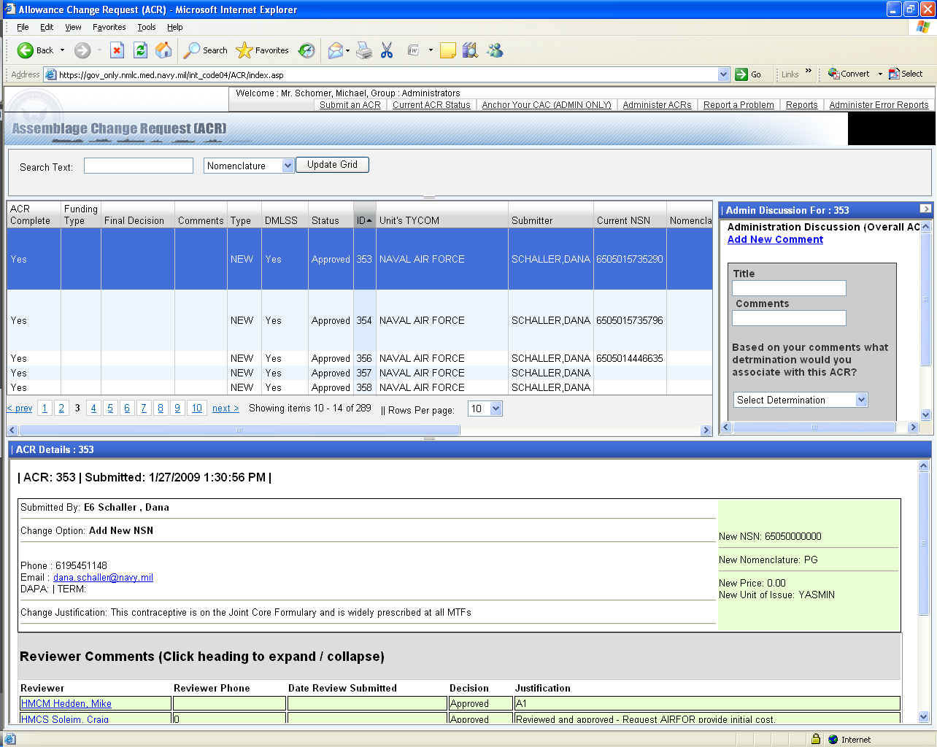

Slide 31
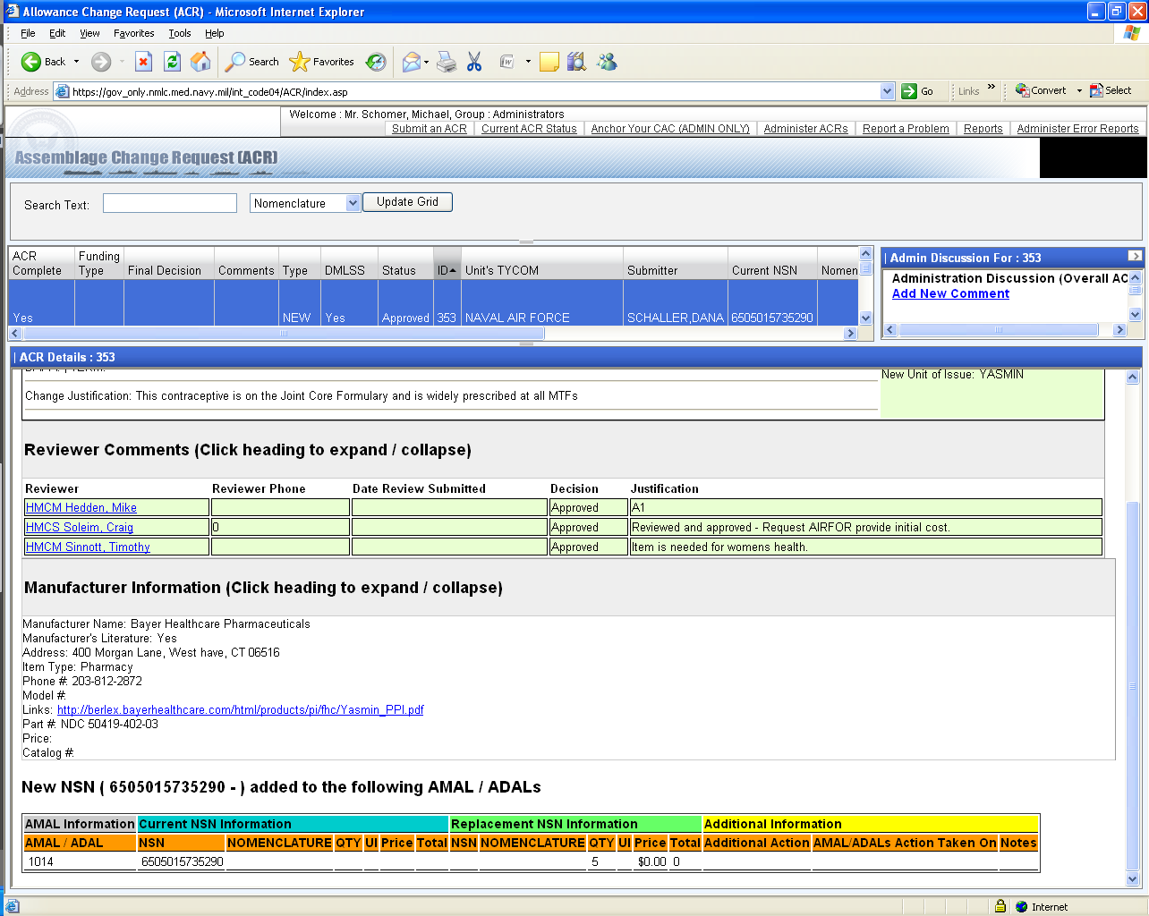

Slide 32
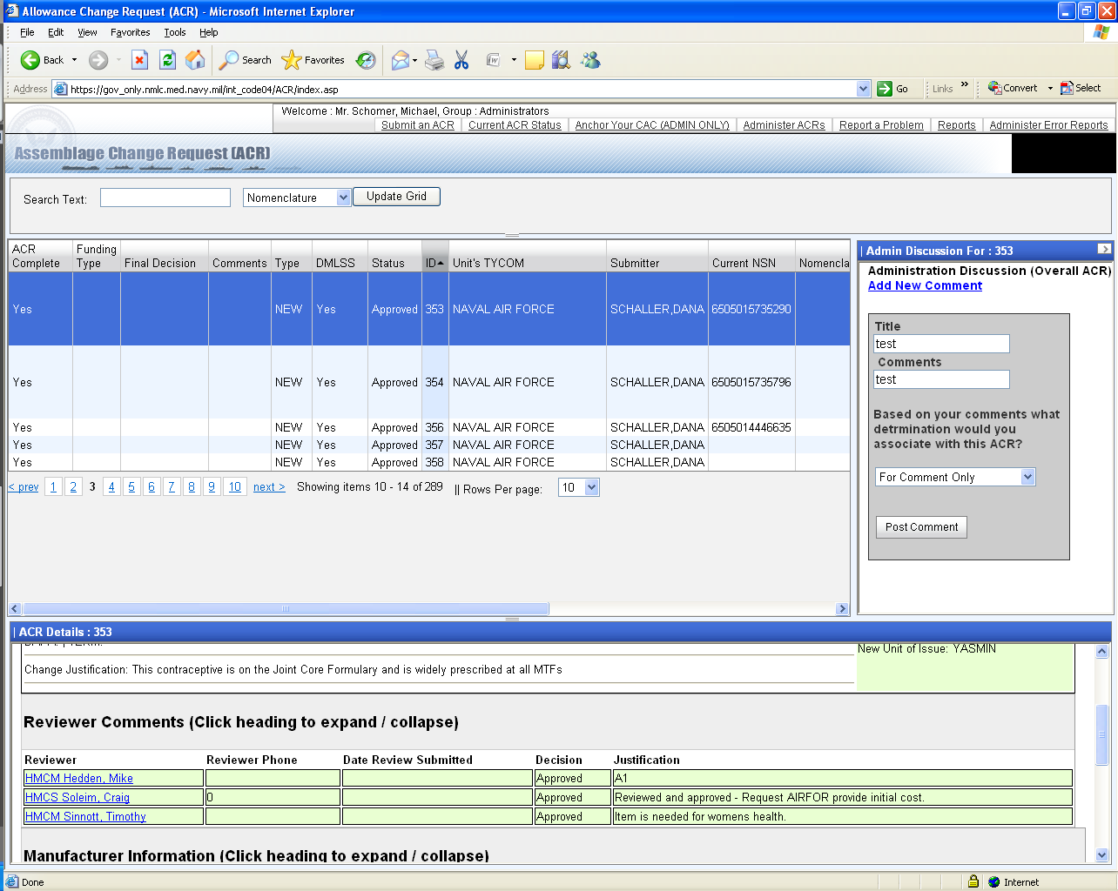

Slide 33
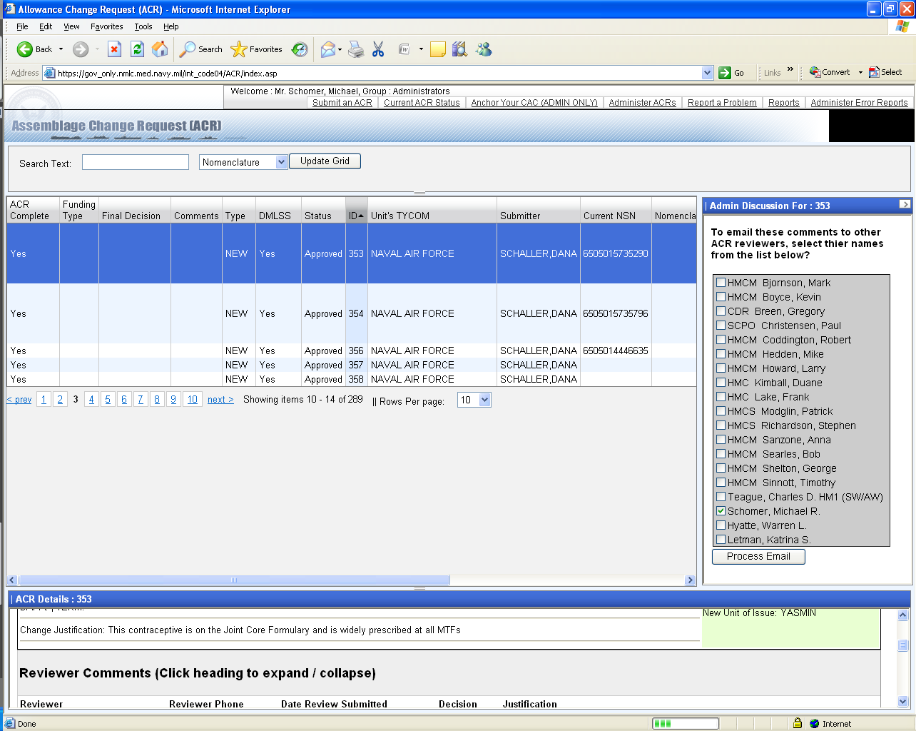

Slide 34
Additional Questions?

