Slide 1
Leadership’s Role in Building and Preserving Resilience
Rob Gerardi, HMCM(SW), USN, Ret., MBA/MSHS
www.nccosc.navy.mil
Notes:
Psychological Initiatives of Executive Leadership
Resilience Factors of Executive Leadership
Executive Leadership Functions
Five Core Leader Functions of Executive Leadership
Actions: Leadership Image – Monique
Review emblem Circular?
Actions: Change or include different image to speak to separate communities ie. FCPO(CPO 365), CPO, Officers
Can we change the order of the USMC/ USN emblems ?
Do we remove the USMC emblem?
Notes for other Presentations: Three covers slides
General -
Actions: Exchange admin image for NECC image.
Same questions as above?
Joint (Purple)
Actions: Recreate with Joint emblem, although US Joint Forces Command has disestablished Aug 4, 2011

Slide 2
NCCOSC Mission Statement
Naval Center for Combat & Operational Stress Control (NCCOSC) improves the psychological health of Marines and Sailors through comprehensive programs that educate service members, build resilience, aid research and promote best practices in the treatment of combat and operational stress injuries. NCCOSC initiatives are informed by science and provide measurable, wide-reaching results.

Slide 3
Organizational Structure
BUMED WII
DIRECTOR
NCCOSC
NCCOSC STAFF
Programs
Knowledge
Management
Research
Facilitation
Strategic
Communications
Notes:
Our organization, which is housed at the Naval Medical Center, San Diego, is chartered under BUMED and is structured as a Special Assistant to the Commander of Naval Medical Center San Diego. Plans are currently in place to re-align under BUMED so that NCCOSC services can be expanded to NAVMEDEAST entities. The four operational units of NCCOSC consist of Knowledge Management, Research Facilitation, Strategic Communications and Programs. Our Interim Director, Capt Scott L. Johnston, takes over for Capt Paul Hammer, who stood up NCCOSC in June 2008. Our personnel grew from 3 in early August 2008 to our current complement of 38 contracted employees.

Slide 4
NCCSOC Departments
Research Facilitation
Support Research
Strategic Communication
Outreach
Website
Knowledge Management
Information Hub
WIIR
Programs
Evaluate Treatment Programs
Research Quarterly
Collect and analyze data
Social Media
Mindlines
Education & Training
Curriculum & Program Development
Psychological Health Pathways -Clinical Pathway -Care Management -Data Management
IT/IM

Slide 5
Organizational Resilience
Leadership’s role in preparing an organization to adapt successfully and function competently despite experiencing adversity or challenge. It leaves the organization more flexible and better able to adapt to future challenges.

Slide 6
Characteristics of Organizational Resilience
Organizational Resilience
Cohesive and Committed
Functionally Competent
Flexible and Adaptive
Notes:
Our Military is being stretched to the breaking point, even our routine military operations can be challenging. This requires leaders and organizations to continually foster the dimensions and characteristics of organizational resilience which are integral to a command being cohesive and committed as a unit to the mission, structurally sound and functionally strong and a command that is flexible and adaptive to changes and challenges.
Leaders influence work behavior and attitudes. When the interaction between the leadership and Sailor is positive, Sailors will make a greater contribution to team and will also be encouraged to better accomplish the, thereby enhancing their job satisfaction and continual performance.

Slide 7
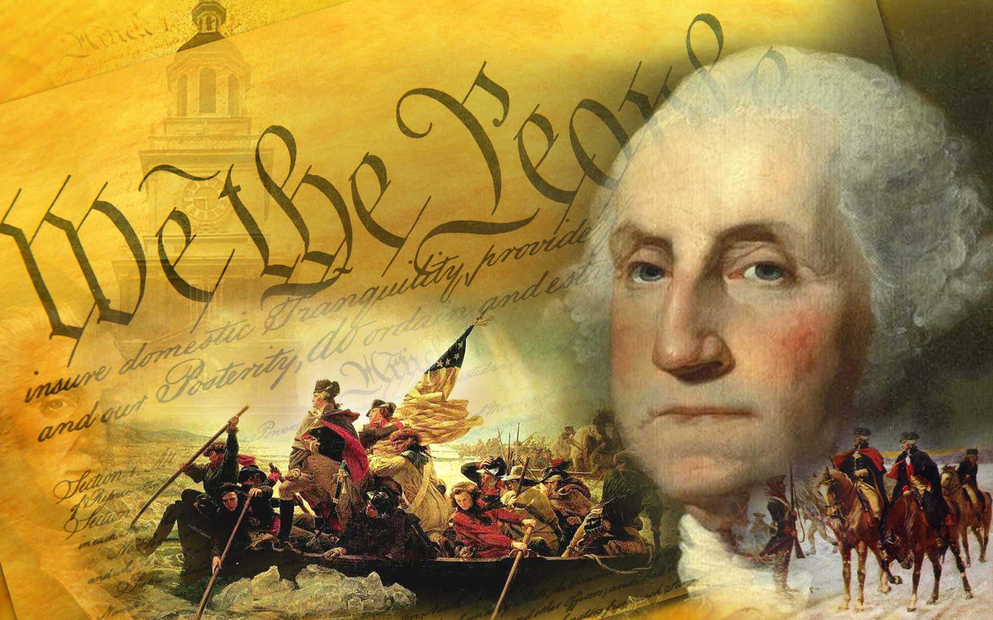
Leadership
Notes:
Our Military is being stretched to the breaking point, even our routine military operations can be challenging. This requires leaders and organizations to continually foster the dimensions and characteristics of organizational resilience which are integral to a command being cohesive and committed as a unit to the mission, structurally sound and functionally strong and a command that is flexible and adaptive to changes and challenges.
Leaders influence work behavior and attitudes. When the interaction between the leadership and Sailor is positive, Sailors will make a greater contribution to team and will also be encouraged to better accomplish the, thereby enhancing their job satisfaction and continual performance.

Slide 8
Organizational Resilience
Leadership
Sailor
Well-Being
Cohesive & Committed
Positive Command Culture
Notes:
Cohesive and Committed (community, commitment, consideration) –
Leadership
Decisive leadership, your Sailors need to be able to look to you and depend on you as a source of courage, good decision-making and judgment.
Leaders that develop a culture of trust, respect, caring, love.
Positive Command Culture
Leaders and an organization that support the importance of unit cohesion, strong connections & commitment to each other, and endorse the common purpose, common goal for departments and the command.
Sailor Well-Being
Actively work to improve life of Sailors- leave no doubt and believe as Theodore Roosevelt said, “People don’t care how much you know until they know how much you care. This concept matters and Sailors perform better when there well-being is important. That means guiding a Sailor to being physically, mentally, socially and spiritually ready.
____________________________________________________________________________________________________
Additional Commentary
Community
This refers to the defining and the internalized understanding that the people within the organization have of the purpose,
present vision, mission, and values in use. The community perspective also reflects the degree of overlap that employee self-interest
has with the organization with regard to areas such as training/learning, compensation, work standards, culture, and work environment. Community answers “Who are we together?” – UNIT Cohesion
Commitment
This refers to the ability of all sectors of the organization to work together during periods of uncertainty with a sense of striving to maintain trust and goodwill. Through commitment we maintain functional trust among members of the organization. Honor, Courage, Commitment
Consideration
This reflects the understanding by organizational leadership that change surrounds and interweaves into people’s lives such that small shifts in organizational activity may be perceived as “overload.” It embodies the necessity for internal benchmarking and self-correction within the system to achieve a measure of accountability and harmony in the workplace. Consideration is how we accommodate the human factor in daily organizational life.

Slide 9
Organizational Resilience
Functionally Competent
Informed Sailors
Positive Command Values
Training & Skills
Coordinated Functioning
Notes:
Structurally Sound & Functionally Strong (communication, coordination) –
Informed Sailors
Leader and organizations need to ensure effective communication, good information dissemination, Sailors perform better when they are “in the know.” Bad news is bad news, we may not like it, but when known and understood, it is accepted and we figure it out. No news is worse! Leads to fear, decreased moral and uncertainty affecting performance, compromising mission.
Example: Long hours, schedule changes, XO agendas
Positive Command Values
Leaders need to ethical and promote positive organizational values. Sailors know!
Example: CAPT Honors’ videos onboard USS Enterprise
Coordinated Functioning
Command well-organized, effective strategic Planning and problem solving, open communication and collaboration, linking of efforts. Coordinated functioning of all individual/departments to maintain high capability, developing a tolerance and ability to endure uncertainty.
Example: Preparing for INSURV
Training and Skills
Well trained with necessary skills to achieve mission- Know your Sailors strengths and weaknesses. Positive encouragement and mentoring even when mistakes made with drills and evolutions. This develops their competence and confidence to do it better next time
Example: First Aid Drill, Fire fighting drill, errors made having negative impact on situation. What not to do- disparaging remark from supervisor/monitor about performance- negative approach (yelling and intimidation) may cause hesitancy in future decision making.
____________________________________________________________________________________________
Additional commentary
Communication
It is by sharing relevant information that we make sense, derive order, define what is working, plan responses, and spur
growth. Communication serves as a major linchpin in the connectedness of the system. Information is the dynamic element that
energizes the understanding of patterns of work, goals, directions, mission, vision, schedules, results, and possibilities relating to significant change. Communication focuses on how we share what we do and where we are going as an organization.
Coordination
The timing of large and small change efforts throughout the entire organization is essential in achieving a system wide alignment
so that employees can gain a whole-goal perspective. Coordination is the linking of OUR efforts together to achieve effective
results.

Slide 10
Organizational Resilience
Flexible & Adaptive
Reliable & Dependable
Adequate Resources
Innovative
Understand & Accept Change
Notes:
Flexible and Adaptive (competence, connections) –
Reliable and Dependable
Consistent leadership, continuity in decision-making, credible, say what you do, do what you say, supportive, firm but fair.
Adequate Resources
Leaders ensure access to resources needed to conduct job, provide support to access resources, and provide access to information to make good decisions. The command also ensures redundancy in operations to survive and adapts even if one component fails for both routine and wartime operations
Example: 3M planned maintenance, not having correct materials available, proper training or understanding, or command processes in place then failing a 3M inspection “spot check”
Innovative
Incorporate process improvement, create new or innovative strategy to address old and new challenges.
Understand and Accept Change
Leaders positively endorse, understand & accept change and perceive as change as an opportunity, find the positives in challenging events and move forward.
Example: CPO Initiation, Transition, Induction to CPO 365……
_________________________________________________________________________________________________________
Additional Commentary
Competence
This is the fit between the capacity for blended skills/knowledge to meet the demands of internal and external environments
matched with the inclination of individuals/groups/teams to be effective and accountable during periods of major organizational
stress. Competence answers “How do we meet the demands of constantly changing conditions?”
Connections
These are characteristics and properties of relationships between persons, groups, and the system that determine the capacity and flexibility of the organization as a whole to respond under pressure. The connections allow us to establish, maintain, and sustain linkage and alignment throughout the entire organization. – Collaboration

Slide 11
Thank you!
NCCOSC, dedicated to the psychological health and well-being of Navy and Marine Corps service members and their families.

